Slide 1
BC and Safe Ear Surgery: When to Operate—and When Not To
Cris Lanting, PhD
Medical Physicist-Audiologist at Radboudumc Nijmegen
Cris.Lanting@Radboudumc.nl

Slide 2
Disclosure
Nothing to disclose

Slide 3
Some assumptions we make
We know how sound gets to the inner ear (or do we?)
We know the difference between air-conduction (AC) and bone-conduction thresholds (BC) (right?)
  Bone conduction always reflects cochlear reserve? (y/n)
  Every air-bone gap is middle-ear disease? (y/n)
  Good BC means safe surgery? (y/n)
  Closing the gap always improves hearing? (y/n)
Sometimes all four are wrong … ehh, should we be worried?

Slide 4
Learning objectives
By the end of this session, you will be able to:
Describe the main pathways through which bone-conducted sound reaches the cochlea
Explain how BC thresholds can be artificially raised (Carhart notch) or lowered (third-window lesions)
  Recognize true conductive loss
  Recognize false BC depression (Carhart)
  Recognize false good BC (third window)
Use BC / AC audiometry and imaging to guide surgical decision-making
Recognise common pitfalls: masking dilemma and interpretation of the air-bone gap

Slide 5
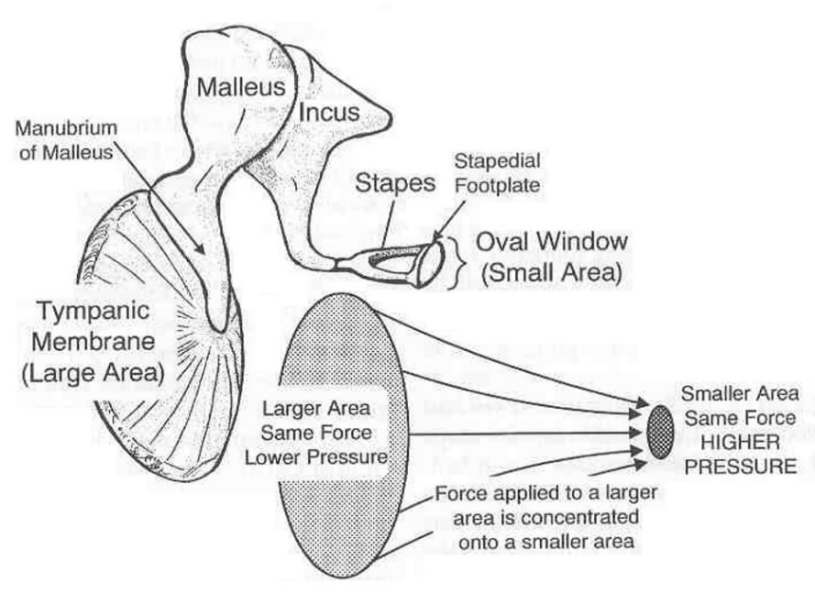
The middle ear: an impedance transformer
The air-water boundary between the middle ear and the inner ear causes an efficiency problem
0.1% transmission → 30 dB loss due to impedance mismatch
How to compensate for this mismatch?
Oval window ≈ 15 times smaller than tympanic membrane
→ pressure increase: p = F/A ≈ 24 dB gain
Lever effect of the ossicle chain → some dB’s

Slide 6
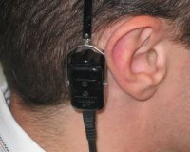
Bone conduction
Important in hearing diagnosis
Rehabilitation of conductive/mixed loss
relatively inefficient re. air-conduction
pitfalls bone-conduction testing – ‘artifacts’
Vibro-tactile sensations (250 … 1000 Hz)
Cross-hearing & Masking dilemma
Virtual sensorineural hearing loss component
Virtual air-bone gap

Slide 7
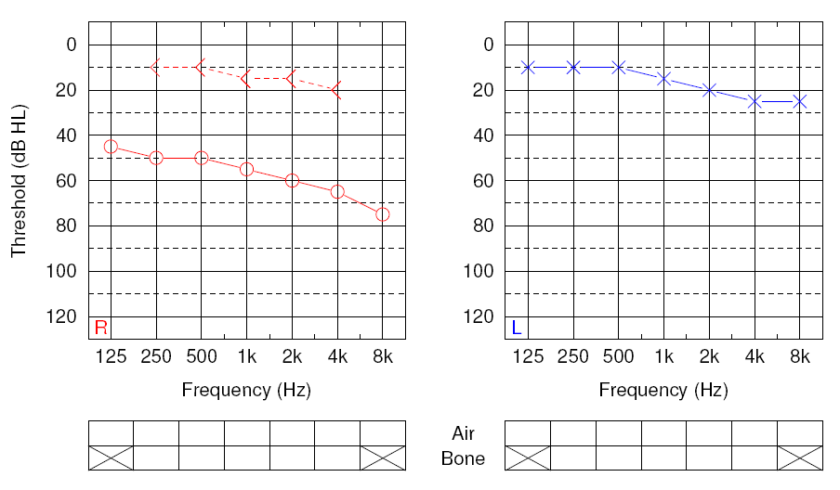
Conductive HL Right Side ?
Was masking applied to left ear??
Sadly, no!

Slide 8
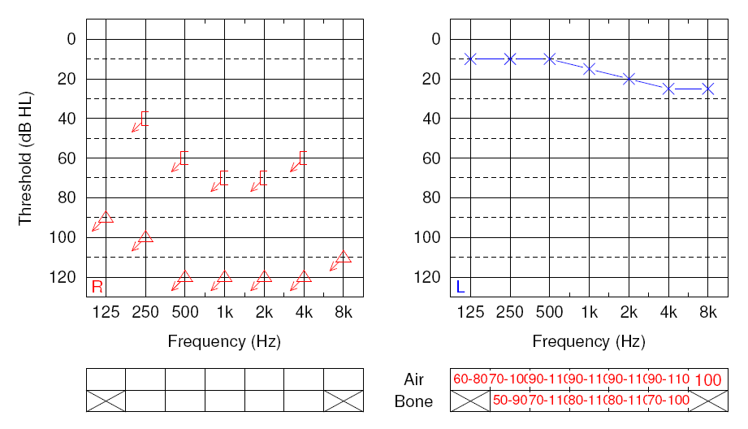
Audiometry - Right Side (!)

Slide 9
Rule #1 Never operate the audiogram
Operate the patient using insights about the mechanism of a conductive loss, using recent and appropiate imaging modalities, not the ABG alone.

Slide 10
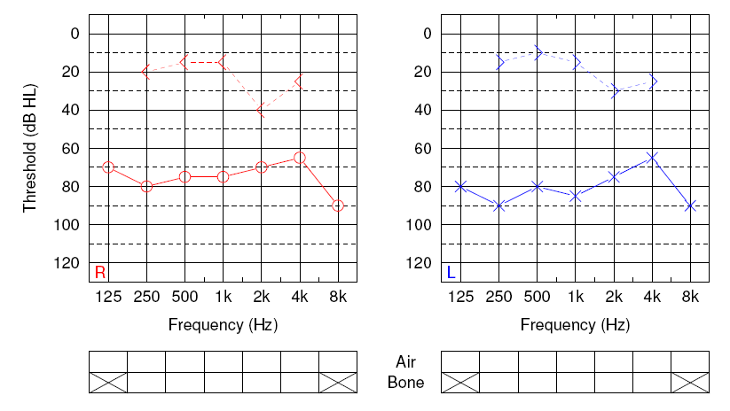
The masking dilemma
The dilemma arises when the masking of the non-test ear is loud enough to barely mask it but loud enough to affect the test ear.
Rule of thumb:
If
∑ ABG (NTE+TE)
≥ 2 × IA – 15dB,
then (AC) masking is not possible!
see e.g., Seneviratne, S. et al., (2019). Otology & Neurotology, 40(1), e1. https://doi.org/10.1097/MAO.0000000000002043

Slide 11
Rule #2 If the test is unreliable, the surgery plan is unreliable.
Important take-home messages:
no masking
inconsistent responses
asymmetry unexplained
repeat first
Repeat when in doubt. Ask you audiologist. Make sure personnel is properly trained.

Slide 12
Bone conduction pathways
A deep dive in the possible pathways

Slide 13
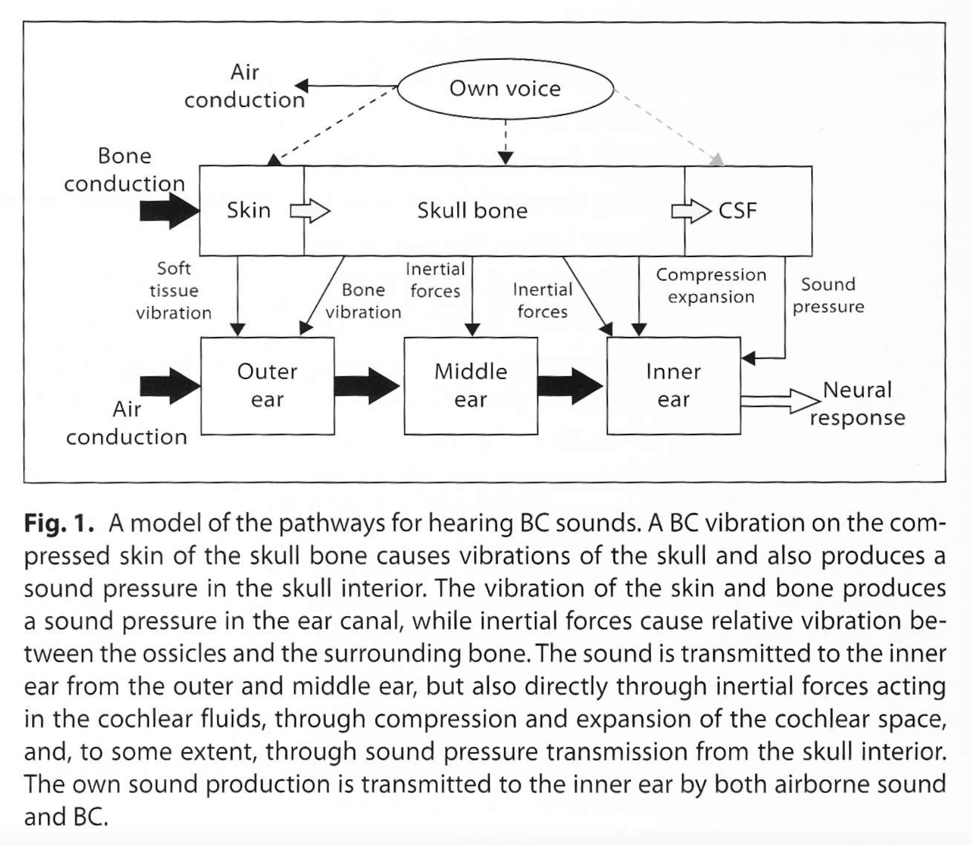
Bone-conduction pathways: A deep dive in the possible pathways
Five contributors:
Generation of sound pressure in the ear canal,
Relative motion of the middle ear ossicles caused by inertial effects from the mass of the ossicles,
Inertial forces acting on the inner ear fluid,
Compression and expansion of the cochlear space, and
Transmission of sound pressure from the skull interior.
Stenfelt 2011, 2015

Slide 14
1. BC and sound pressure in the ear canal & occlusion
Skull vibration-produced AC sound →
Sound pathway like AC
Irradiation by the soft part of the ear canal: LF
Irradiation by the bony part of the ear canal: HF
This explains the phenomenon of
occlusion: up to 40 dB increase in sensitivity @LF
Notes:
Open ear: low impedance; sound leaks from the ear
Closed ear: high impedance; sound energy trapped
Shallow occlusion: most increase in sensitivity low f
-> Irradiation of soft part cannot escape out of the ear.
Deep occlusion: hardly an effective pathway .
With frontal stimulation close to the ear canal opening, the ear canal sound pressure (and not irradiation through direct AC) dominates the perception of bone conduction (BC) sound (25 dB above the other pathways).
So, skull vibration-produced AC sound →
Irradiation by soft part of the ear canal: LF
Irradiation by the bony part of the ear canal: HF
So, this device is probably only useful for subjects with reasonable AC thresholds.
(normal

Slide 15
2. Inertia of the middle ear ossicles​
BC Vibration causes resonance of the movement of the ossicles at 1.5 kHz​
Example 1: Immobilization of ossicular chain causes LF loss in BC thresholds.​
Example 2: Otosclerosis of stapes causes worsening of 2 kHz BC and increased BC sensitivity below 2 kHz due to artificial mass loading through a shift in resonance
→ Carhart's Notch
​
Notes:
Supporting this theory is, for example, the worsening in BC thresholds around 2 kHz following immobilization of the ossicles due to otosclerosis of the stapes (also known as the Carhart's notch) l27l and increased BC sensitivity below 2 kHz with artificial mass loading of the ossicles (lowering the resonance frequency) [28]

Slide 16
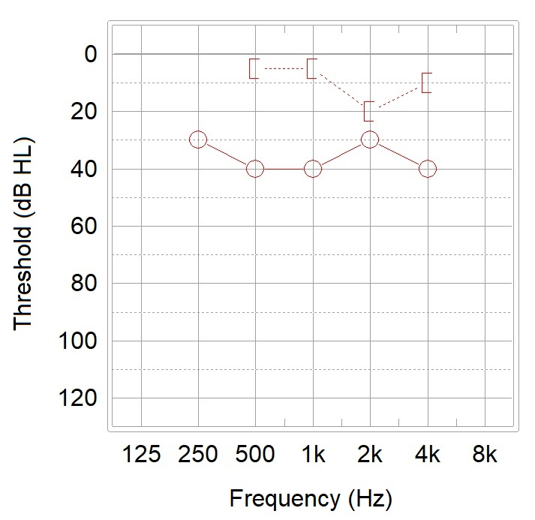
Case: Fixated ossicles – ‘Carhart notch’
Classical example: otosclerosis
  Carhart notch = mechanical artifact, not cochlear loss
Typically around 2 kHz
Due to stapes fixation altering BC mechanics
After successful stapes surgery BC may improve
Implication: do not overestimate SNHL pre-op.
Notes:
Note however (Stenfelt 2016 hearing research):
However, in a model simulation of BC excitation of the inner ear (Stenfelt, 2015), the depressed BC thresholds close to 2 kHz could be simulated as a result of increased impedance at the oval window (OW). In those simulations, the effect of middle ear inertia was not included but the Carhart notch was seen as a result of increasing the impedance at the OW seen from inside the inner ear.
t is more likely, as indicated in Stenfelt (2015), that the changed BC sensitivity is a result of removal of the middle ear component together with alteration of the impedance at the OW leading to less efficient contribution from the inner ear components. Similar results are shown in finite element models of the inner ear with BC stimulation

Slide 17
Rule #3 A depressed BC threshold may still be surgically reversible.
Important take-home messages:
BC is not always cochlear damage!
Stapes fixation can worsen BC around 2 kHz
BC may improve after surgery

Slide 18
3. inertia of the cochlea fluid
Mechanism:
BC causes pressure gradient along the BM between oval and round window
-> fluid flow
-> traveling wave on the BM
Main cause: inertia of fluid
Notes:
Only a small fraction of the fluid of the cochlea (less than one millionth) is necessary to be displaced to give a hearing sensation of 80-100 dB HL [21]
Stenfelt S, Goode RL: Bone conducted sound: physiological and clinical aspects Otol Neurotol 2005:26:1245 -1261.

Slide 19
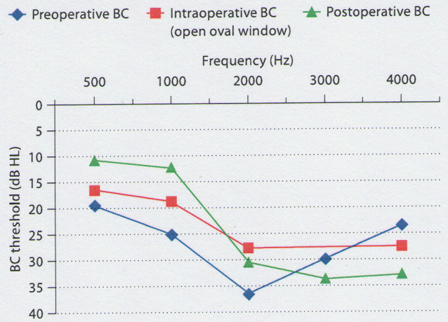
Case: advanced otosclerosis
Arnold, A., Fawzy, T., Steinhoff, H.-J., Kiefer, J., & Arnold, W. (2011). Influence of a totally open oval window on bone conduction in otosclerosis. Audiology & Neuro-Otology, 16(1), 23–28. https://doi.org/10.1159/000308302
Notes:
Our results demonstrate that after total removal of the fixed stapes footplate, the condition of a totally open oval window has an influence on BC threshold and therefore on cochlear micromechanics.
The pathologic situation of a fixed stapes footplate restricts normal spreading of sound energy and appropriate movement of the BM. Under these conditions, sound transfer to the BM is mechanically reduced, resulting in ‘pseudo-sensorineural hearing loss’. T

Slide 20
4. Compression/expansion of the cochlear space
Impedance of oval window is greater (stiffer) than that of the round window (more compliant)
Compression and expansion leads to fluid motion from scala vestibuli -> scala tympani or vice versa
Mechanism sort of similar to inertia: fluid motion in cochlea -> perception
Notes:
Scala vestibuli space is about 50% greater than scala tympani, and the impedance of the oval window is greater (stiffer) than the impedance of the roundwindow (more compliant) [20].
Consequently, when the cochlea is compressed, excess fluid is forced from the scala vestibuli side to the scala tympani side and the round window. The opposite happens when the cochlea expands, i.e., fluid flows from scala tympani towards scala vestibuli, thereby exciting the basilar membrane.
Note however (Stenfelt 2016 hearing research):
However, in a model simulation of BC excitation of the inner ear (Stenfelt, 2015), the depressed BC thresholds close to 2 kHz could be simulated as a result of increased impedance at the oval window (OW). In those simulations, the effect of middle ear inertia was not included but the Carhart notch was seen as a result of increasing the impedance at the OW seen from inside the inner ear.
(see also Arnold: The pathologic situation of a fixed stapes footplate restricts normal spreading of sound energy and appropriate movement of the BM. Under these conditions, sound transfer to the BM is mechanically reduced, resulting in ‘pseudo-sensorineural hearing loss’. )
It is more likely, as indicated in Stenfelt (2015), that the changed BC sensitivity is a result of removal of the middle ear component together with alteration of the impedance at the OW leading to less efficient contribution from the inner ear components. Similar results are shown in finite element models of the inner ear with BC stimulation

Slide 21
5. Pressure transmission from the intracranial spaces through third window
Examples: canal dehiscence and EVAs causes increased sensitivity in BC thresholds at LF -> third window

Slide 22
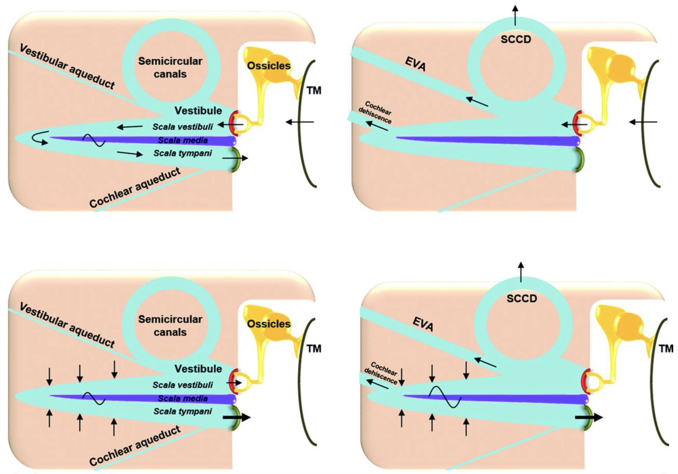
3rd window
AC: acoustic energy shunted away from cochlea. Increased AC thresholds
BC
lowering the impedance on the vestibuli side by 3rd window, thereby improving the cochlear response to bone conduction
Merchant, S. N., & Rosowski, J. J. (2008). Conductive hearing loss caused by third-window lesions of the inner ear. Otology & Neurotology: Official Publication of the American Otological Society, American Neurotology Society [and] European Academy of Otology and Neurotology, 29(3), 282–289. https://doi.org/10.1097/mao.0b013e318161ab24
Notes:
B, Third-window lesions, air conduction. It is hypothesized that a third window (in one of the canals, the vestibule or the scala vestibuli) allows a portion of the acoustic energy entering the vestibule through motion of the stapes to be shunted away from the cochlea. The shunting occurs primarily at low frequencies, resulting in a hearing loss by air conduction.
C, Normal ear, bone conduction. Compression of inner ear fluid by bone-conducted sound results in a hearing percept because of an inequality in the impedance between the scala vestibuli side and the scala tympani side of the cochlear partition. This inequality is primarily due to a difference in the impedance between the oval and windows. As a result, there is a pressure difference across the cochlear partition, resulting in motion of the basilar membrane that leads to perception of boneconducted sound.
D, Third-window lesions, bone conduction. A third window increases the difference between the impedance on the scala vestibuli side and the scala tympani side of the cochlear partition by lowering the impedance on the vestibuli side, thereby improving the cochlear response to bone conduction. In patients with healthy cochleae as in SCD, supranormal bone conduction thresholds may be evident. In other patients with an accompanying true sensorineural hearing as in DFN-3, LVAS, etc., the improved bone conduction due to the third-window mechanism may not result in supranormal thresholds.

Slide 23
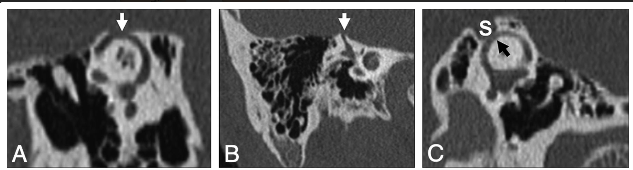
Superior semicircular canal dehiscence (SSCD)
Ho, M.-L., Moonis, G., Halpin, C. F., & Curtin, H. D. (2017). Spectrum of Third Window Abnormalities: Semicircular Canal Dehiscence and Beyond. American Journal of Neuroradiology, 38(1), 2–9. https://doi.org/10.3174/ajnr.A4922

Slide 24
3rd window present?
Low-frequency ABG does not always mean middle-ear disease
Think third window if:
Normal middle ear exam
Present reflexes
Good OAEs
Vertigo with sound/pressure
BC better than 0 dB
Do CT before surgery.
Examples:
SSCD
EVA
DFNX2 / gusher risk
other third-window states

Slide 25
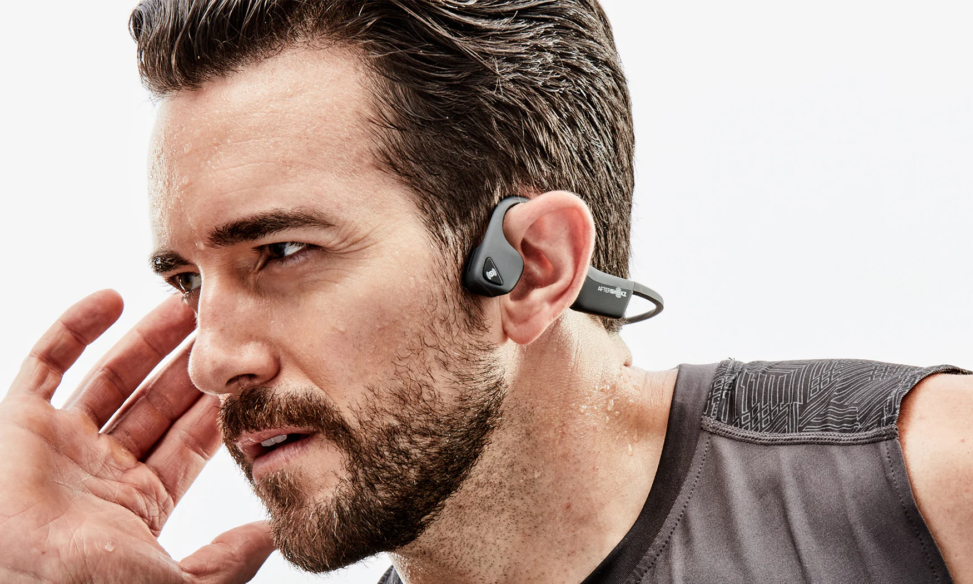
Testcase AfterShokz
What pathway is causing the positioning of the transducer IN FRONT of the ear canal, rather than posterior to the canal, to be beneficial for the AfterShokz?
Surendran, S., Prodanovic, S., & Stenfelt, S. (2023). Hearing Through Bone Conduction Headsets. Trends in Hearing, 27, 23312165231168741. https://doi.org/10.1177/23312165231168741

Slide 26
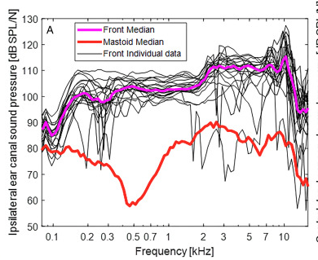
AfterShokz – it is mostly AC after all
With frontal stimulation close to the ear canal opening, the ear canal sound pressure (and not irradiation through direct AC) dominates the perception of bone conduction (BC) sound (25 dB above the other pathways).
So, skull vibration-produced AC sound →
Irradiation by soft part of the ear canal: LF
Irradiation by the bony part of the ear canal: HF
So, this device is probably only useful for subjects with reasonable AC thresholds.
(normal

Slide 27
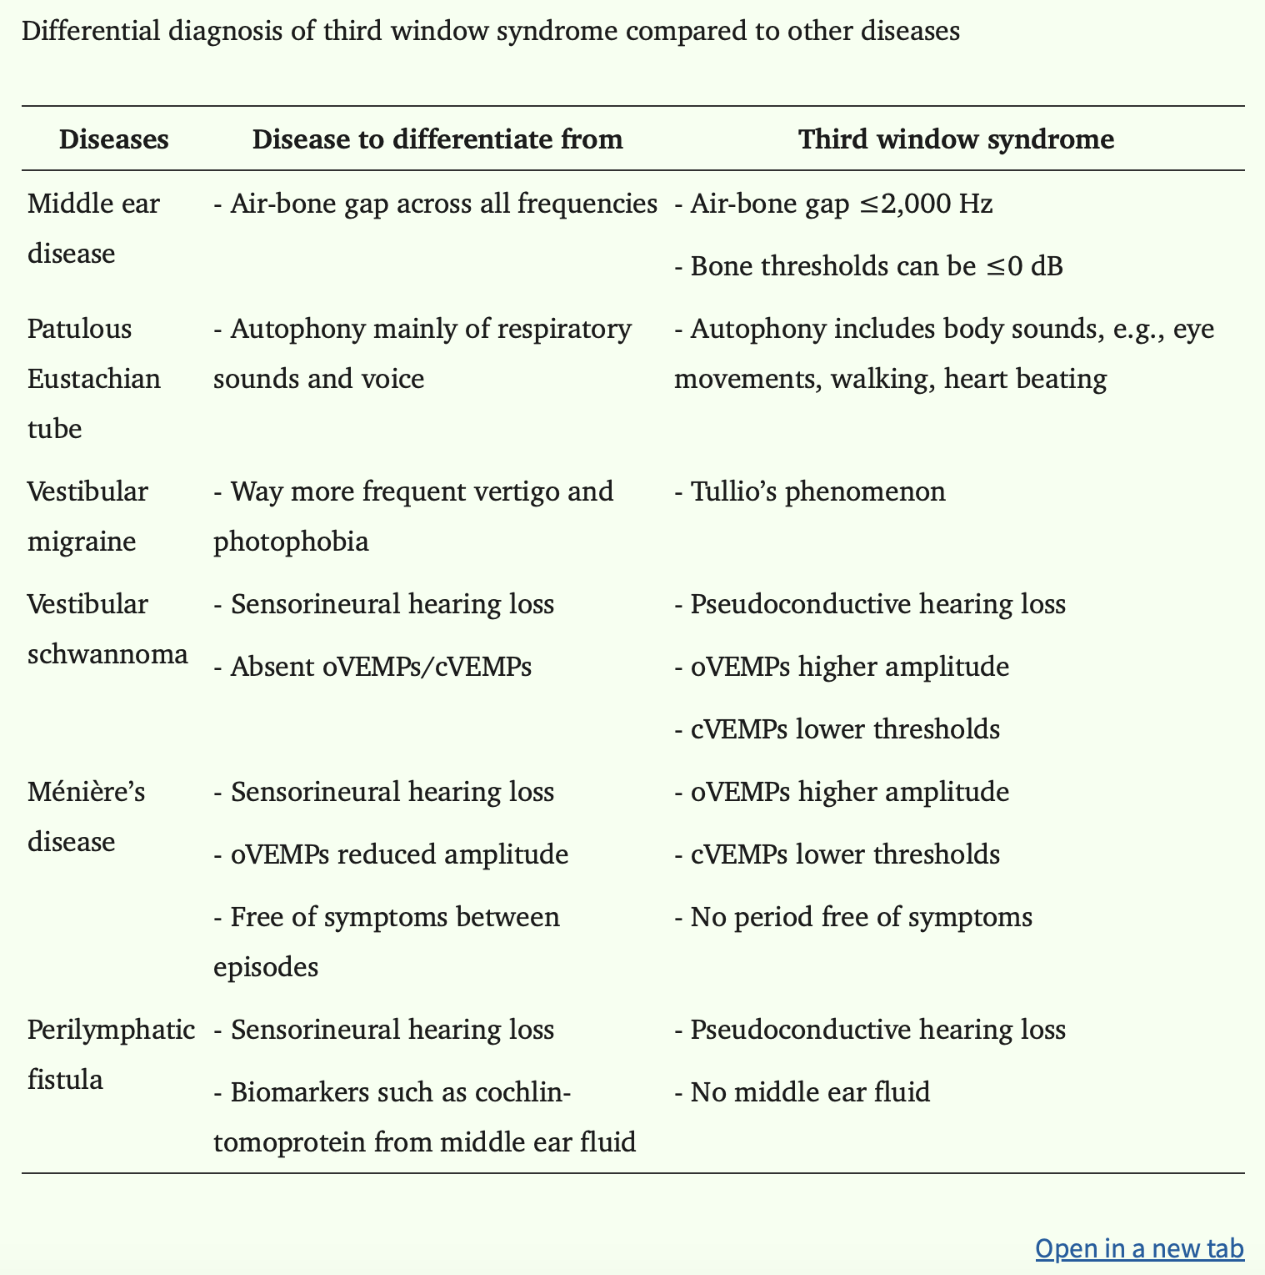
Lazarou, Ilias, Giorgos Sideris, Nikolaos Papadimitriou, Alexander Delides, and George Korres. 2025. “Third Window Syndrome: An Up-to-Date Systematic Review of Causes, Diagnosis, and Treatment.” Journal of Audiology & Otology 29(2):86–94. doi:10.7874/jao.2024.00696.

Slide 28
Take home: Clinical Decisions: Operate / Pause / Reconsider
Usually Operate
Conductive loss with preserved cochlear
reserve
Classic stapes fixation + Carhart notch
Ossicular discontinuity or
reconstructable chain
Symptoms and imaging fit diagnosis
Pause First
Inconsistent audiogram
No or uncertain masking
Speech scores worse than expected
Normal tympanogram but large ABG
Repeat tests / imaging first
Avoid / Reconsider
Supranormal BC thresholds
Sound/pressure-induced vertigo
Autophony / pulsatile symptoms
Third-window CT findings
Inner ear malformation / gusher risk
Operate the patient + mechanism + imaging — not the audiogram alone.

Slide 29
Air-Bone Gap Decision Framework
Is audiogram reliable?
Proper masking?
Tympanogram / reflexes fit diagnosis?
Speech scores plausible?
Imaging needed?
Mechanism surgically correctable?
If not all yes → pause.

Slide 30
Summary
# | Pathway | Mechanism | Relevance / Notes
1 | Ear Canal Sound Pressure | BC vibrations induce sound pressure in the ear canal, which reaches the cochlea via the ossicles (like air conduction). | Affected by occlusion effect; significant at low frequencies; enhanced if ear canal is closed or transducer is near canal.
2 | Middle Ear Ossicle Inertia | Skull vibrations cause relative motion between the ossicles and surrounding bone, especially the stapes footplate. | Important around ossicular resonance (~2 kHz). Dysfunction (e.g., stapes fixation in otosclerosis) leads to Carhart’s notch.
3 | Cranial Cavity Pressure Transmission | BC creates fluid pressure in the cranial cavity (e.g., cerebrospinal fluid), transmitted to the inner ear via compliant pathways (e.g., cochlear aqueduct). | Less dominant; contributes in some pathologies (e.g., large vestibular aqueduct).
4 | Cochlear Fluid Inertia | Skull vibration causes inertial motion of the incompressible cochlear fluids → pressure differential across the basilar membrane. | Main contributor in normal hearing, especially at low to mid frequencies.
5 | Cochlear Compression/Expansion | Skull vibration deforms the cochlear shell, causing volume changes that move cochlear fluids. | Dominates at higher frequencies (>4 kHz) where cochlear size is smaller than vibration wavelength.

Slide 31
Questions?
Cris Lanting, PhD
Medical Physicist-Audiologist, Radboudumc Nijmegen
Cris.Lanting@Radboudumc.nl

