Slide 1
Reaction-Time Spectrotemporal Modulation Transfer Functions as Biomarkers of Cochlear Dysfunction
Beyond thresholds, toward distortion fingerprints
Cris Lanting, PhD
WAS-dag 07 may 2026

Slide 2
Why?
“Ik hoor het wel, maar ik versta het niet…”
“I can hear it but cannot understand it…”
Notes:
“Ik hoor het wel maar versta het niet.” — every audiologist in this room has heard a version of this. “I can hear it but cannot understand it.”
The FDA approved the first inner-ear gene therapy just last week We have near to nothing in our test battery that goes beyond the audiogram. If we evaluate these therapies the way we evaluate hearing aids, we will declare success on patients who still cannot follow a conversation.

Slide 3
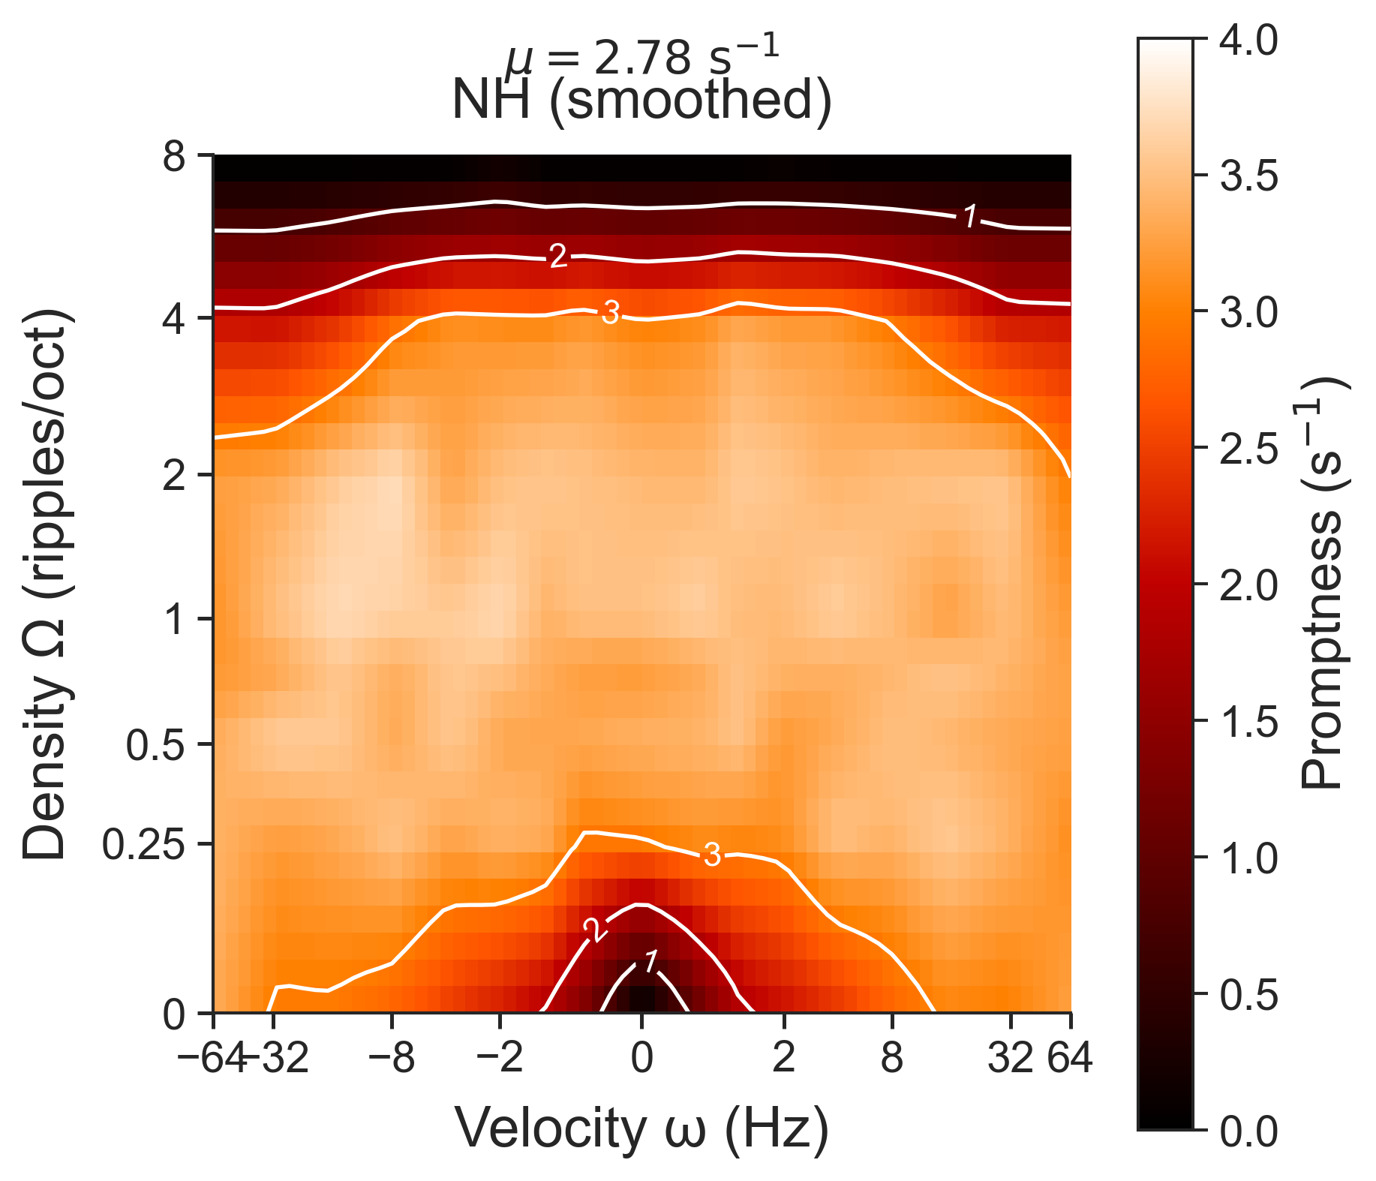
By the end
By the end of this talk, you will understand our reaction-time test that resolves the cochlear site-of-lesion in monogenic hearing loss, predicts speech-in-noise variance better than the audiogram (R² = 0.74), and is ready to use as an outcome measure for the gene-therapy trials about to land in your clinic.
Notes:
In the next 30 minutes I will give you insight in our reaction-time test that resolves the cochlear site-of-lesion in monogenic hearing loss, predicts speech-in-noise variance better than the audiogram, and is ready to use as an outcome measure for the trials about to land in your clinic.
Three monogenic groups. One reaction-time test. One mechanism, validated. Let’s go.

Slide 4
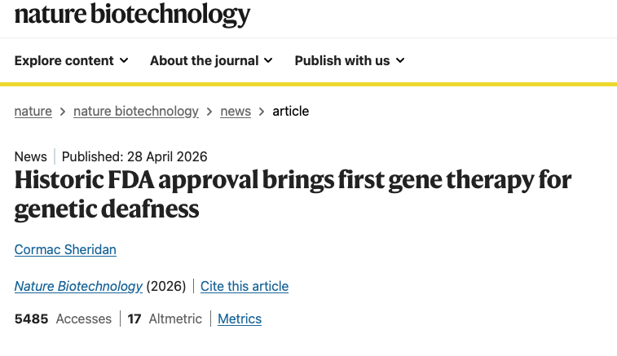
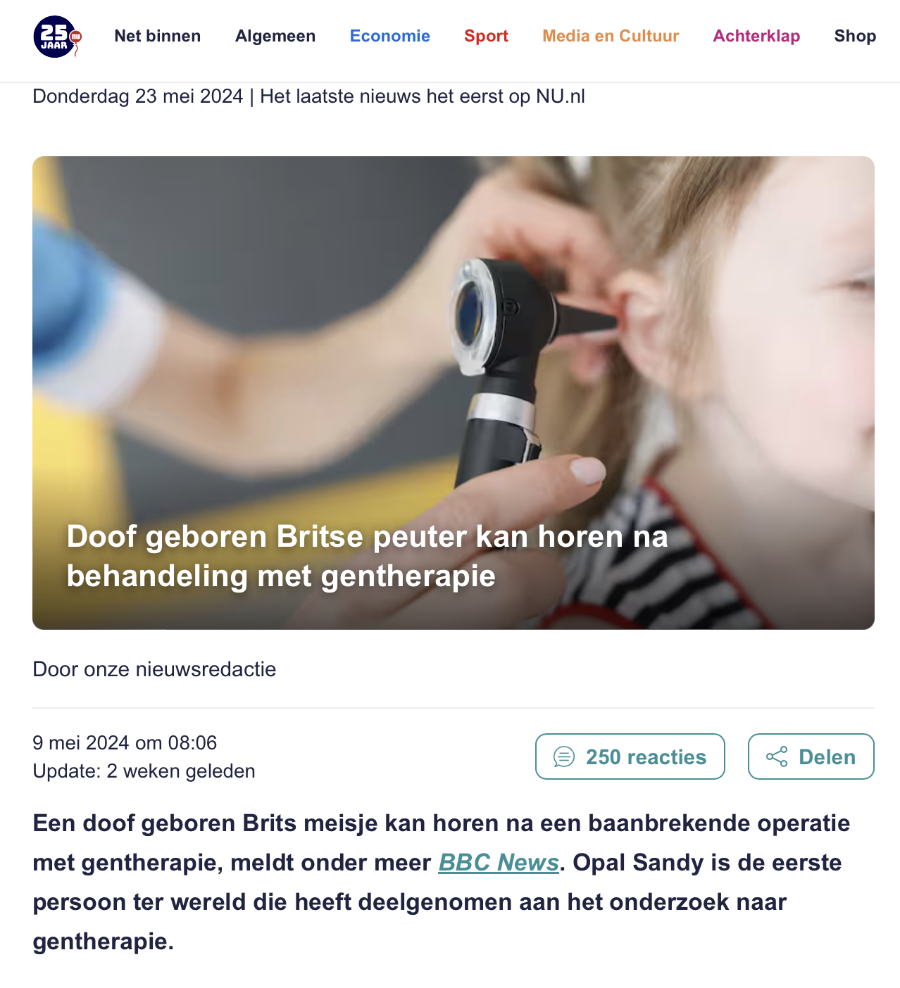
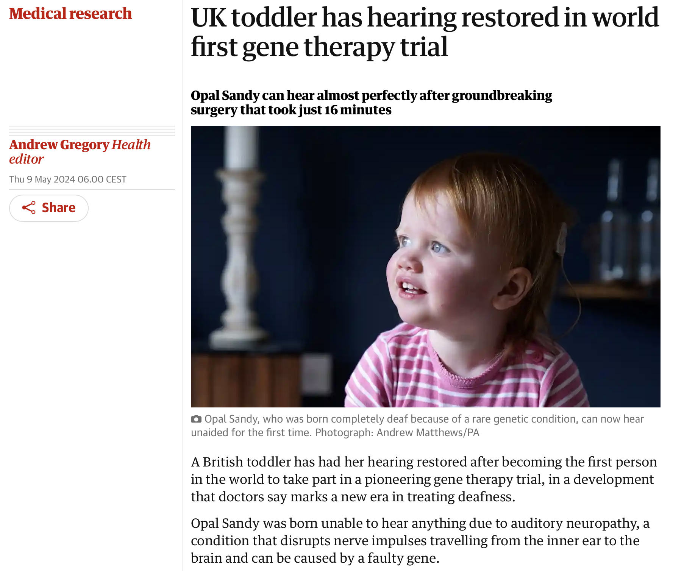
Notes:
Gene therapy for hereditary hearing loss suddenly reached our field when in January 2024 there were two Chinese groups that within a week from eachother published their first (6m) results after injection of paitents with gene therapy, curing hearing loss in people suffering for OTOF-mediated hearing loss. Two years down the line, only two weeks ago, the FDA approved this AAV-based gene therapy. Yet, at the ARO beginning this year we leand that while threshold may recover quite well, along with speech in silence, they still may experience some problems in speech in noise. This concept of hearing loss for speech is not new, already 50 years ago, Plomp laid the foundations for understanding, or at least describing factors underlyng this loss. Bridge: We will build on this framwork.

Slide 5
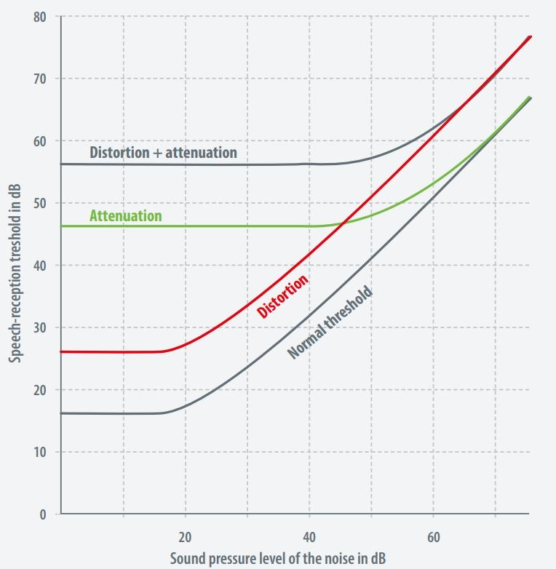
Plomp (1978): A–D Model of Speech-in-Noise
A-factor: attenuation
Related to the audiogram; can be compensated
D-factor: distortion
Speech in noise deficit; higher SNRs needed for speech understanding in noise
Notes:
“Reinier Plomp, 1978. The performance loss in speech-in-noise comes from two sources, not one.”
Point to A on the figure: “Attenuation — audibility — what the audiogram measures. Hearing aids fix this.”
Point to D: “Distortion — suprathreshold processing — what the audiogram does NOT measure. Hearing aids do not fix this.”
“This is the gap. Tonight is about measuring D.”
Transition: “We know D exists. Here’s evidence from our own work.” Click.

Slide 6
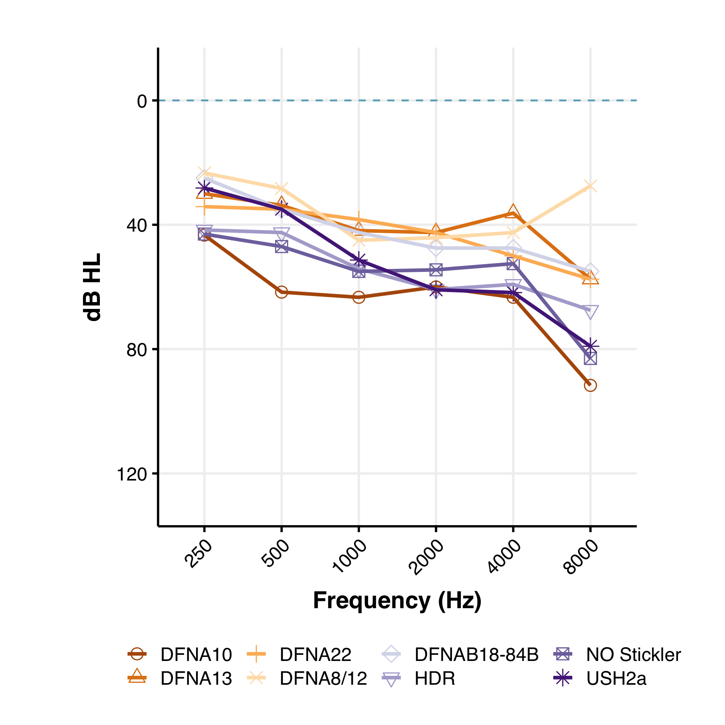
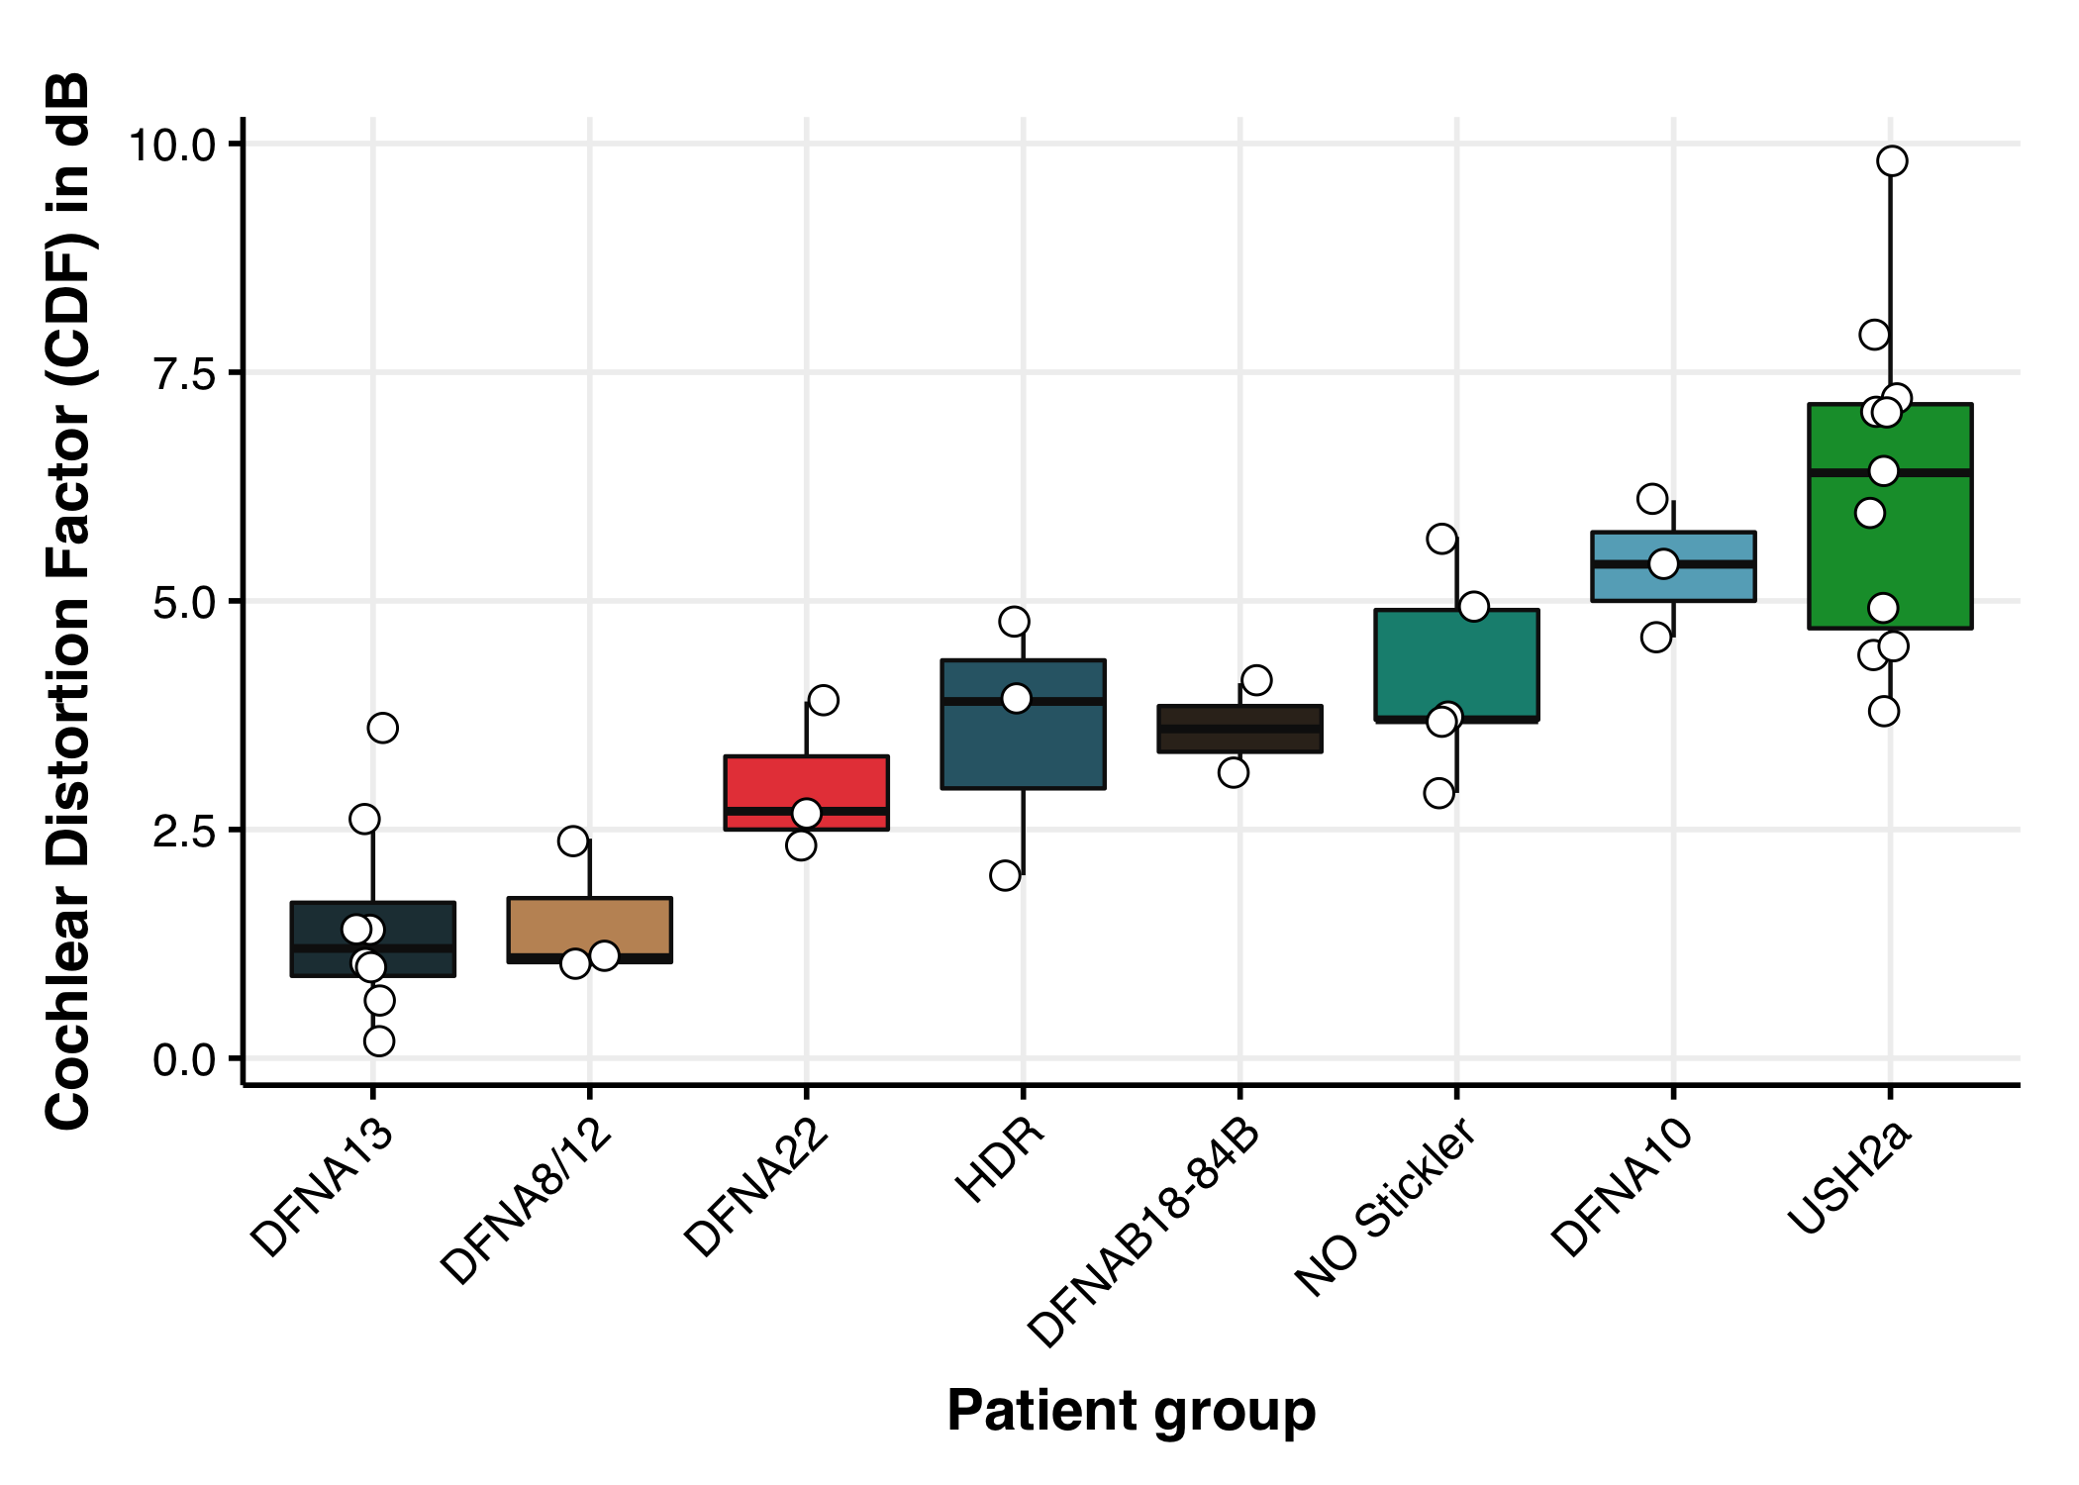
What is the cochlear basis of D?
Differences between groups
DFNA 8/12 and DFNA13 relative normal performance (i.e., close to 0)
DFNA10/Usher2a poor (> 5 dB loss)
What underlies this distortion?
Lanting, Cris, Ad Snik, Joop Leijendeckers, Arjan Bosman, and Ronald Pennings. 2022. “Genetic Hearing Loss Affects Cochlear Processing.” Genes 13(11):1923. doi:10.3390/genes13111923.
Notes:
“Data from a 2022 Genes paper. D-factor across genetic hearing-loss groups.”
Point: “DFNA8/12 and DFNA13 sit near zero — D is small. DFNA10 and Usher2a have D values above 5 dB — they have substantial extra loss BEYOND what their audiogram predicts.”
Pause. Then the question that drives the rest of the talk: “What is the cochlear basis of D? What is going wrong in those patients that the audiogram doesn’t see?”
Transition: “To answer that, we need a test that doesn’t collapse audibility and processing into one number.”

Slide 7
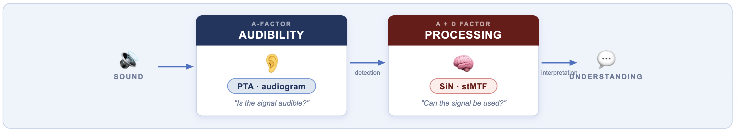
Current tests collapse audibility and processing.
We need to separate them
How to disentangle A&D?
Notes:
“The audiogram collapses audibility and processing into one number. We need to separate them.”
Transition: “Where are we going to get clean test cases?”

Slide 8
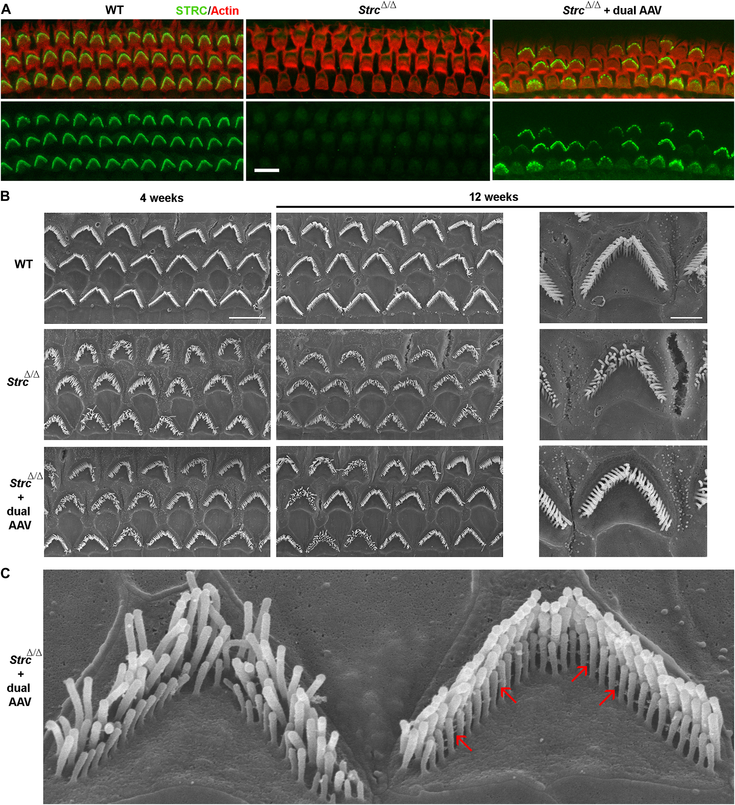
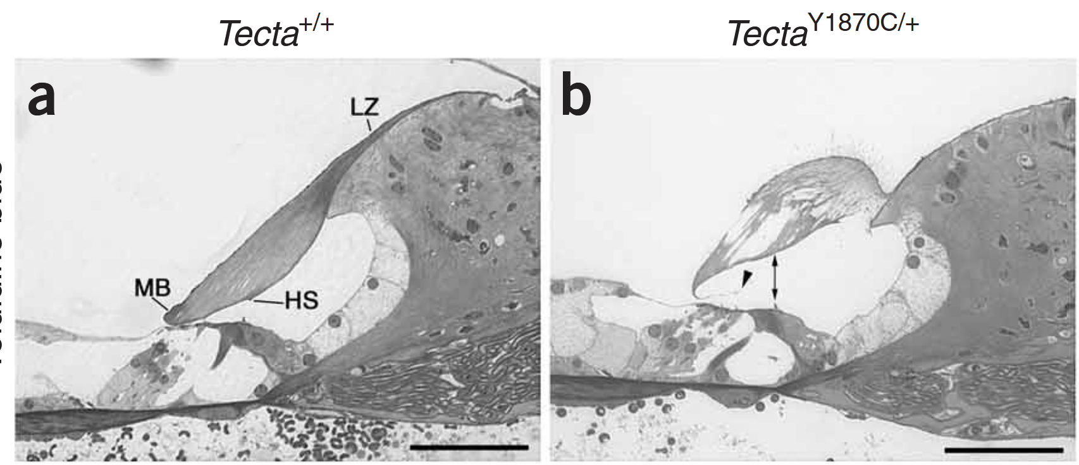
Why monogenic hearing loss may help
Monogenic HL as natural site-of-lesion models. In some cases, like OTOF, the mechanism is well understood. Also:
STRC: OHC/tectorial membrane (de)coupling. Stable 40 dB hearing loss
TECTA / COL11A2: tectorial membrane structure/composition -> cookie-bite audiogram
Both are relatively good performers (SiN)
Bel Hach, in preparation
Notes:
“Monogenic hearing-loss patients are natural site-of-lesion models.”
“STRC: outer-hair-cell / tectorial membrane decoupling. Stable, around 40 dB hearing loss.”
“TECTA and COL11A2: tectorial membrane structure and composition. Classic cookie-bite audiogram.”
“What’s striking is that all three groups perform reasonably well in speech-in-noise on average. The audiogram does not separate them. Tonight we will.”
Transition: “Here’s the picture I want you to keep in your head all evening.”

Slide 9
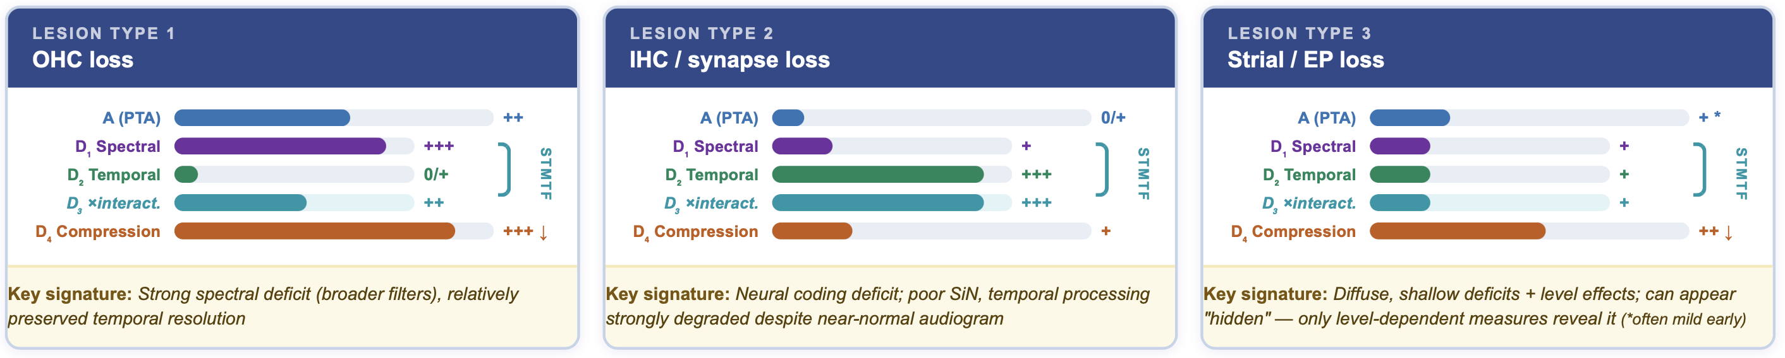
Auditory ‘fingerprint’
Notes:
“This is the central image. Same audiogram. Different fingerprints. Same amount of hearing loss, three different cochlear stories.”
“By the end of the talk you will know how to read these.”
Transition: “Our method to extract those fingerprints uses ripple stimuli.”

Slide 10
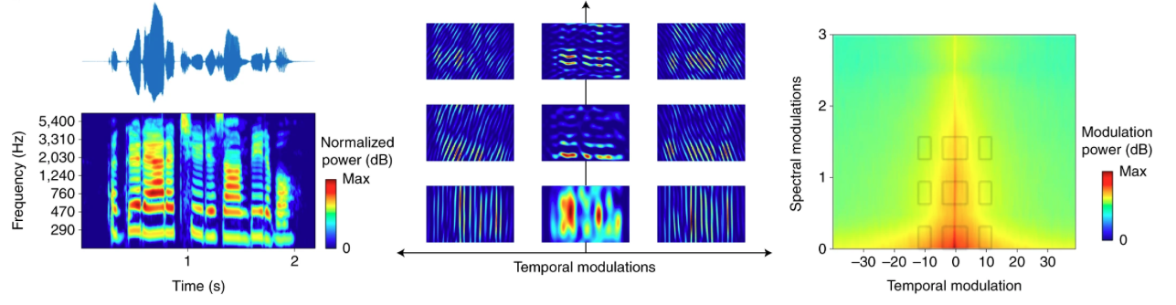
Our method: sound represented as spectrotemporal ripples
Speech = modulation of energy across frequency × time (c.f., Bernstein et al., 2016), decomposed in ripple stimuli
Hearing loss ↓ temporal resolution
↓ spectral resolution
Notes:
“Speech is energy varying across frequency and time. You can decompose it as a weighted sum of ripples — sinusoidal modulations in the spectrogram, modulations in time and fequency”
“If the cochlea has degraded spectral resolution, certain ripples become invisible. Same for temporal resolution.”
“So instead of testing speech directly, we probe each axis with controlled ripple stimuli.”
Transition: “Here’s what they sound like.”

Slide 11
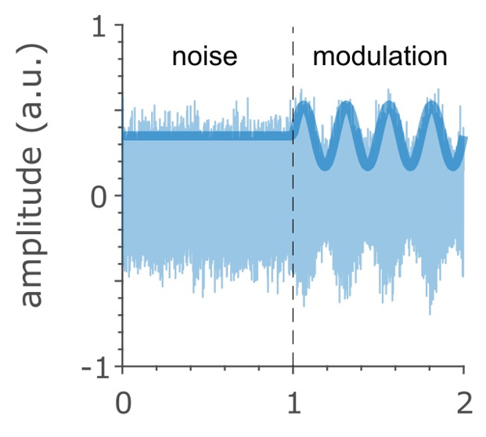
The task: “Detect the ripple onset.”
Take the reaction time to the detection of the (jittered) onset of a ripple from static noise
Ripple stimuli vary as a function of spectral, temporal, and combined modulations
Previously used in
  Monkeys (Massoudi et al., 2013-15)
  Humans (Veugen et al., 2022)
Massoudi et al., 2013. European Journal of Neuroscience 37(11):1830–42. doi:10.1111/ejn.12180.
Veugen et al., 2022. Trends in Hearing 26:23312165221127589. doi:10.1177/23312165221127589.
Notes:
“Subject hears continuous static noise. At a jittered moment, a ripple modulation begins. They press a button as soon as they detect it.”
“The dependent variable is reaction time — not threshold, not accuracy.”
“This paradigm has a track record: Massoudi in monkeys, Veugen in humans. We’re the first to apply it to monogenic patient cohorts.”
Transition: “One quick warning before the audio demo: the icons are hiding the spectrograms behind them. The figures still convey what matters — each cell is a different ripple.”

Slide 12
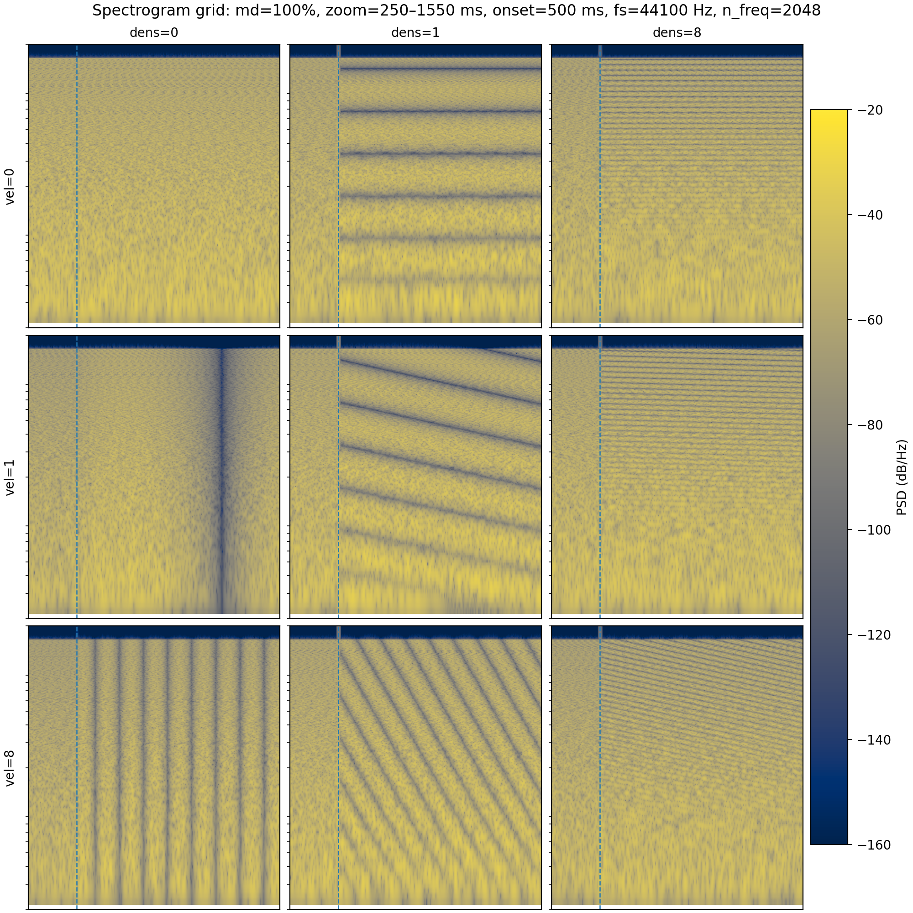

Ripples
Spectral modulations
~How wide are the auditory filters
Unit: densities = [0, 1,…., 8] cycles/oct
Temporal modulations
~How fast is the auditory system?
Unit: velocities = [0, 1, …, 8] Hz (s⁻¹)
Both positive (upward) and negative (downward)
Notes:
“Two dimensions. Spectral density — how many cycles per octave. Temporal velocity — how fast the modulation moves. Both can be positive or negative.”
Play dens=0/vel=0 (noise): “That’s your baseline. Static noise.”
Play dens=1/vel=0: “You heard texture appear. Spectral structure on top of the noise.”
Play dens=8/vel=0: “Finer texture. Higher density.”
“Open your eyes. The same logic in the temporal axis: high velocity sounds rougher, low velocity sounds smoother.”
“We sweep this 2D space and read off the reaction time at every point.”

Slide 13
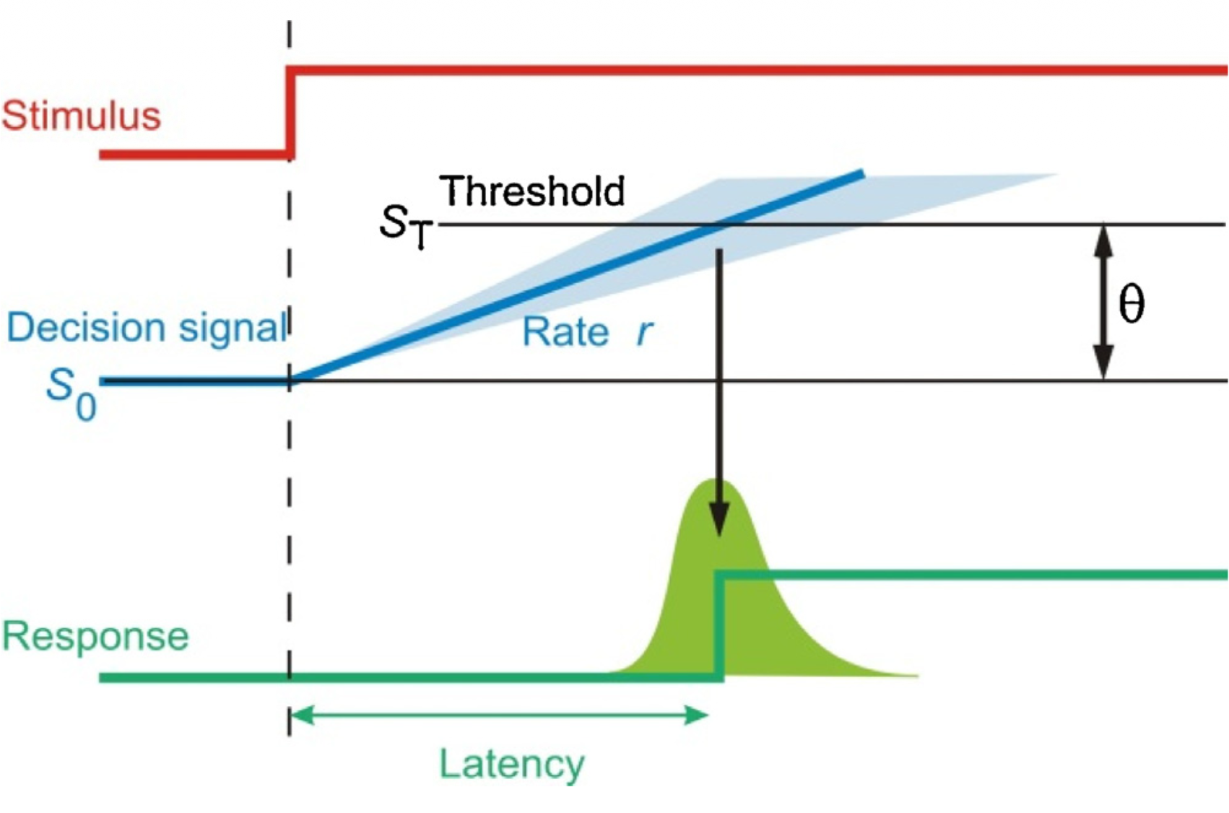
Why RT? RT indexes evidence accumulation (LATER)
Easier stimulus → faster accumulation → shorter RT
RT also depends on decision threshold
risk-averse = slower / cautious
risk-taking = faster / liberal
  → separate sensory vs decision components
Between-subject variability
  → controlled for using within-subject comparisons and Bayesian models
Noorani, Imran, and R. H. S. Carpenter. 2016. “The LATER Model of Reaction Time and Decision.” Neuroscience & Biobehavioral Reviews 64:229–51. doi:10.1016/j.neubiorev.2016.02.018.
Notes:
“Reaction time decomposes into evidence accumulation rate — a sensory parameter — and decision threshold — a strategy parameter.”
“Easier stimuli accumulate evidence faster → shorter RT. That’s what we want to read out.”
“We handle decision-threshold variability with within-subject comparisons and Bayesian models.”
Don’t go deeper than this. Researchers in the room know LATER. The non-experts don’t need it.
Transition: “Once we have RT across the 2D ripple space, we get a 2D map.”

Slide 14
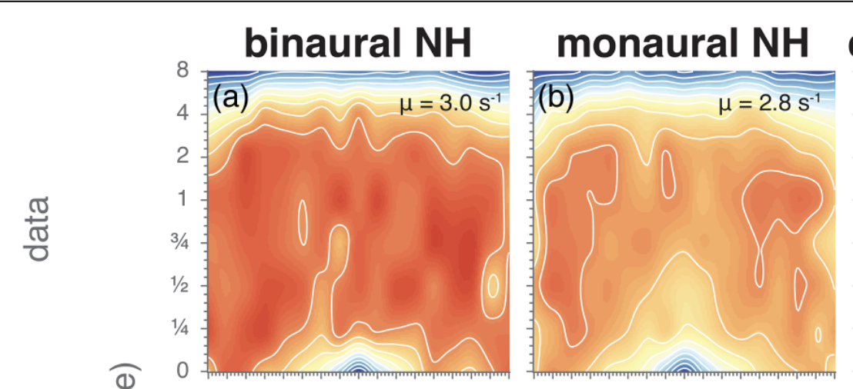
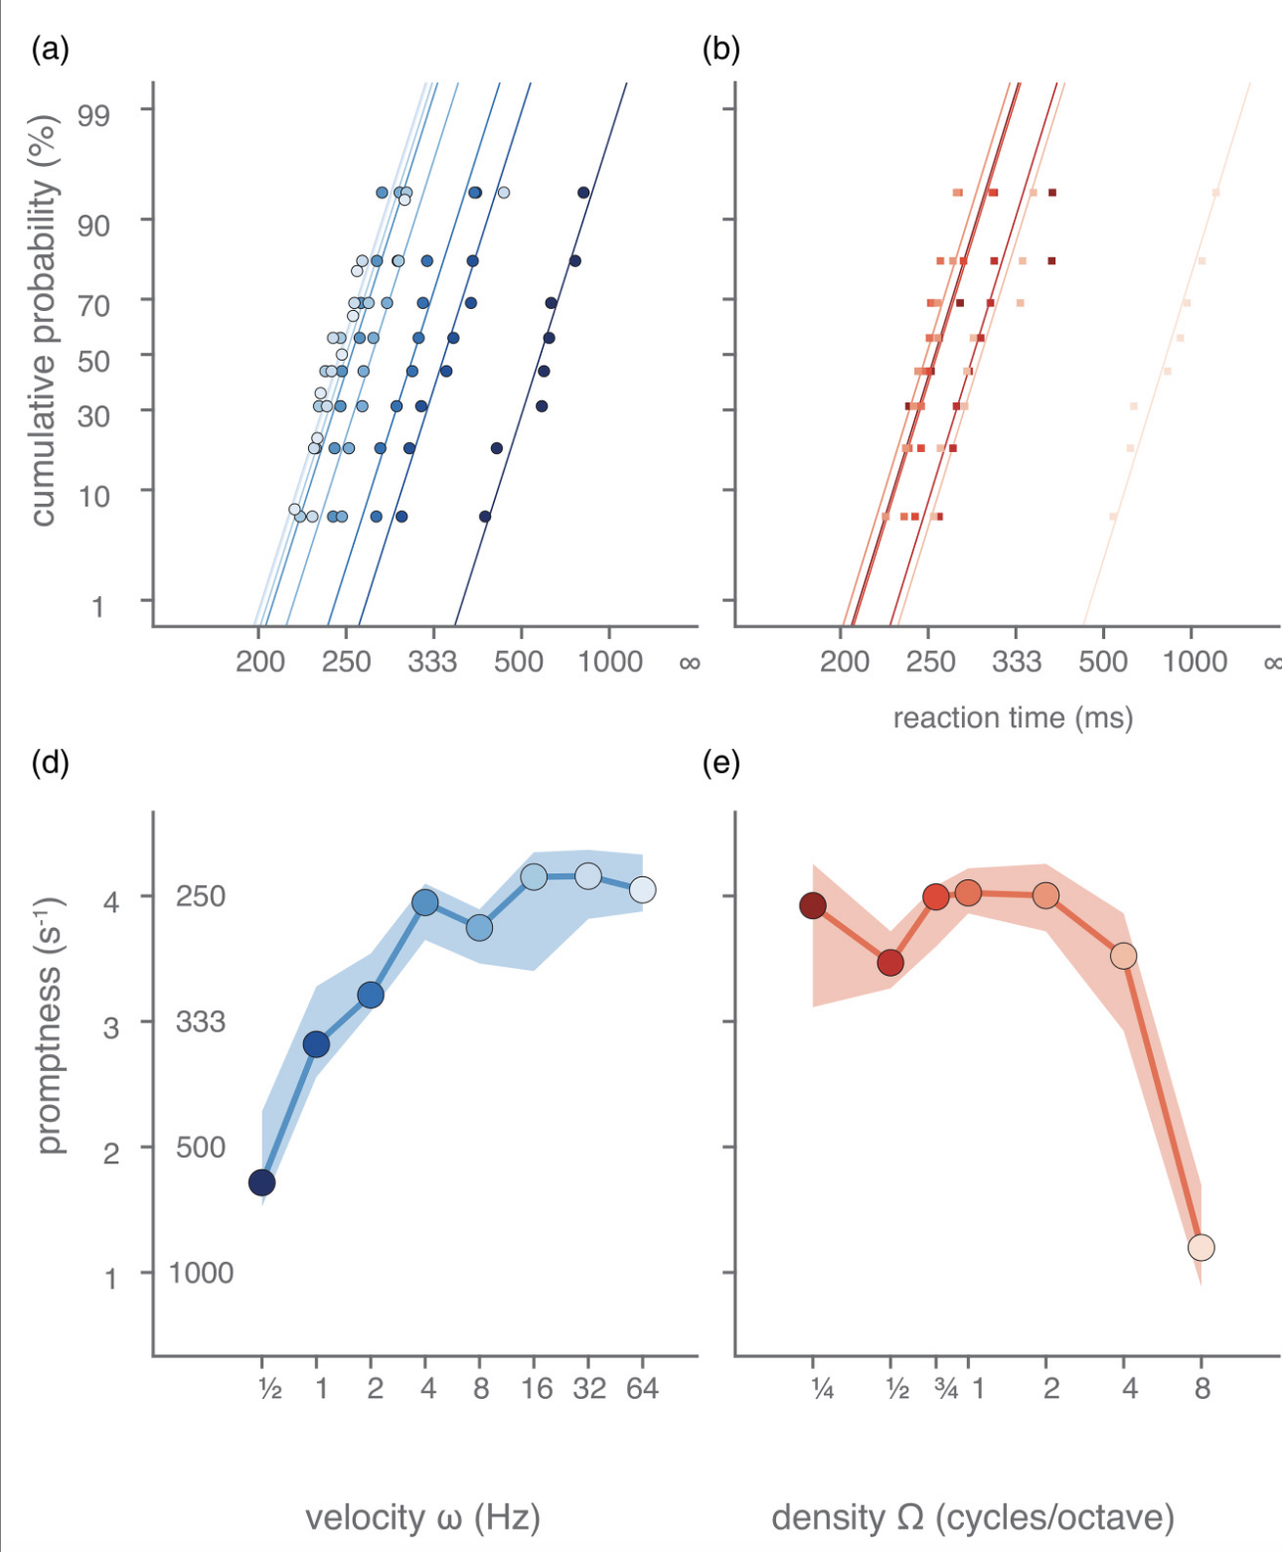
From RT to stMTF
spectral
temporal <> spectral
temporal
Veugen et al., 2022. Trends in Hearing 26:23312165221127589. doi:10.1177/23312165221127589.
Notes:
“For each ripple condition we get a distribution of RTs. Invert and rescale them and you get ‘promptness’ — high values mean fast, easy detection.”
“Collect promptness across all densities and velocities, and you have a 2D modulation transfer function. The stMTF.”
Trace the arrow with your finger if you can: RT distributions on the left, 2D map on the right.
Transition: “Before I show you the data, what should we expect?

Slide 15
Predictions
Group | Prediction
STRC (OHC/TM coupling) | ↓ Spectral | Temporal ~ preserved (c.f. Benoit et al., 2023)
TECTA / COL11A2 (TM structure) | ↓ Spectral + Temporal
Overall Speech-in-noise | Strongest link with spectral tuning c.f. vocoder experiments
Notes:
“STRC: damage is to the OHC-TM coupling. Spectral selectivity should drop. Temporal processing should be roughly preserved — Benoit et al. saw this with 2AFC.”
“TECTA and COL11A2: structural changes to the tectorial membrane. Both spectral AND temporal should drop — the membrane is part of how the cochlea times things.”
“And if these patterns matter for everyday hearing, the spectral side should track speech-in-noise.”
Transition: “First the audiogram, to confirm groups don’t differ in pure audibility.”

Slide 16
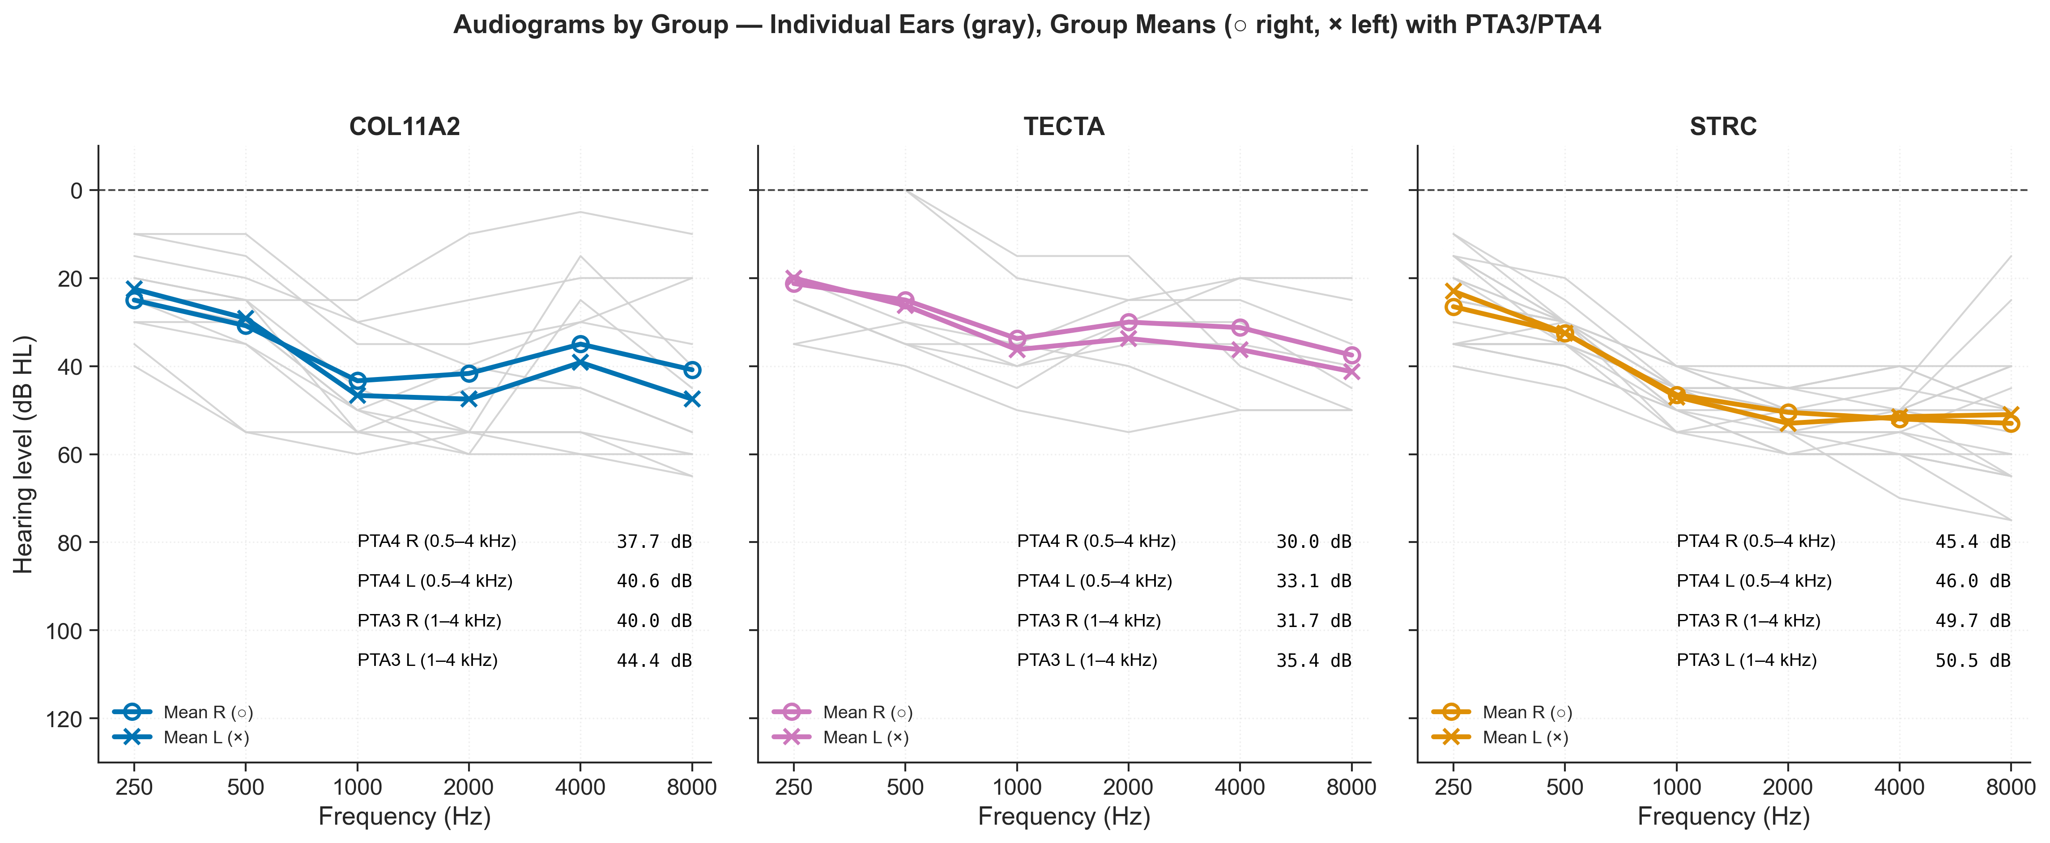
Results: thresholds (A-factor)
Notes:
“Here are the audiograms by group. STRC, TECTA, COL11A2.”
“All three sit between 30 and 50 dB HL across speech frequencies.”
Punchline: “The audiogram cannot tell these patients apart. If we stopped measuring here — which is what most clinics do — we would conclude these groups have the same hearing loss.”
Transition: “Now let’s look at the stMTF.”

Slide 17
Results: stMTFs
2D stMTFs of normal hearing subjects (n=8) are similar to those by Veugen et al., 2022
Faster responses for high velocities (i.e., high-pass filter characteristic)
Positive and negative velocities are very similar
Higher spectral densities are more difficult, slower responses (i.e., low-pass characteristic)
Spectral axis
Temporal axis
Notes:
“First, the normal-hearing reference. Eight subjects.”
“What you see matches Veugen 2022. High-pass in temporal velocity — faster modulations are easier. Low-pass in spectral density — finer modulations are harder.”
“Symmetry between positive and negative velocities. This shape is your baseline. Remember it.”
Transition: “Now our three patient groups, side by side.”

Slide 18
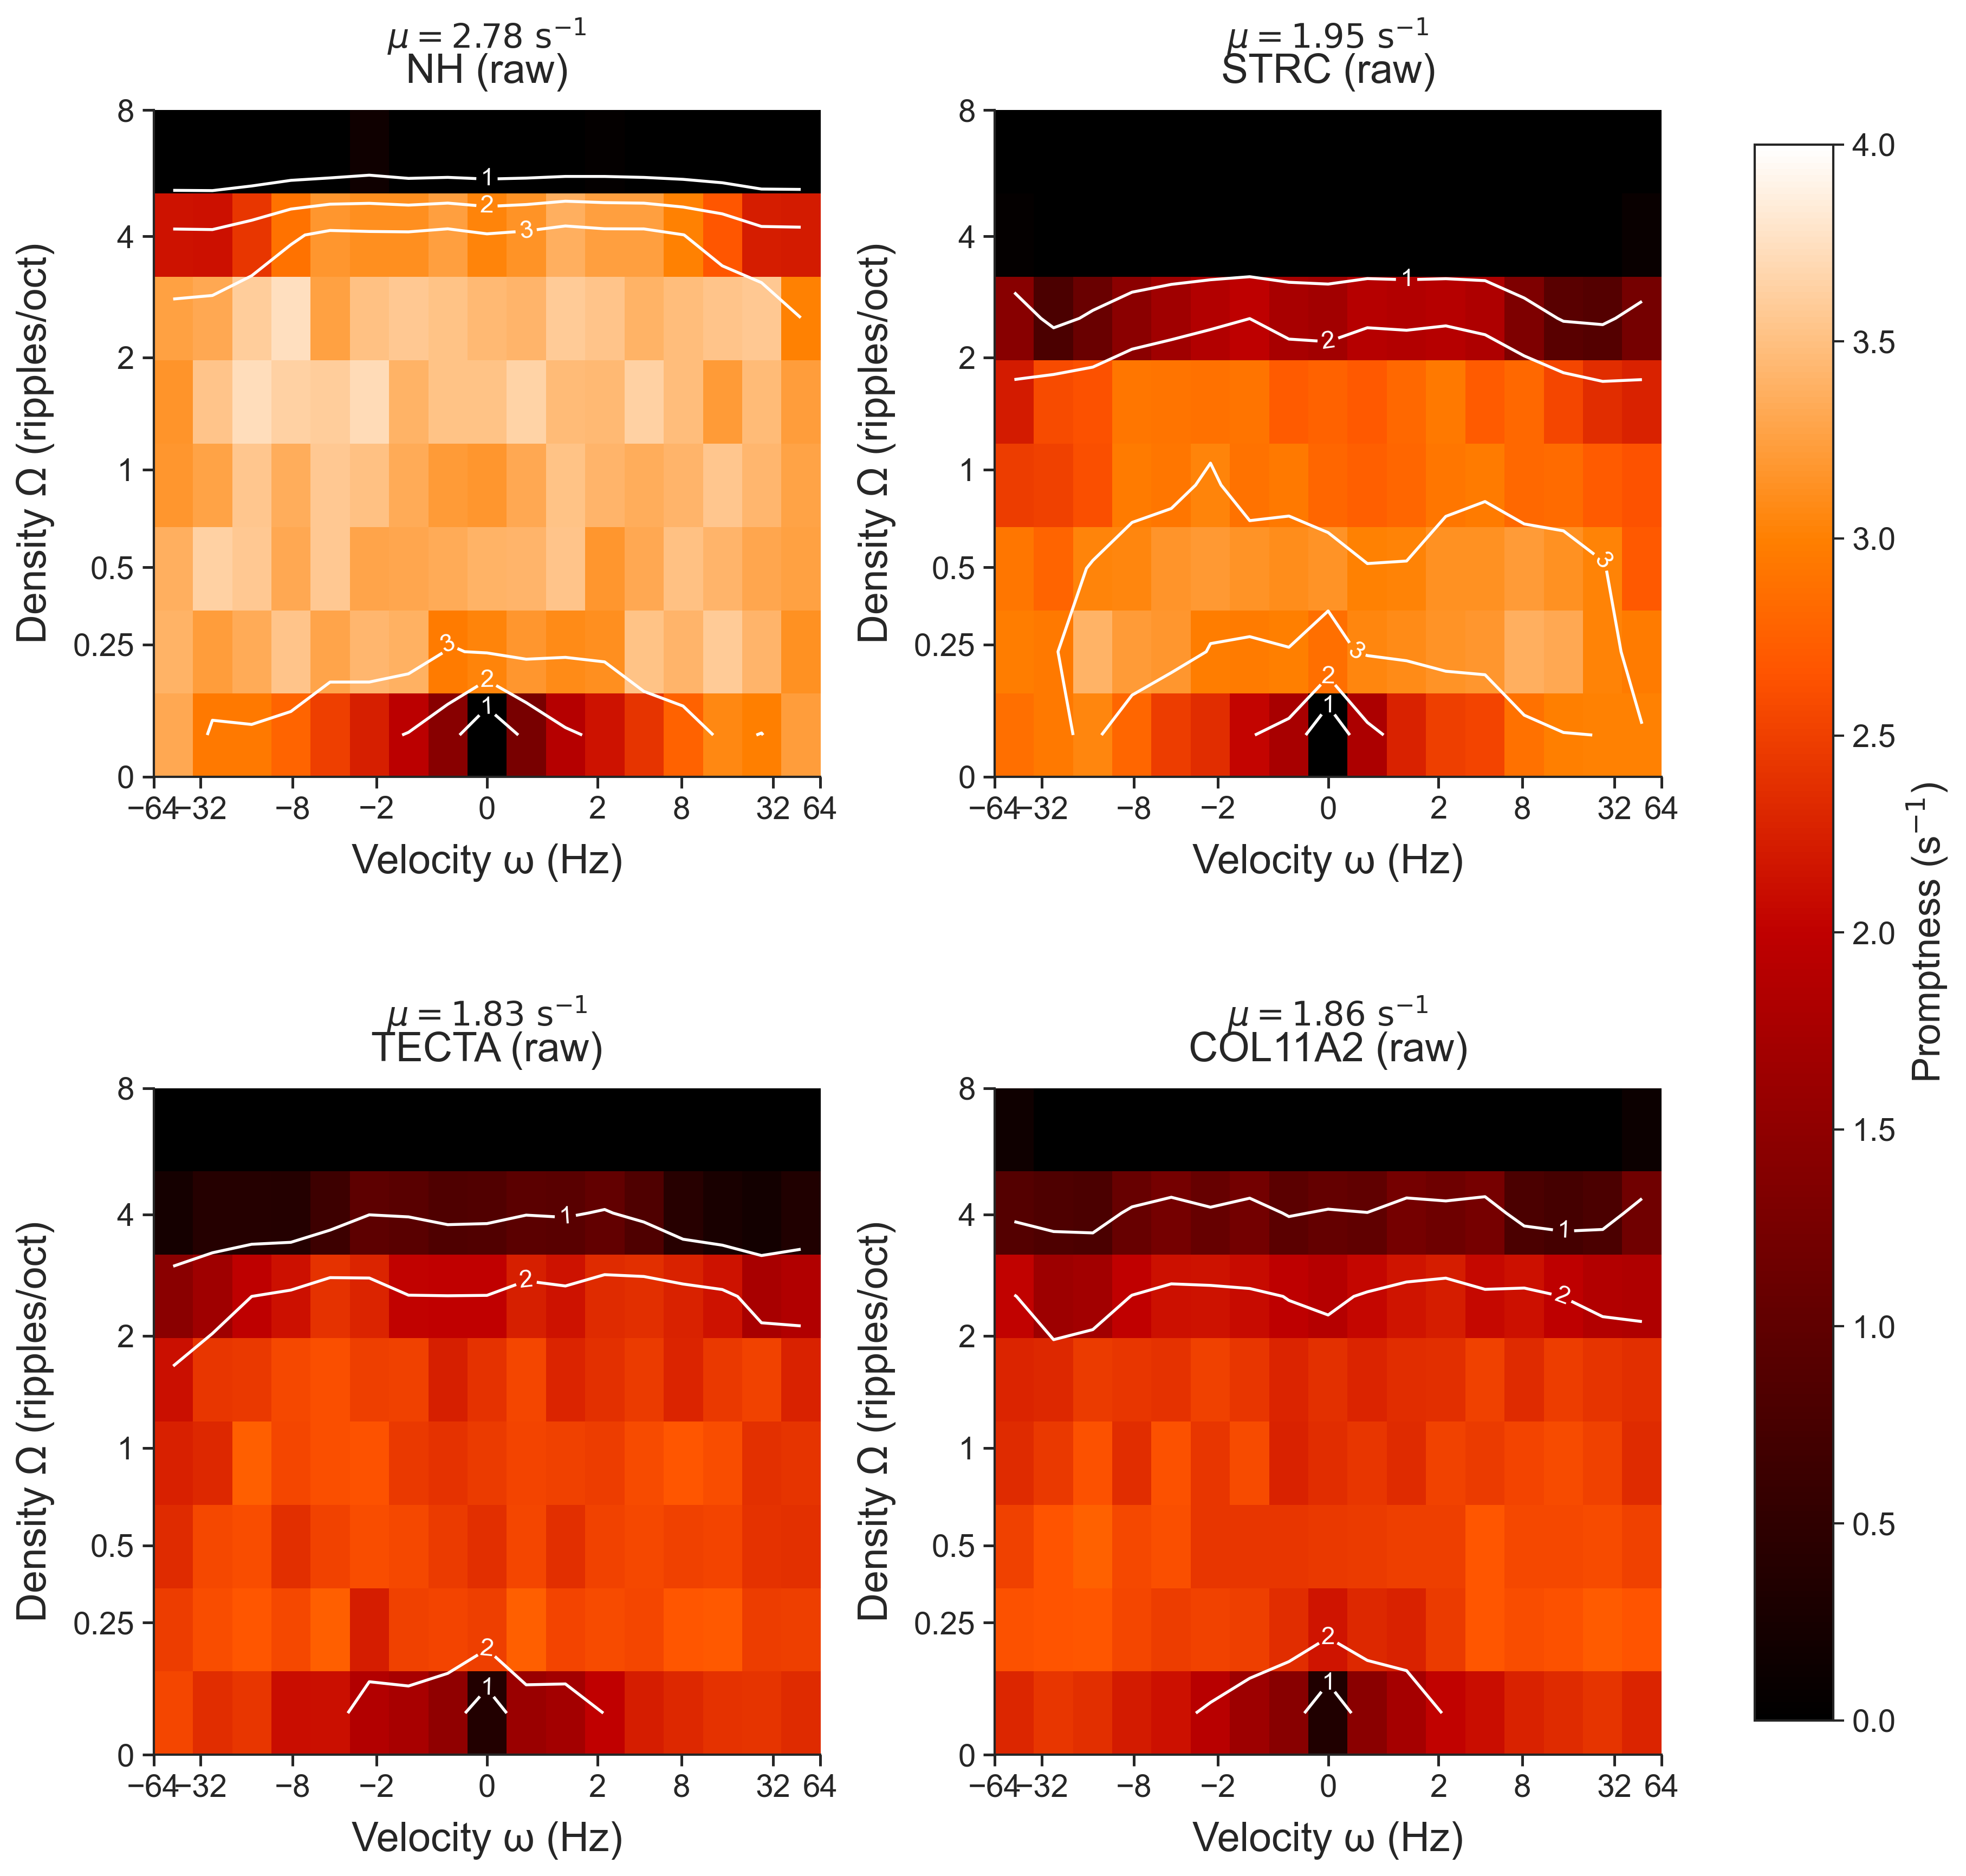
Results: stMTFs across groups
spectral
STRC (OHC–TM coupling)
Selective spectral impairment, stronger than in other groups
TECTA and COL11 are very similar and impaired re NH in both domains
Same site of lesion → similar fingerprints
Notes:
“Four panels: NH, then STRC, TECTA, COL11A2.”
Pause. Let the audience look.
“STRC: spectral collapse. The map is squashed in the spectral direction. Temporal axis looks fine.”
“TECTA and COL11A2: similar to each other. BOTH axes degraded.”
“Same audiogram. Different fingerprints. Predictions confirmed.”
Transition: “We can summarise each fingerprint with a few parameters.”

Slide 19
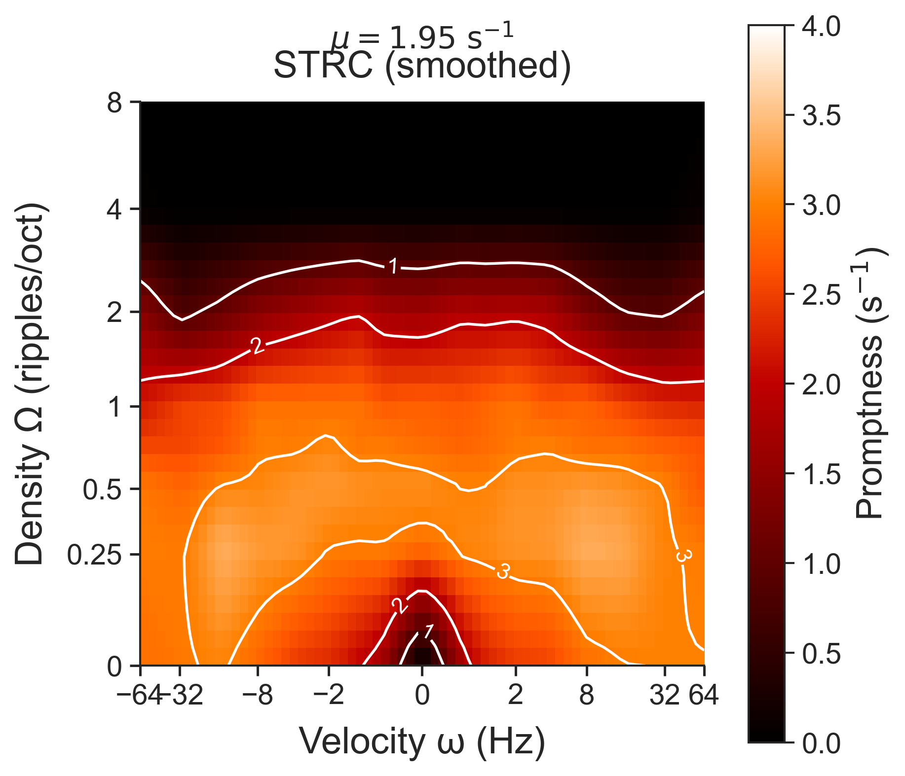
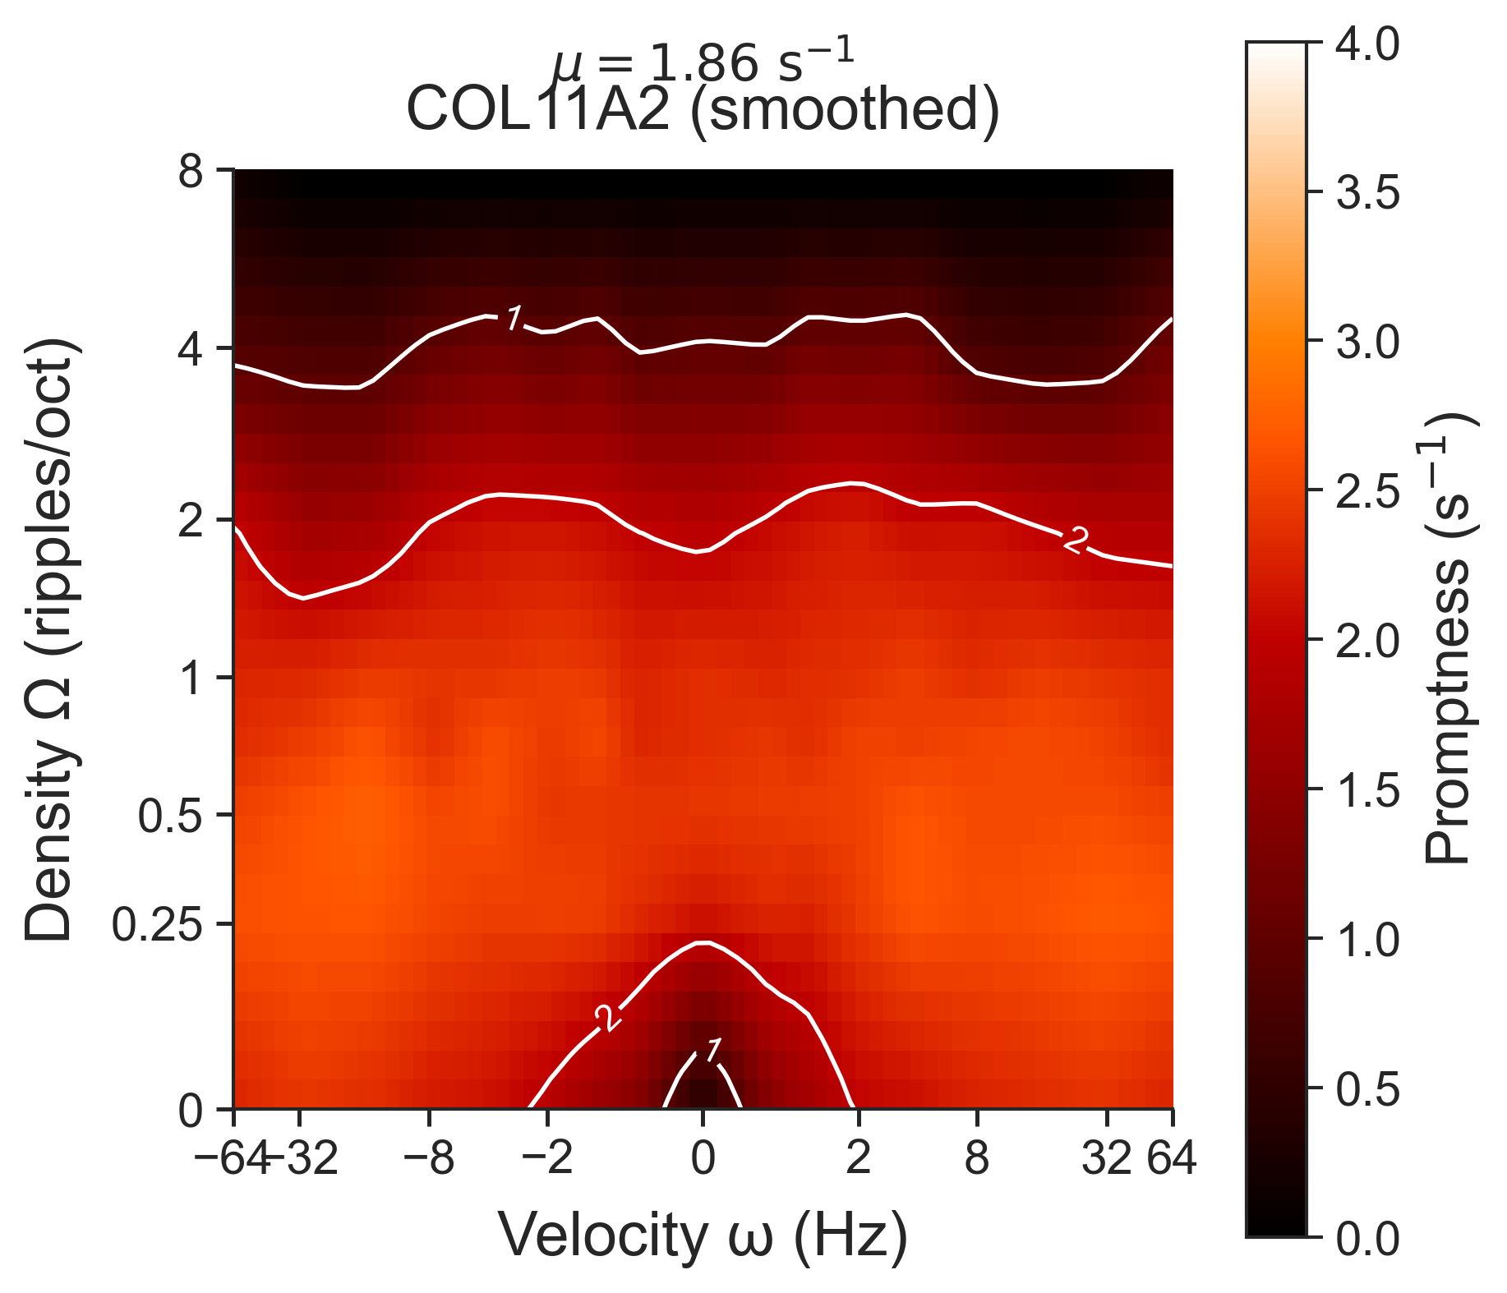
Site-of-lesion specific stMTF aka ‘fingerprints’
Notes:
“We fit a parametric transfer function to each axis. From it we read the spectral edge — the cutoff density above which detection collapses.”
“The edge is the single most informative parameter. Hold that idea — it predicts almost everything that’s coming.”
Transition: “Does the spectral edge actually matter for real-world hearing?”

Slide 20
Clinical relevance: does the fingerprint explain speech-in-noise?
Subject-specific spectral edge vs SRT (Matrix test)
Variance explained
  Age + tMTF R² = 0.24
  Age + sMTF + tMTF R² = 0.63
  Age + sMTF + tMTF
    + group R² = 0.74
Spectral edge shows the strongest association with SRT, more so than temporal resolution
Notes:
“Here’s the variance-explained progression for speech-in-noise on the Matrix test.”
“Age plus tMTF: R² = 0.24. Add the sMTF: R² jumps to 0.63. Add group: 0.74.”
“The spectral side of the fingerprint is a stronger predictor of speech-in-noise than the audiogram is.”
“For a clinician, this is the headline. The fingerprint is not cosmetic. It tracks the things patients actually complain about.”
Transition: “One challenge: is the sMTF really measuring spectral resolution — or just general task difficulty?”

Slide 21
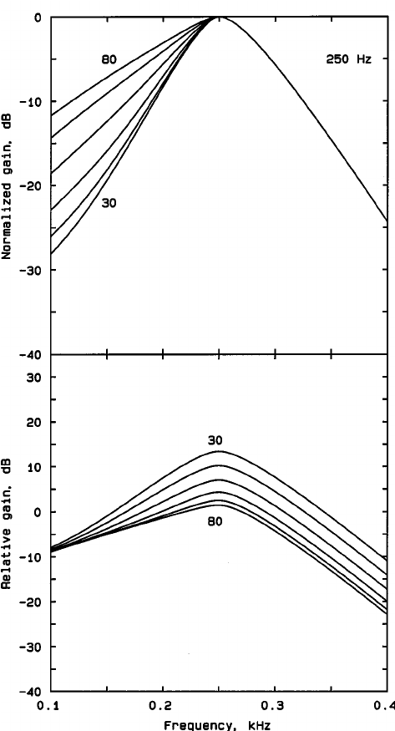
Discussion and mechanistic validation: does sMTF reflect spectral resolution?
sMTF explains speech-in-noise
  → Does it reflect auditory filter width?
Test: manipulate spectral resolution
  Smooth the spectral envelope (Gaussian)
  Impose only spectral change (temporal preserved)
Prediction: if sMTF = spectral resolution:
  → Spectral smearing then sMTF-edge frequency ↓
  → tMTF unchanged
Notes:
“One sentence test: if the sMTF really measures spectral filter width, then degrading ONLY the spectrum of our stimuli should reduce sMTF — and leave tMTF untouched.”
“If we see both axes drop, our ‘spectral resolution’ interpretation is wrong.”
Don’t read the bullets. The slide should be cut to the one prediction.
Transition: “Here’s how we generated spectrally smeared stimuli.”

Slide 22
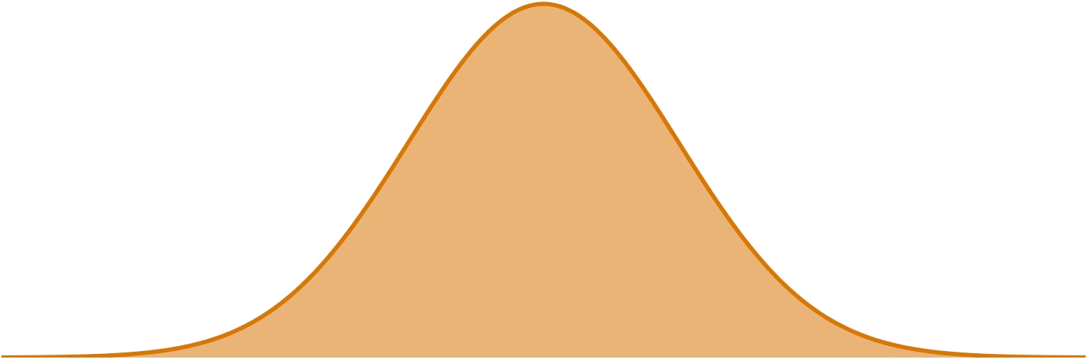
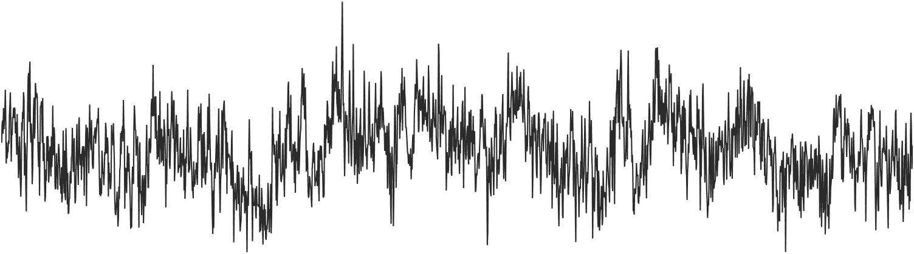
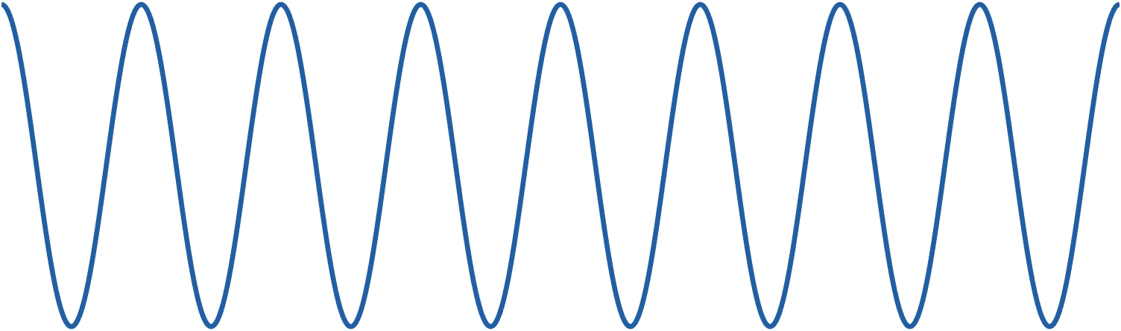
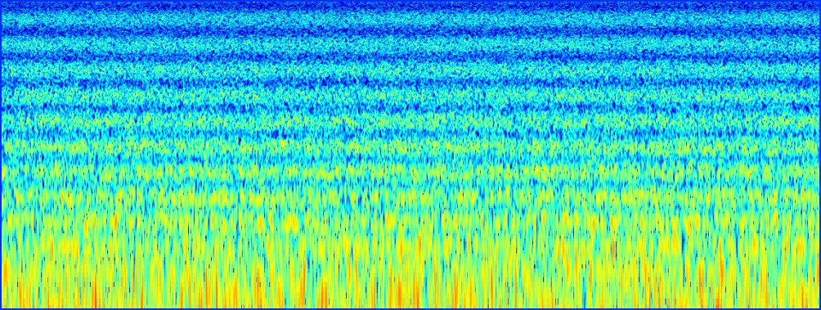
Gaussian kernel
σ in octaves
⊛ convolve
Carrier
Spectral envelope
Ripple sound
×
IFFT
pink noise
cosine on octave axis
output
Notes:
“Pink noise carrier. Cosine spectral envelope on an octave axis. Convolve the envelope with a Gaussian kernel of width sigma.”
“Increasing sigma smears the envelope but leaves the temporal structure of the carrier intact.”
“This is a clean way to manipulate one axis at a time.”
Transition: “Here’s what that looks like in the spectrogram.”

Slide 23
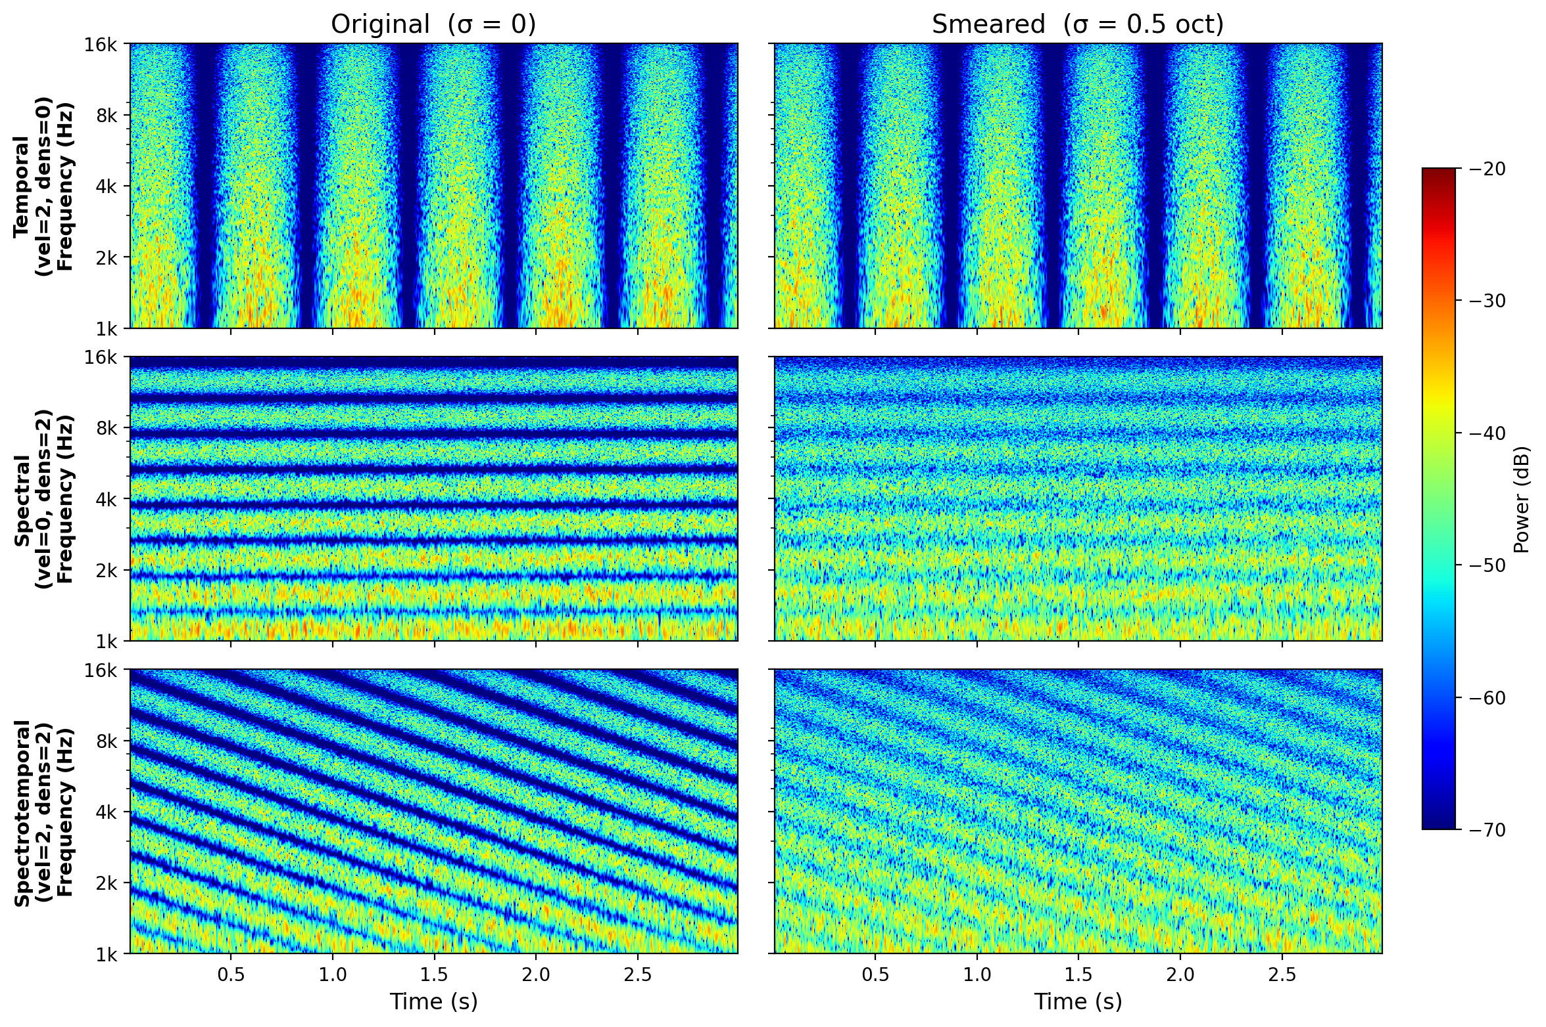
Credit:
Tim van Schaik, MSc thesis
Modelling spectral smearing and stMTFs
Smearing is spectral-selective: temporal structure preserved, spectral structure destroyed
Notes:
“Original on top, smeared underneath. Three modulation types: temporal-only, spectral-only, spectrotemporal.”
Point: “Temporal modulations — untouched. Spectral modulations — partially gone. Spectrotemporal — the spectral component is wiped, the temporal trace remains.”
Credit Tim van Schaik briefly: “Tim van Schaik’s MSc work.”
Transition: “Does that show up in the stMTF?”

Slide 24
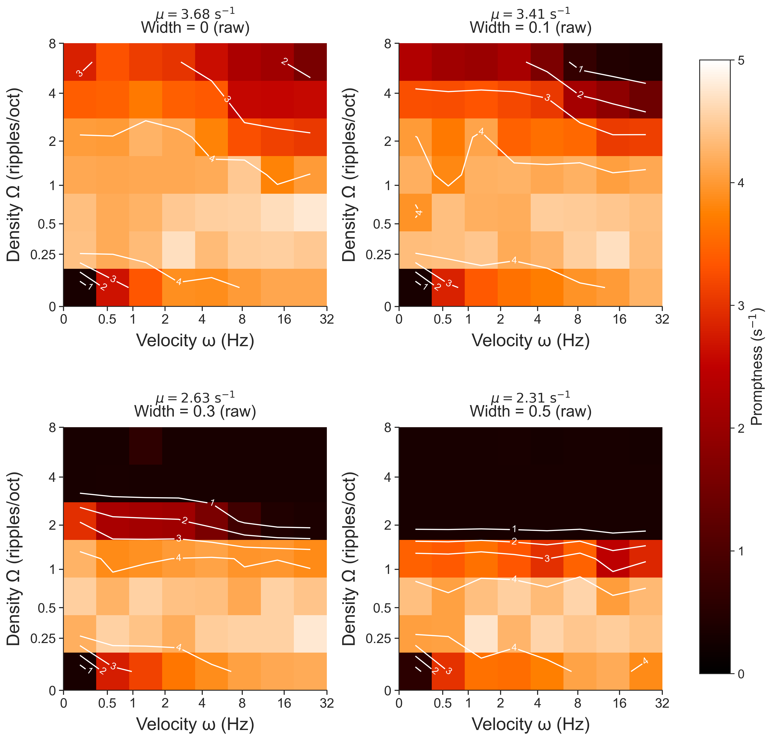
Smear
Four degrees of smoothing
0, 0.1, 0.3, 0.5 octaves
Reduces spectral resolution
Notes:
“Same subject. Sigma 0, 0.1, 0.3, 0.5 octaves — increasing spectral smearing.”
Point: “Watch the spectral axis collapse. The temporal axis barely moves.”
“Exactly the prediction.”
Transition: “One more way to see it.”

Slide 25
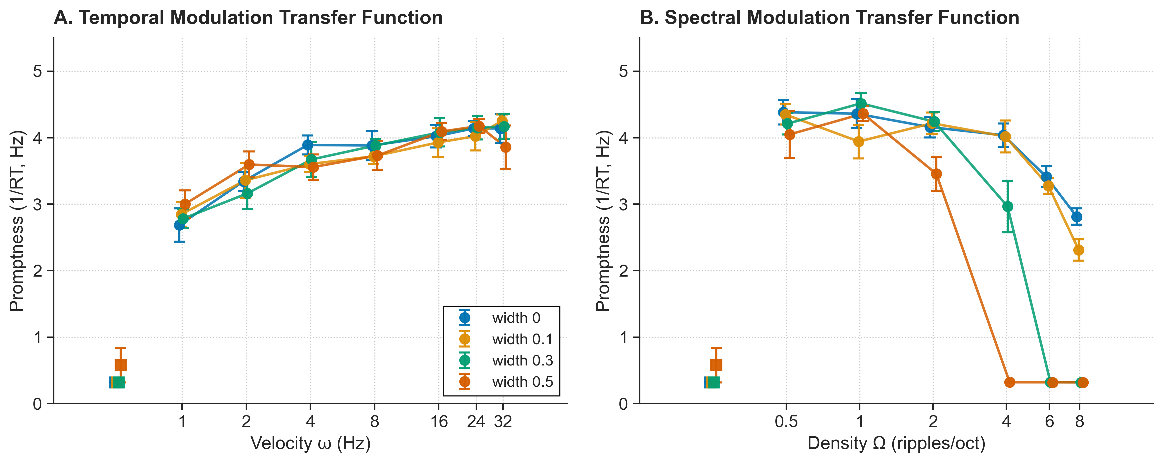
Temporal and spectral MTF
Notes:
“Two panels. tMTF on the left, sMTF on the right.
Pause. “sMTF drops, especially edge frequency . tMTF doesn’t move.”
“The task is sensitive to spectral resolution. Not just general difficulty.”
“This is the mechanistic validation.”
Transition: “Time to thank the people who made this possible — then the contributions, then your questions.”

Slide 26
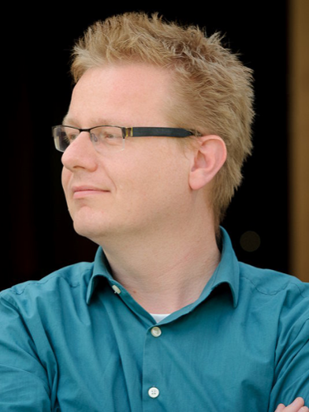
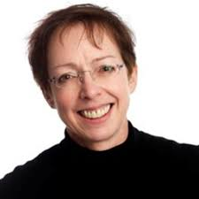
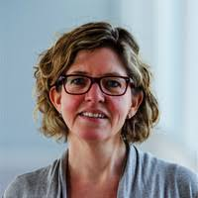
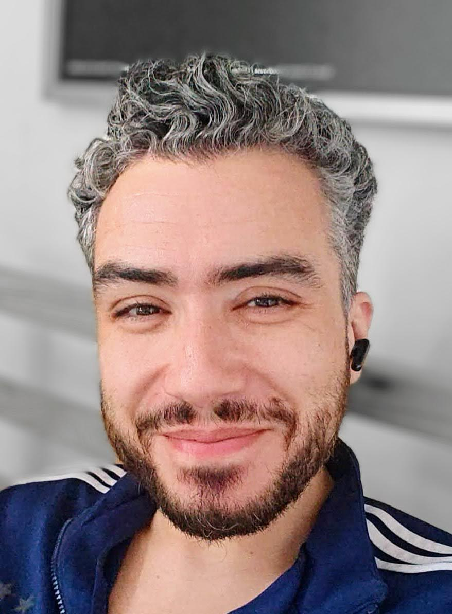
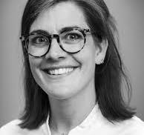
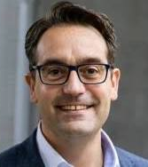
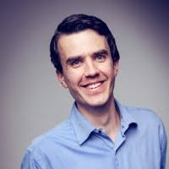
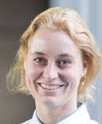
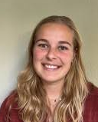
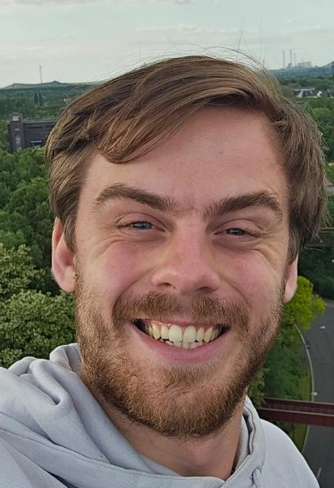
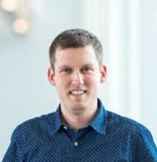
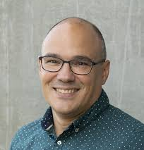
Teamwork makes the dream work
Clinical Otogenetics
Ronald Pennings
Froukje Cals
Cris Lanting
Ilse Feenstra
Jeroen Smits
Marc van Hoof
Molecular Otogenetics
Hannie Kremer
Suzanne de Bruijn
RU Collaborations
DCN Neurophysics
Marc van Wanrooij
John van Opstal
Ignacio Calderon de Palma
DNA Diagnostics Lab
Helger Yntema
Lonneke Haer-Wigman
Ilse de Wijs
Audiology trainees
Bilal bel Hach
Noortje van der Mast
MSc students
Marit van de Craats
Tim van Schaik
Otogenetic Therapy
Erwin van Wijk
Erik de Vrieze
Theo Peters
Jaap Oostrik
Notes:
“Three students did the heavy lifting.”
Specifically credit: “MSc work by Tim van Schaik and Marit van de Craats. Bilal Bel Hach for science training becoming an audiologist. Marc van Wanrooij for the original RT paradigm.”
One sentence about the consortium: “DOOFNL and ERN CRANIO for the patient cohorts.”
Transition: “So what does this mean?”

Slide 27
Teamwork makes the dream work
Clinical Otogenetics
Ronald Pennings
Froukje Cals
Cris Lanting
Ilse Feenstra
Jeroen Smits
Marc van Hoof
Molecular Otogenetics
Hannie Kremer
Suzanne de Bruijn
RU Collaborations
DCN Neurophysics
Marc van Wanrooij
John van Opstal
Ignacio Calderon de Palma
DNA Diagnostics Lab
Helger Yntema
Lonneke Haer-Wigman
Ilse de Wijs
Audiology trainees
Bilal bel Hach
Noortje van der Mast
MSc students
Marit van de Craats
Tim van Schaik
Otogenetic Therapy
Erwin van Wijk
Erik de Vrieze
Theo Peters
Jaap Oostrik

Slide 28
Four contributions; stMTF-RT is a good suprathreshold biomarker
1. Same PTA, different fingerprints: patient with STRC, TECTA and COL11A2 differ in their stMTF, hardly in their audiogram.
2. The spectral edge is the largest contributor to predict speech-in-noise (R² = 0.74).
3. Selective spectral smearing reduces sMTF but not tMTF; the test measures auditory-filter width.
4. The test runs in minutes and works in clinical populations; ready as a trial endpoint.
If future therapies aim to restore hearing, we should not only ask whether thresholds improve, but whether the distortion fingerprint normalizes.
Notes:
“One. Same PTA, different fingerprints.”
“Two. The spectral edge predicts speech-in-noise. R-squared zero point seven four.”
“Three. Selective spectral smearing reduces sMTF, not tMTF. The test measures auditory filter width.”
“Four. Only a few minutes per patient (well chosen sampling of the stMTF space). Works in clinical populations. Ready as a trial endpoint.”
“If future therapies aim to restore hearing, we should not only ask whether thresholds improve — but whether the distortion fingerprint normalizes.”
Pause two seconds. Then the recruiting line:
“If you have a monogenic cohort, talk to me. If you run a trial of an inner-ear therapy, talk to me — we should add this to your endpoints.”

