Slide 1
Guest lecture
Hearing impairment and rehabilitation
Step 1: https://form.typeform.com/to/ViPUA0Ke
Cris Lanting
Klinisch Fysicus-audioloog
Cris.Lanting@radboudumc.nl

Slide 2


Slide 3
Recap and why care?
Sound and signals: sensitivity and range across species
  Do dogs hear better than humans?
The Ear as an Engineering Marvel: Hearing: anatomy, cochlear mechanics, and tonotopy
  Impedance matching
  Role of swings, outer hair cells, and neonatal hearing screening
  Tonotopic mapping of the cochlea
When Things Go Wrong
  Hearing impairment: from damaged hair cells to neural coding deficits
  Measuring hearing (audiogram, otoacoustic emissions, RT, many more)
  Cochlear implants: exploiting the tonotopic map to restore hearing

Slide 4
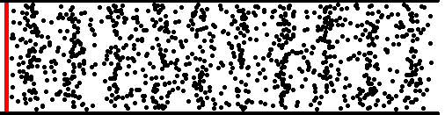
Sound
Sound is a pressure wave: a sound source causes a periodic increase (condensation) and decrease (rarefaction) of the pressure at a given time and place. The ear pick it up and ultimately converts movement into action potentials which then cause perception of sound
condensation
rarefaction
http://www.acs.psu.edu/drussell/Demos/waves/wavemotion.html

Slide 5
Sound pressure levels & decibel (dB)
Decibel sound pressure level (dB SPL): de change in pressure (p) of a sound source re atmospheric pressure (p₀).
  Doubling + 6dB
  x10 +20 dB
Fraction (p/p₀) | dB
2 | 6
10 | 20
100 | 40
1000 | 60
10000 | 80
etc

Slide 6
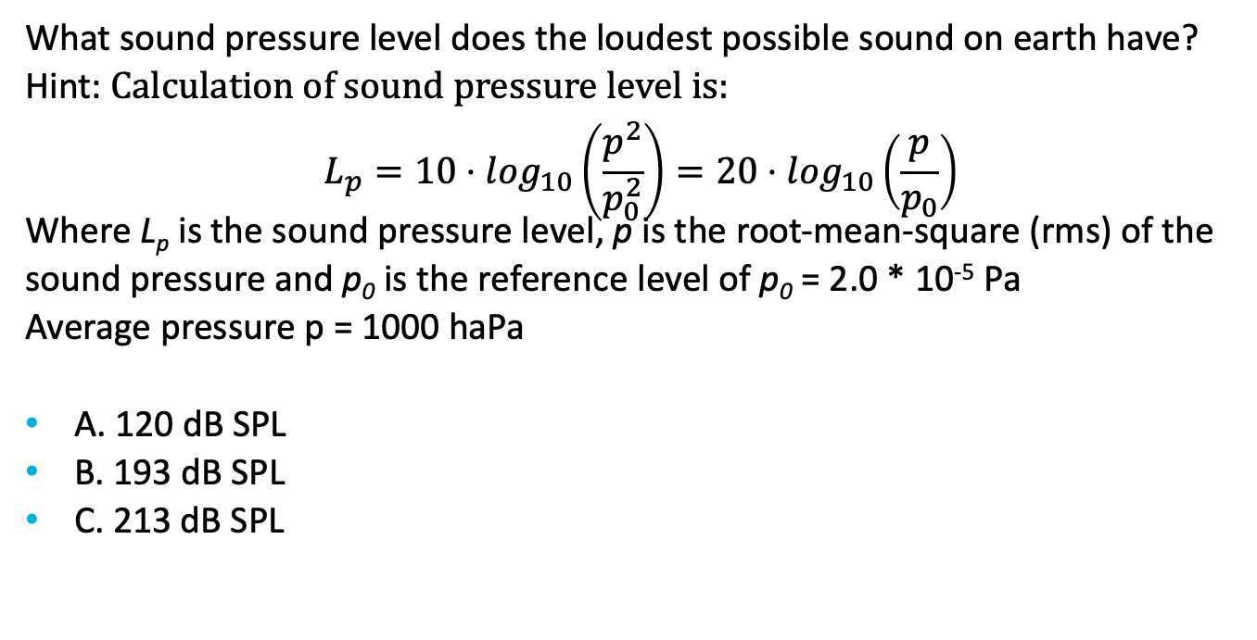
Question 1
What sound pressure level does the loudest possible sound on earth have?
Hint: Calculation of sound pressure level is:
$$L_{p}=10⋅\log_{10}\left(\frac{p^{2}}{p_{0}^{2}}\right)=20⋅\log_{10}\left(\frac{p}{p_{0}}\right)$$
Where L_{p} is the sound pressure level, p is the root-mean-square (rms) of the sound pressure and p₀ is the reference level of p₀ = 2.0 * 10⁻⁵ Pa
Average pressure p = 1000 haPa
A. 120 dB SPL
B. 193 dB SPL
C. 213 dB SPL

Slide 7
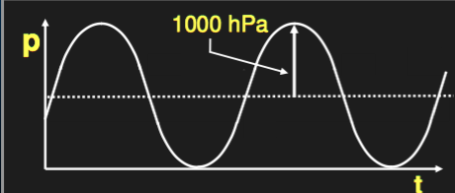



Q: Loudest sound possible?
RMS value
$$p= \frac{p_{max}}{\sqrt{2}}=\frac{1000 hPa}{\sqrt{2}}=7.07 ⋅{10}^{4} Pa$$
$$L_{p}=10⋅\log_{10}\left(\frac{p^{2}}{p_{0}^{2}}\right)=20⋅\log_{10}\left(\frac{p}{p_{0}}\right)$$
$$L_{p,max}=20⋅\log_{10}\left(\frac{p}{p_{0}}\right)=193 dB SPL$$

Slide 8
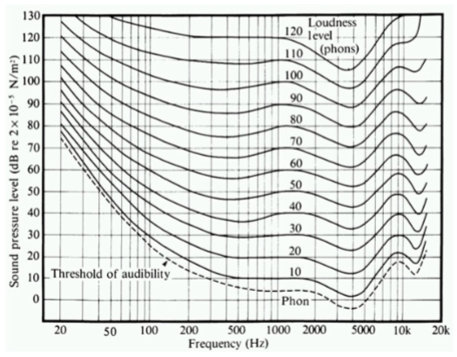
Hearing level & equal-loudness curves
dB SPL
-> Physical quantity
dB Hearing level (HL) -> perception
0 dB HL = hearing threshold

Slide 9
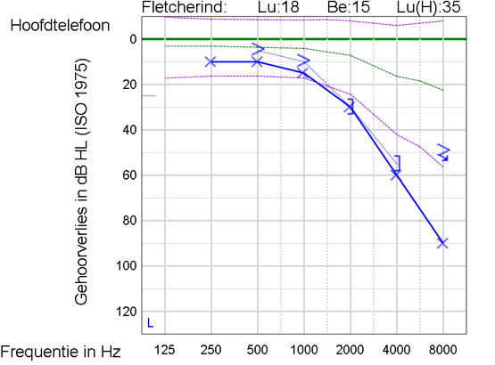

Slide 10
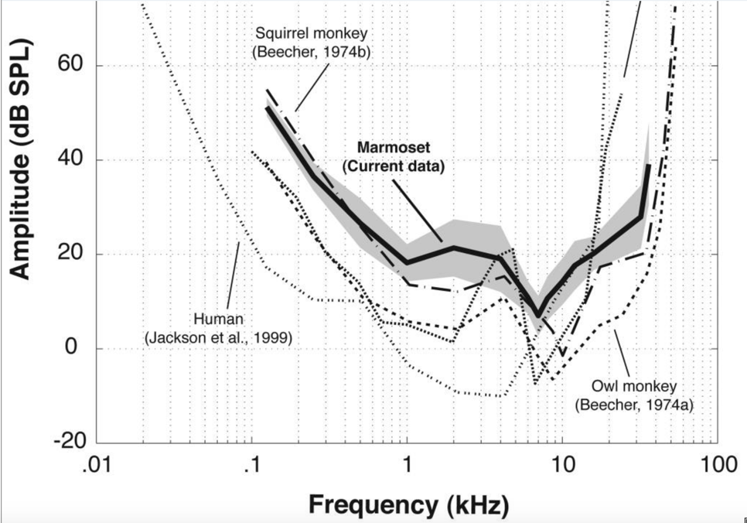
sensitivity: thresholds across species
Osmanski, M.S., Wang, X., 2011. Measurement of absolute auditory thresholds in the common marmoset (Callithrix jacchus).
Hearing Research 277, 127–133. https://doi.org/10.1016/j.heares.2011.02.001

Slide 11
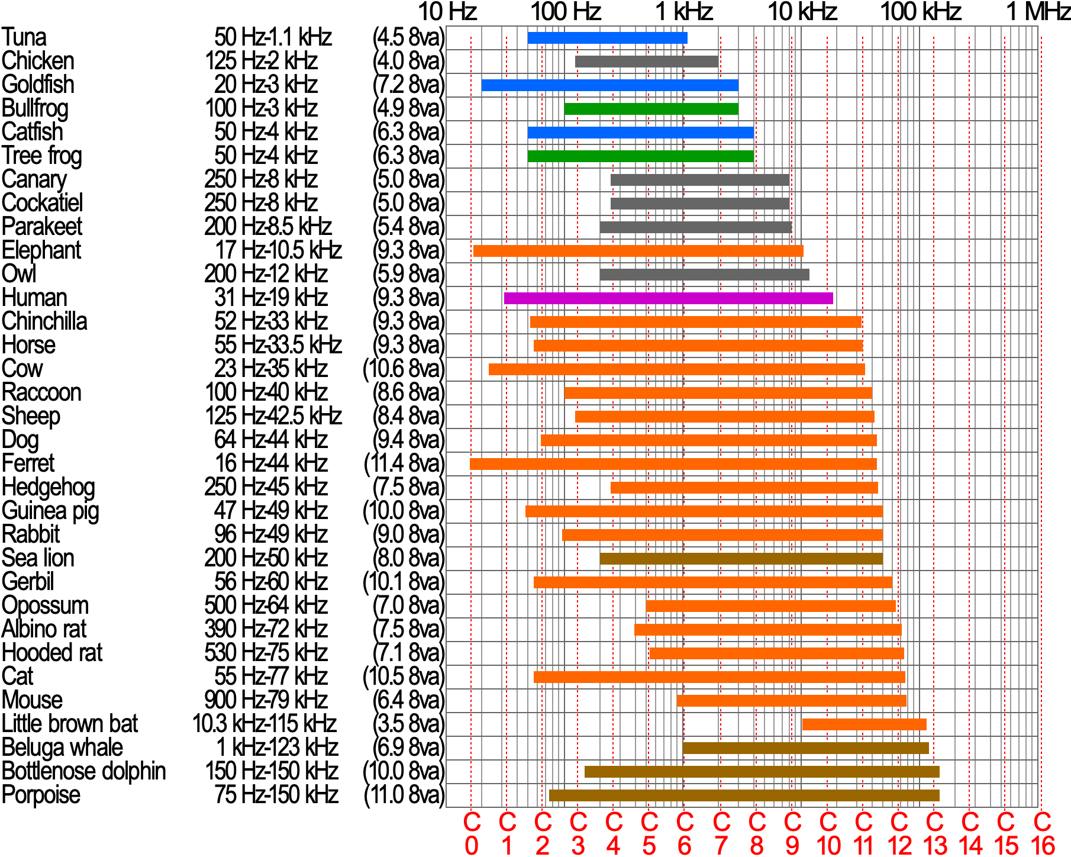
Sensitivity: range of frequencies
ultrasoon
infrasoon

Slide 12
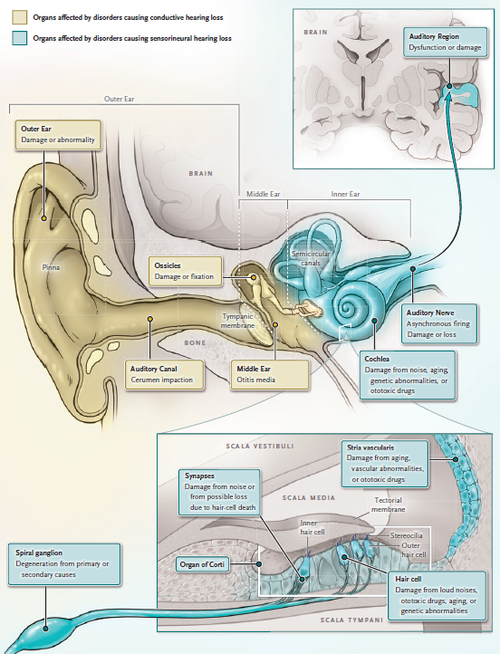
Anatomy
Three parts:
Outer,
Middle, and
Inner ear
Outer ear
‘shapen’ of sound for vertical localization
Cunningham en Tucci, 2017, N ENGL J MED

Slide 13
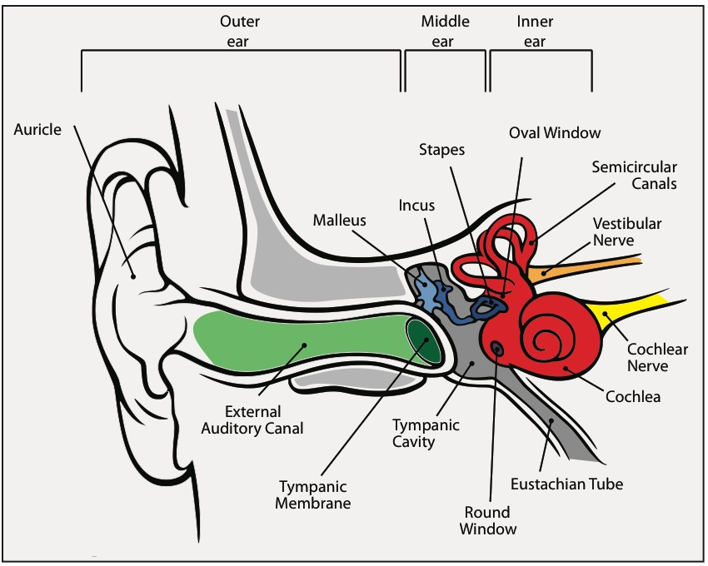

Slide 14
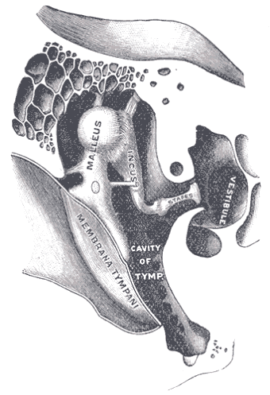
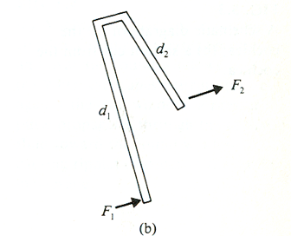
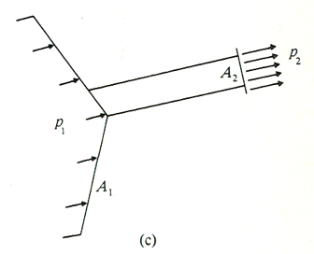
Function of the middle ear
Efficient coupling between air and liquid-filled inner ear by:
Lever action of the ossicular chain (moment coupling; product arm length × force)
→ mechanical gain ≈ 1.3× (~+2 dB)
Area ratio between the tympanic membrane and the oval window
→ mechanical gain ≈ 17× (~+25 dB)
Curved/concave shape of the tympanic membrane (buckling motion)
→ mechanical gain ≈ 2× (~+6 dB)
Overall middle ear transfer gain (combined effects): mechanical gain ≈ 44× (~+33 dB)
Pickles, J.O. (2013). An Introduction to the Physiology of Hearing (4th ed.). Bingley: Emerald Group Publishing.

Slide 15
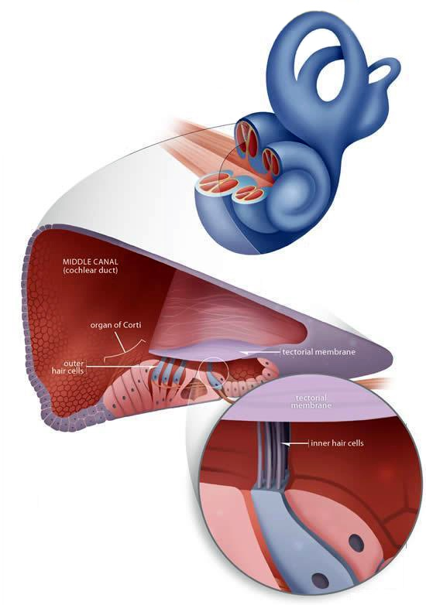
Cochlea
Rask-Andersen et al., (2012). Anatomical Record, 295(11), 1791–1811.

Slide 16
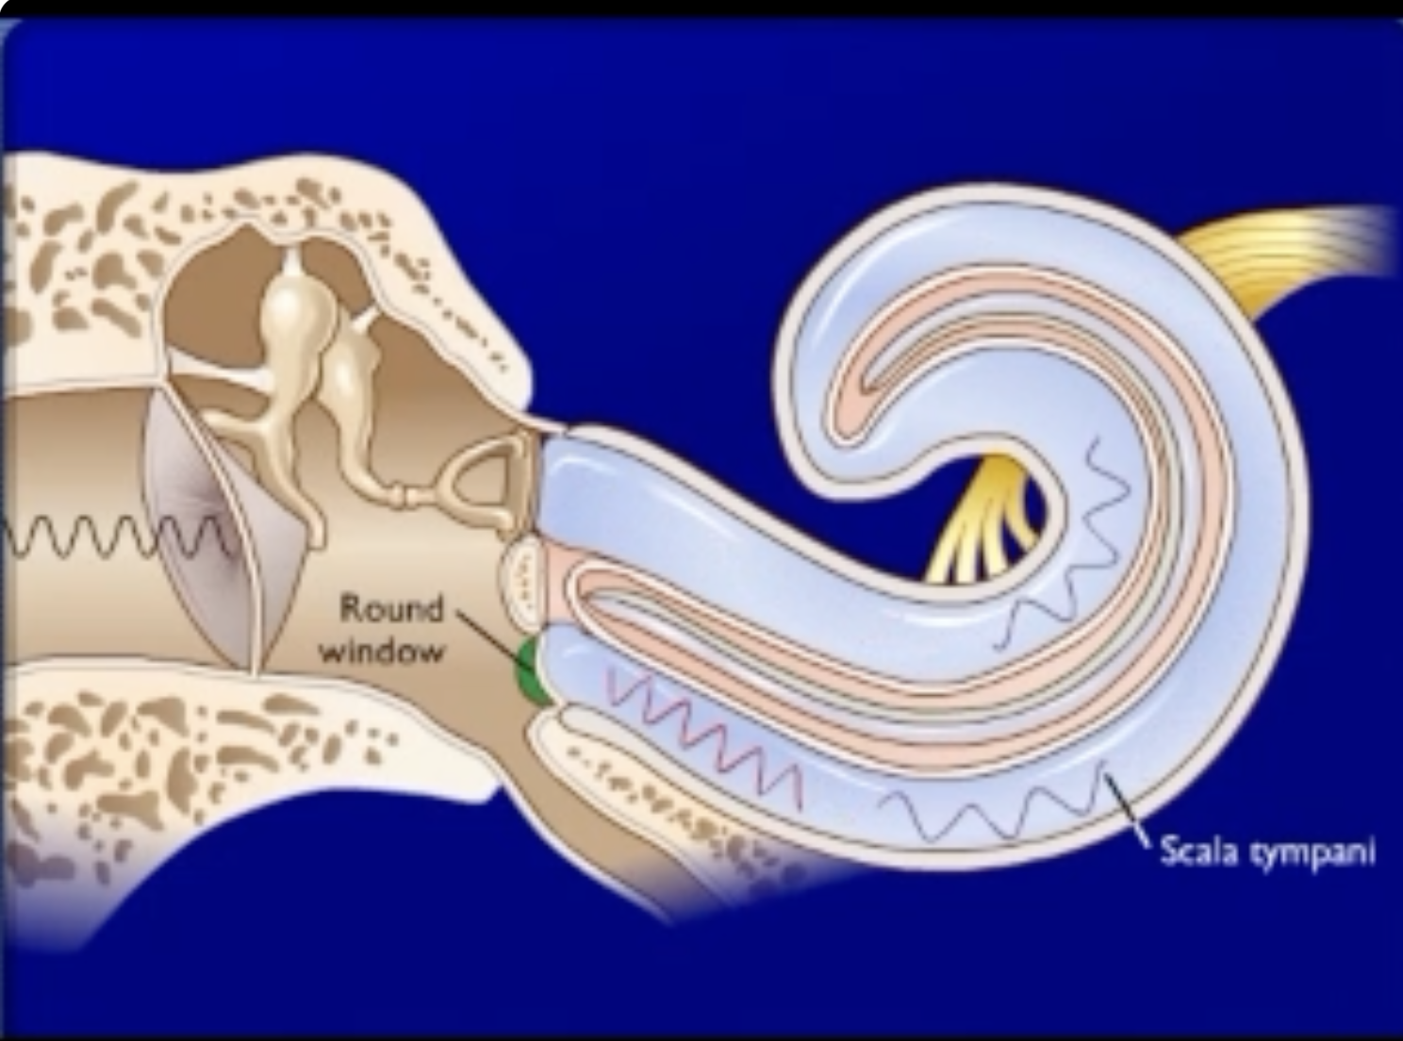
Pathway of sound

Slide 17
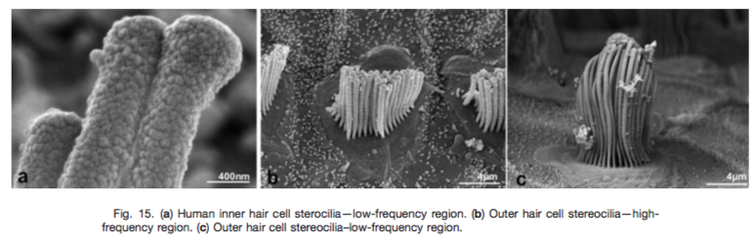
Orgaan van Corti
Inner Hair Cells (IHCs)
Mechanotransduction – deflection of stereocilia opens mechano-electrical transducer channels, causing K⁺/Ca²⁺ influx, depolarization, and glutamate release onto auditory nerve fibers → action potentials.
Outer Hair Cells (OHCs)
Cochlear amplification – electromotility (via prestin) generates mechanical energy that is fed back to the basilar membrane, enhancing motion and sensitivity.
Sharpening of tuning – enhances frequency selectivity and resolution.
Notes:
– convert basilar membrane motion into receptor potentials by opening mechanically gated ion channels in their stereocilia.

Slide 18
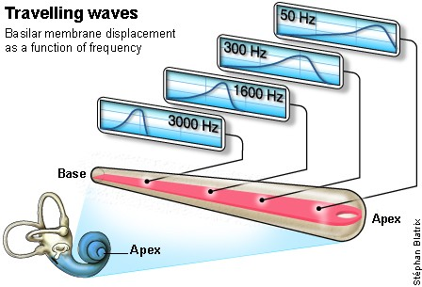
Tonotopy
Notes:
http://www.cochlea.eu/en/cochlea/function

Slide 19
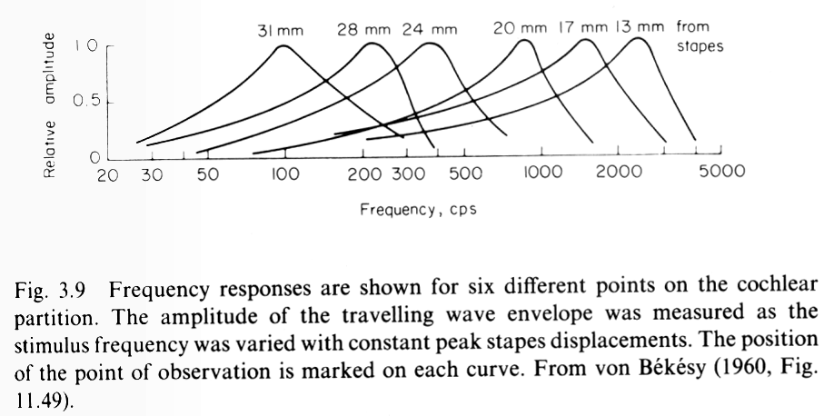
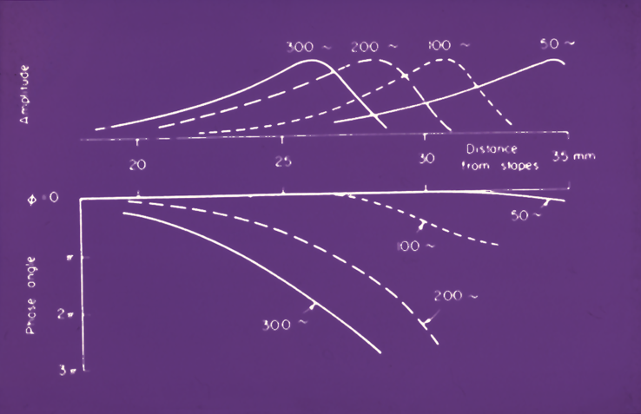
Von Bekesy (1960)

Slide 20
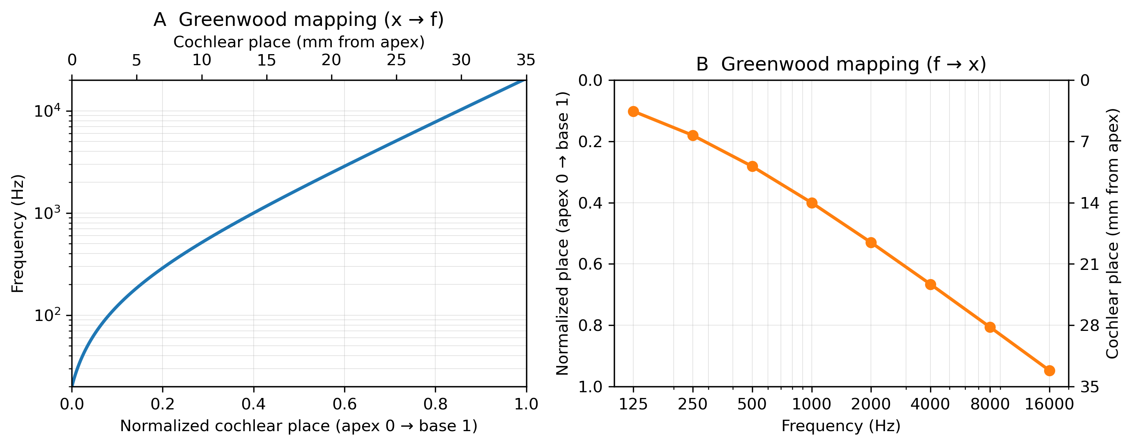
Greenwood formalization of von Bekesy’s findings

Slide 21
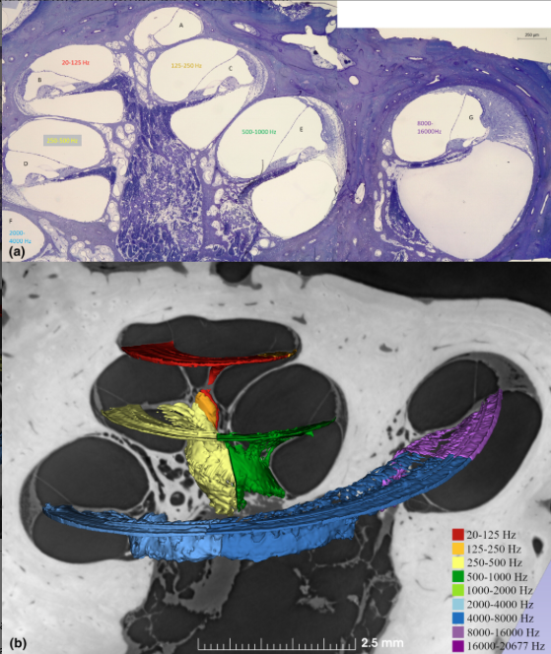
(a) Mid-modiolar cross-section of an archival human cochlea (~1 μm semi-thin section, osmium/toluidine blue staining, specimen1). The OCs are magnified in Figure 2. (b) SR-PCI and 3D reconstruction of a matched cochlea with delineated octave bands constructed from Greenwood's formula (Greenwood, 1961). Insets show the appraised frequency map.
Giese, Dina, Hao Li, Wei Liu, Karin Staxäng, Monika Hodik, Hanif M. Ladak, Sumit Agrawal, Anneliese Schrott-Fischer, Rudolf Glueckert, and Helge Rask-Andersen. 2024. “Microanatomy of the Human Tunnel of Corti Structures and Cochlear Partition-Tonotopic Variations and Transcellular Signaling.” Journal of Anatomy 245(2):271–88. doi:10.1111/joa.14045.

Slide 22
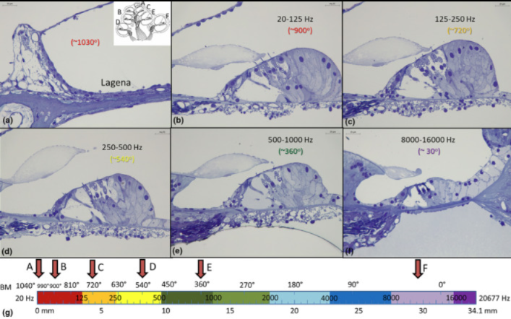
Giese, Dina, Hao Li, Wei Liu, Karin Staxäng, Monika Hodik, Hanif M. Ladak, Sumit Agrawal, Anneliese Schrott-Fischer, Rudolf Glueckert, and Helge Rask-Andersen. 2024. “Microanatomy of the Human Tunnel of Corti Structures and Cochlear Partition-Tonotopic Variations and Transcellular Signaling.” Journal of Anatomy 245(2):271–88. doi:10.1111/joa.14045.

Slide 23
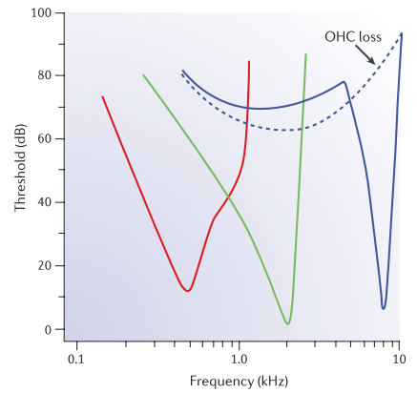
Role of the outer hair cells (OHCs)
Outer Hair Cell Active Process
Frequency-specific amplification – boosts basilar membrane motion near the characteristic frequency.
Improved sensitivity – lowers hearing thresholds.
Enhanced frequency selectivity – sharpens cochlear tuning (Q10).
By-product: otoacoustic emissions (OAEs) – sound energy emitted back into the ear canal.
Fettiplace & Hackney (2006). Nature Reviews Neuroscience

Slide 24
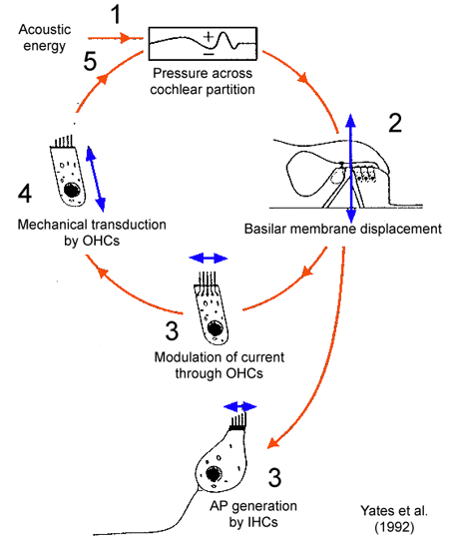
OHCs and IHCs
Stebbins et al., Am J Otolaryngol. 1979 Fall;1(1):15-27.
Notes:
Source(s):
http://www.d.umn.edu/~jfitzake/Lectures/UndergradPharmacy/SensoryPhysiology/Audition/OHCFunction.html
See also: http://www.d.umn.edu/~jfitzake/Lectures/DMED/InnerEar/CochlearPhysiology/ActiveProcess.html
PM (oktober 2025) Site (www.d.umn.edu) is down
this is still online: https://www2.tulane.edu/~h0Ward/BrLg/AuditoryTransduction.html

Slide 25
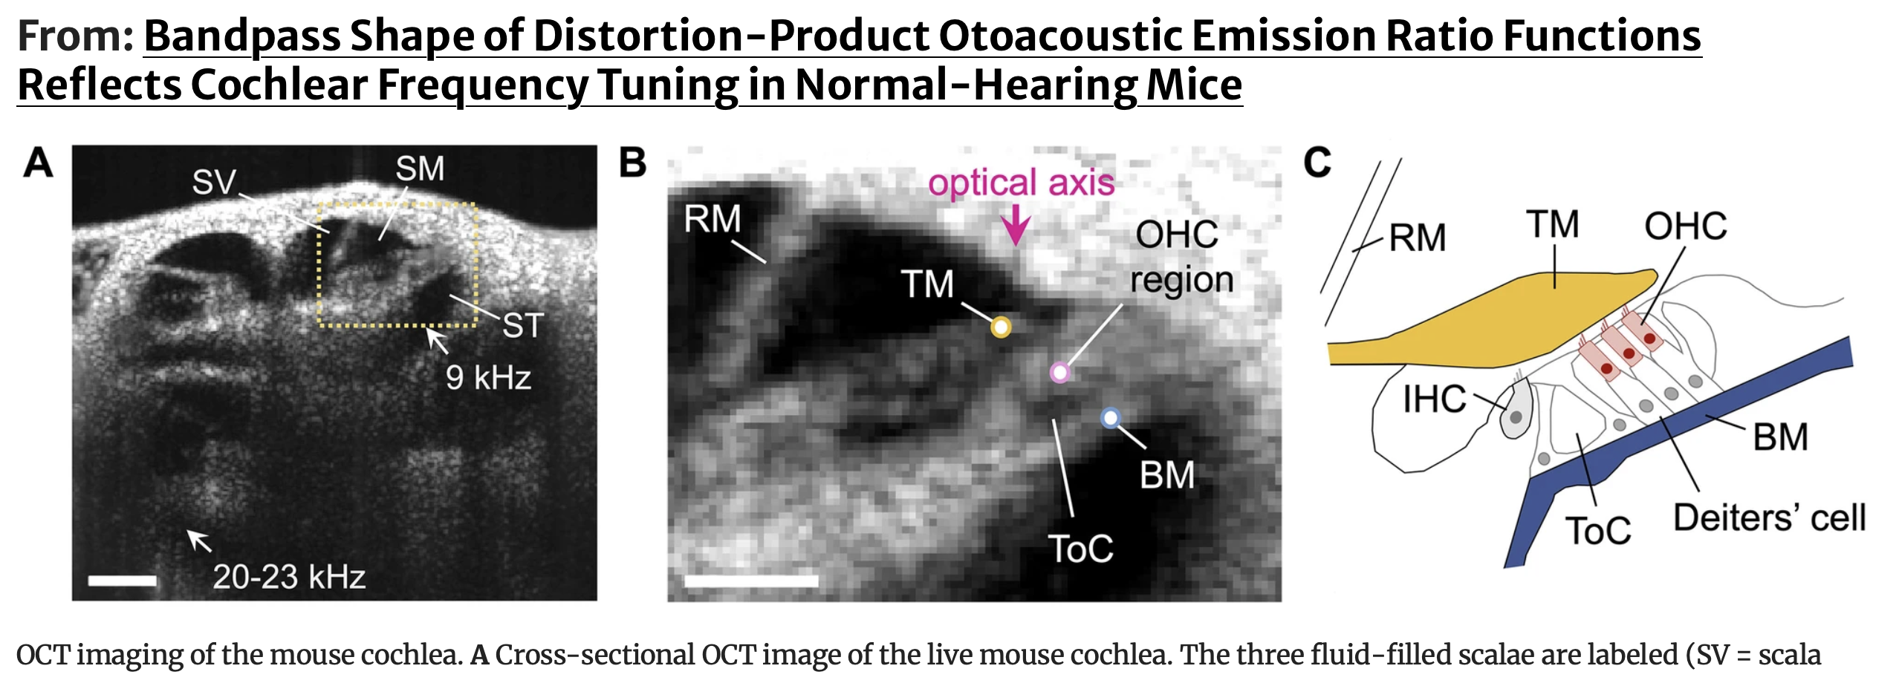
OHC tuning & OCT data
Dewey, James B., and Christopher A. Shera. 2023. “Bandpass Shape of Distortion-Product Otoacoustic Emission Ratio Functions Reflects Cochlear Frequency Tuning in Normal-Hearing Mice.” Journal of the Association for Research in Otolaryngology 24(3):305–24. doi:10.1007/s10162-023-00892-4.

Slide 26
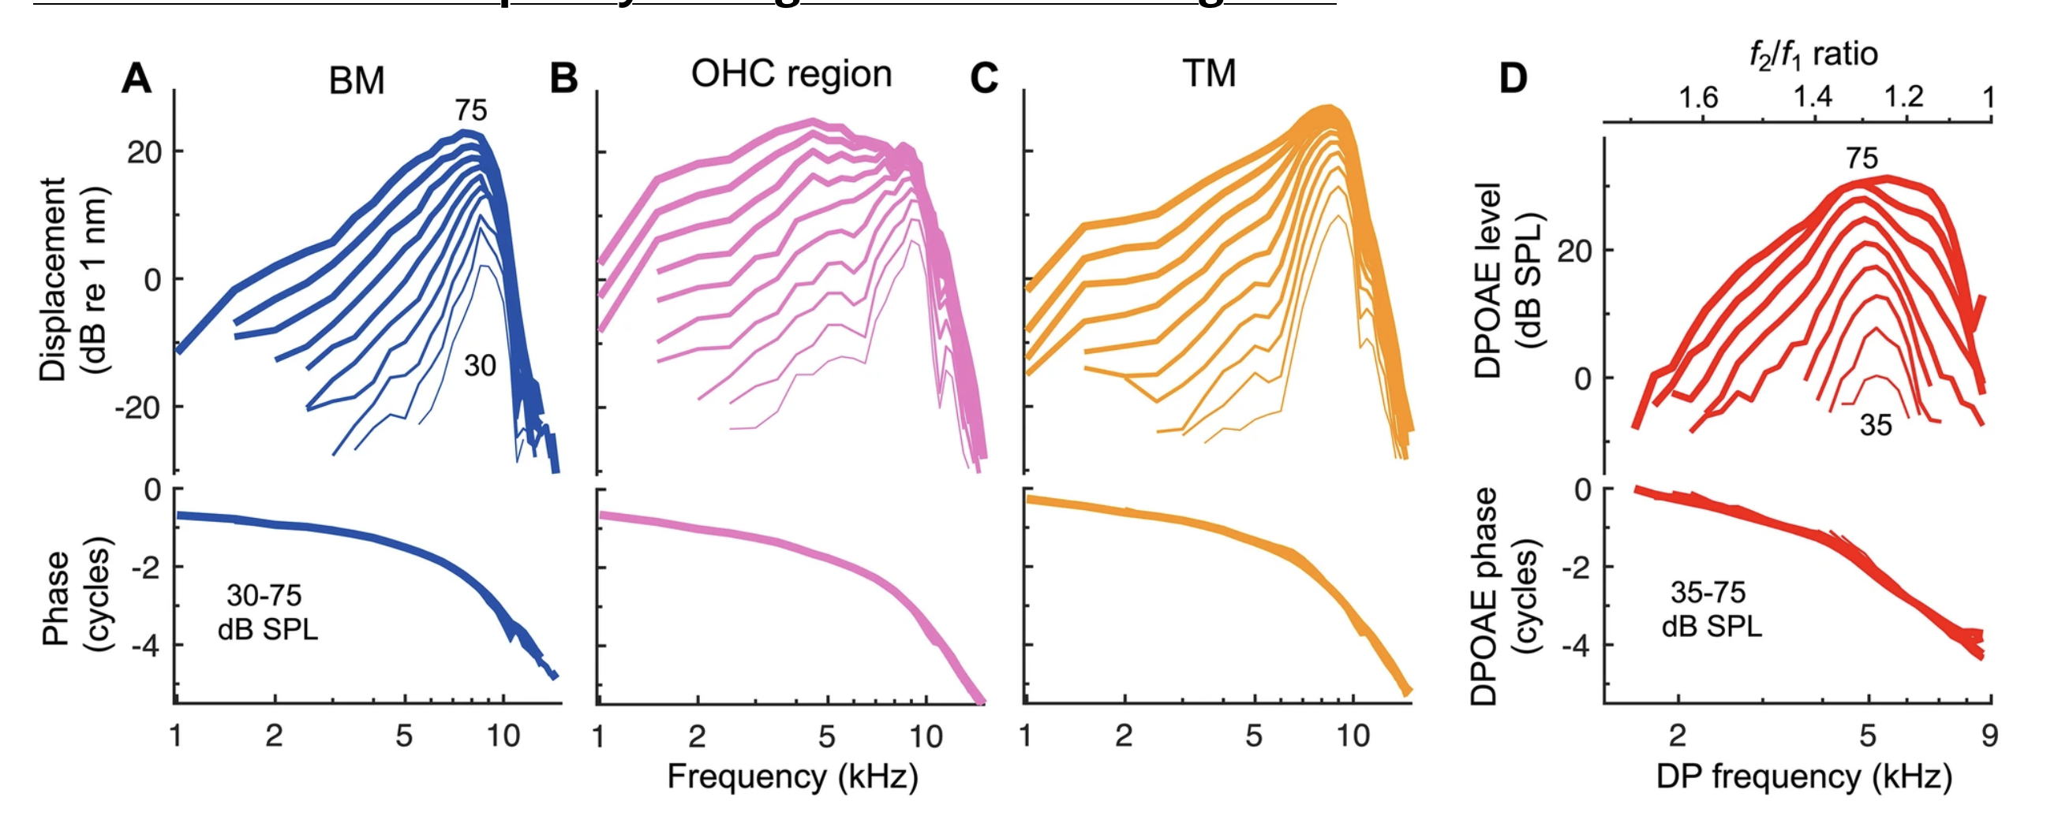
OHC tuning & OCT data
Sharp tuning observed at the BM, TM and DPOAE; OHC more wide at higher levels

Slide 27
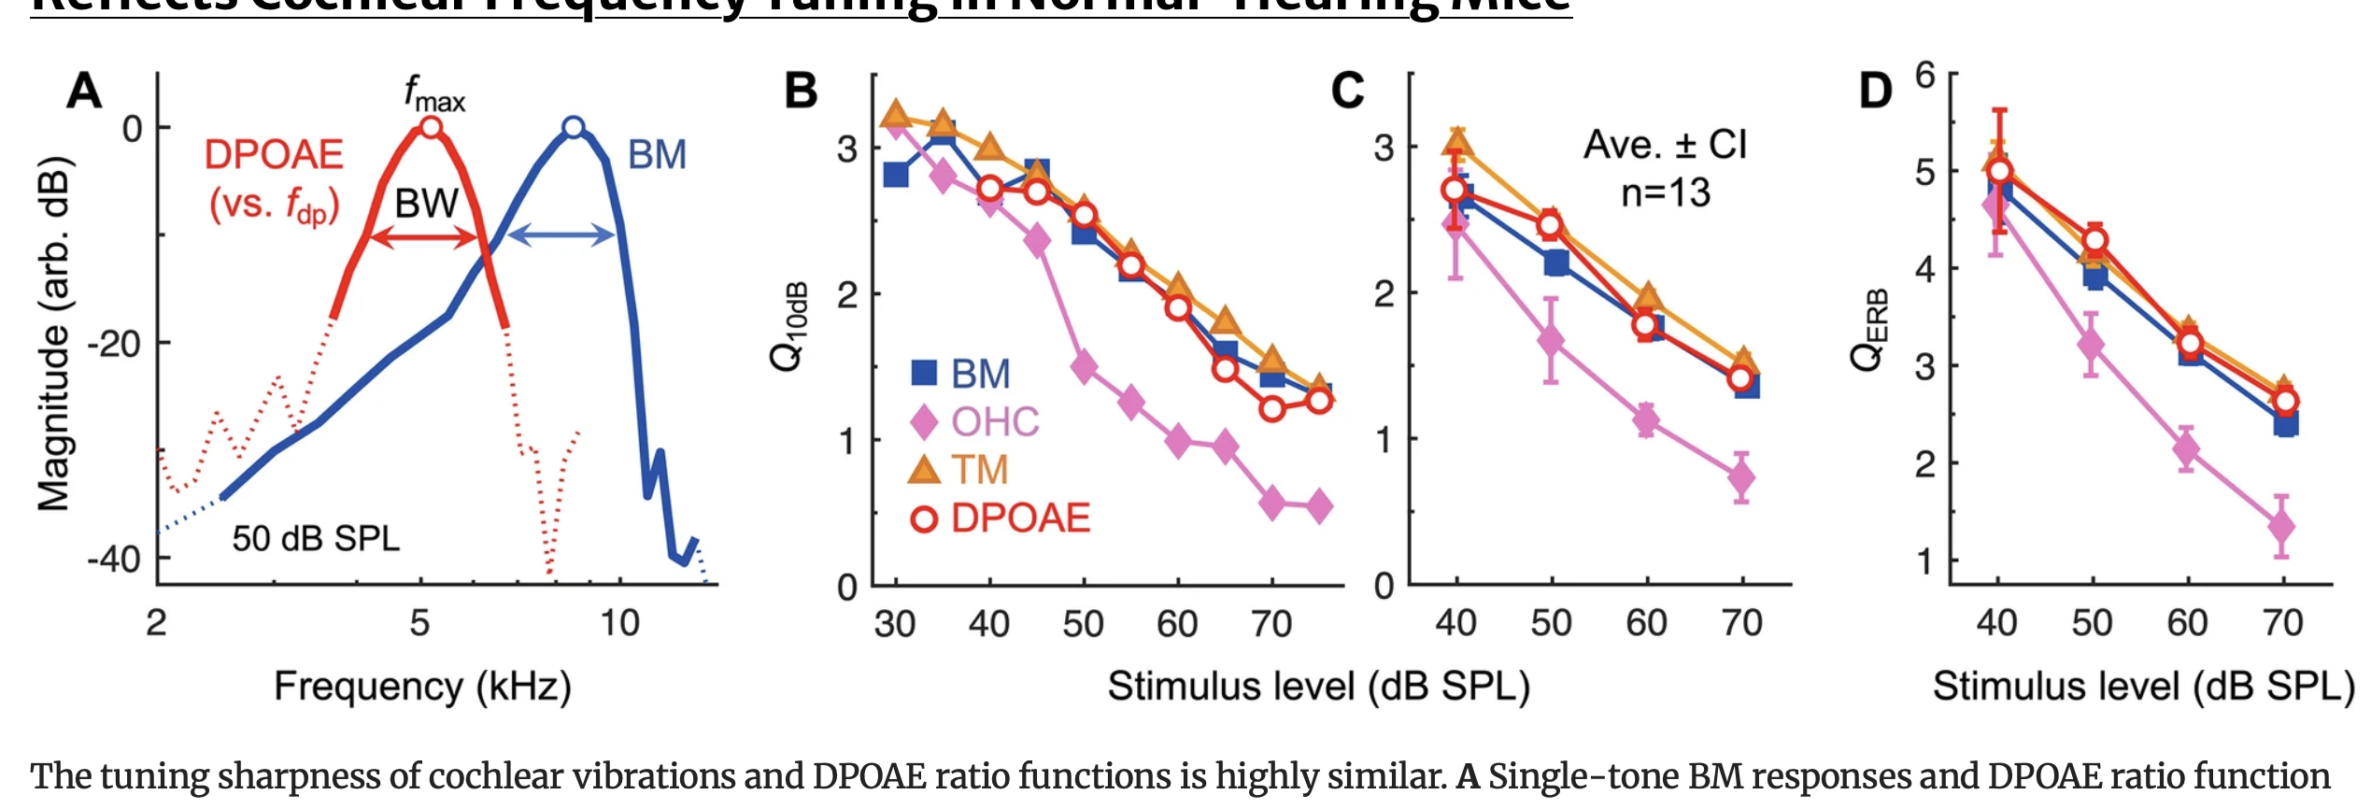
OHC tuning & compression
OHC filtering more wide at lower intensities:
Compression at CF/more linear off-frequency: wider tuning
OHC receptor potential is low-pass filtered (membrane RC)

Slide 28
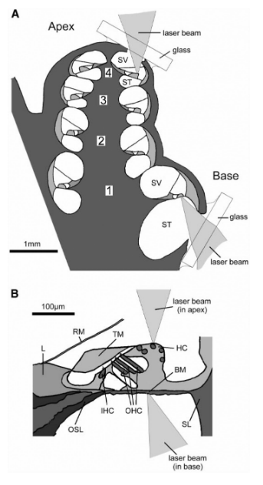
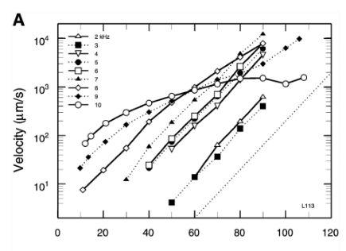
OHCs
Compressive @ CF (@10kHz)
Linear at f << CF
Robles, L., and M. A. Ruggero. 2001. “Mechanics of the Mammalian Cochlea.” Physiological Reviews 81(3):1305–52. doi:10.1152/physrev.2001.81.3.1305.

Slide 29
OHC and BM movement
OHC active gain: Outer hair cells boost basilar-membrane motion by ~40–60 dB at low levels, then saturate with level → high sensitivity at threshold but compressive growth near CF.
Sharp but level-dependent tuning: BM/TM responses are sharply tuned at low level and broaden with level; OHC region is broader still due to low-pass filtering of receptor potentials.
Compression builds up spatially: Nonlinearity isn’t purely local; weakly nonlinear elements accumulate along the cochlea, producing the observed strong compression. (Kondylidis et al.)
DPOAEs reflect tuning: Band-pass DPOAE ratio functions (optimal f₂/f₁ ≈ 1.3 at 9 kHz, ≈ 1.1 at 20 kHz) closely track BM/TM sharpness.
Band-pass mechanism: Shaped mainly by spatial wave interference of distortion products, not by local resonance or suppression.
Robles & Ruggero; Yates; Stebbins; Dewey & Shera; Kondylidis et al.

Slide 30
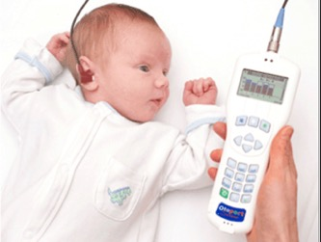
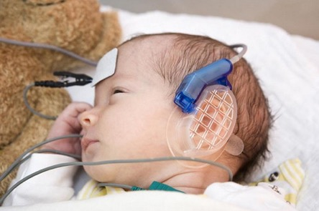
Neonatal Hearing Screening (NHS)
NHS organised by VWS/RIVM
Measurments of otoacoustic emissions (OAEs) combined with ‘hielprik’
  Integrity outer hair cells (pass/refer)
  No emissions: referral to audiological center (AC)
    repeat OAE
    ABR
    Tympanometry; examine the motility of the tympanic membrane
  Link screening: https://www.youtube.com/watch?v=gpZE12mal1k

Slide 31
Consequences of HL: why measure?
Question: Suppose a child has a mild hearing loss (soft speech just barely inaudible) and this is only identified after 6 months; what effect does this have on language scores?
A No effect (score 100 on verbal IQ)
B Small effect (score 85-100)
C Large effect (score <85, more than 1 SD lower)
And what about severe hearing loss then?

Slide 32
Purpose: communication skills!
average NH
    Identificatie SH:
    - tot 6 maanden - vanaf 6 maanden
Take home message: it is important to screen for HL as is has profound effects on language development!
Downs Yoshinaga-Itano, 1999

Slide 33
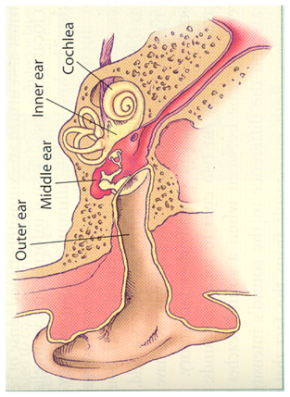
Audiological
tests
(Spraak) Audiogram
Brainstem / BERA/ASSR
Otoakoestische Emissies
Tymponometrie

Slide 34
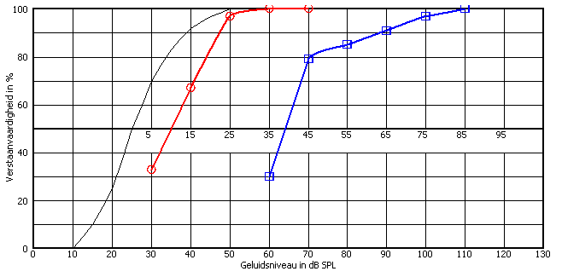
Overview of tests
Tympanometry
Otoacoustic emissoins (OAEs)
Brain evoked response audiometry (BERA)
Auditory Steady State Repsonses (ASSR)
Pure tone audiometry
Speech audiometry

Slide 35
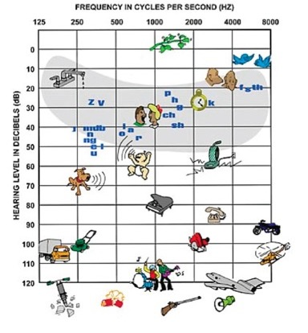
Pure tone audiogram
Normal hearing
Hearing aid criterium (avg. 35 dB @ 1,2 en 4 kHz)
“Deaf”
Pain

Slide 36
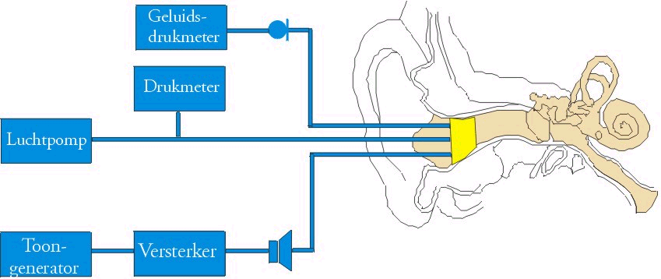
Tympanometry

Slide 37
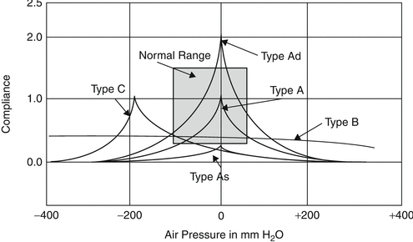
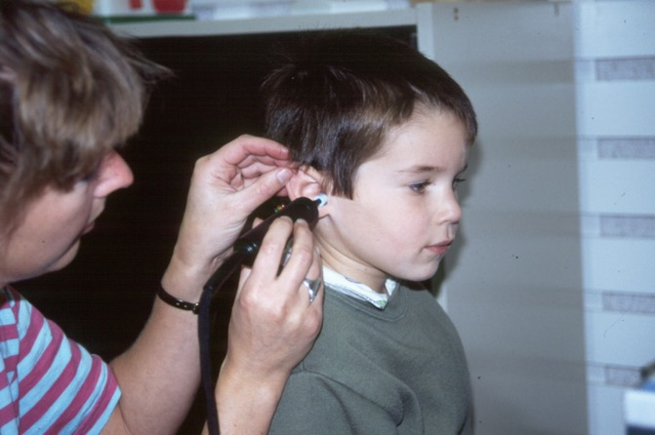
Tympanogram

Slide 38
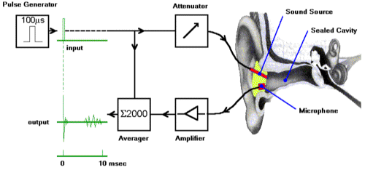
Otoacoustic emissions

Slide 39
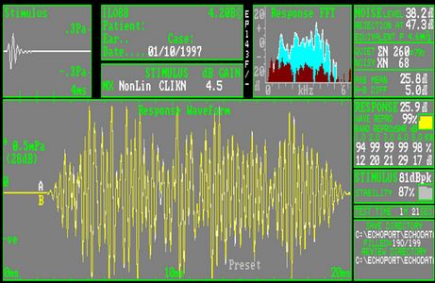
OAEs

Slide 40
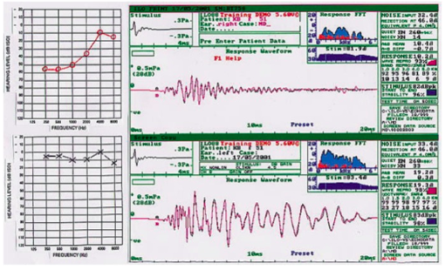
Example: OAE & Ménière’s disease
Golfpatroon ~ toonhoogte

Slide 41
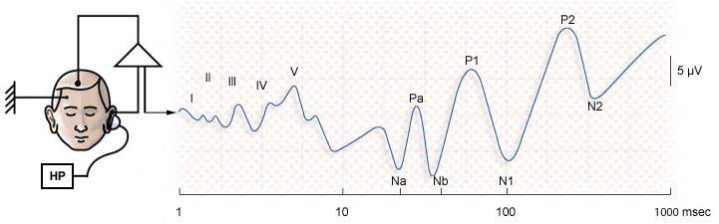
Brainstem Evoked Response Audiometry (BERA)

Slide 42
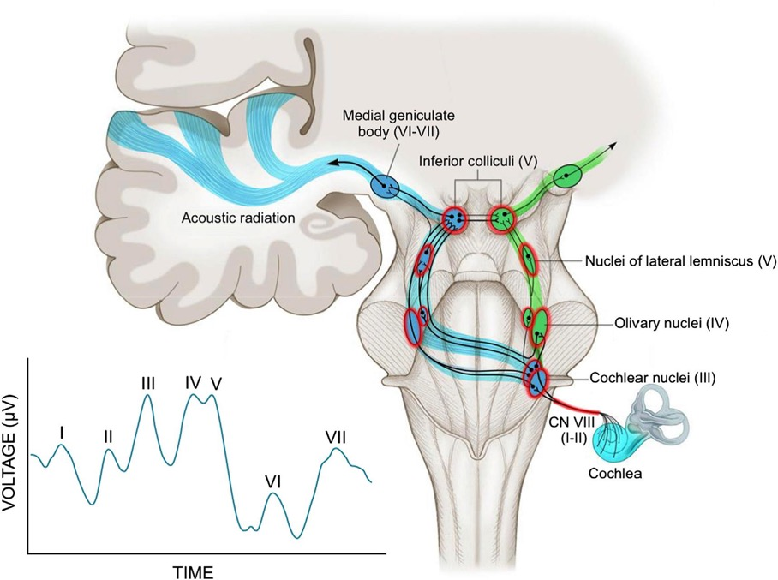
BERA – contribution of different sources in the brainstem

Slide 43
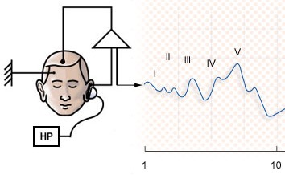
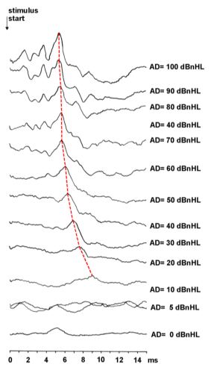

Slide 44

Hearing loss configuration
Vraag 3
  Wat voor soort gehoorverlies is dit?
  A Geen idee
  B Lage tonen conductief verlies
  C Lage tonen perceptief verlies
  D Hoge tonen conductief verlies
  E Hoge tonen perceptief verlies

Slide 45
Spraakaudiometrie: varianten
1
2
3
4
1 – normaal
2 – conductief gehoorverlies
3 – cochleair gehoorverlies
4 – retro-cochleair gehoorverlies

Slide 46
Toonaudiogram
x
x
x
x
x
x

Slide 47
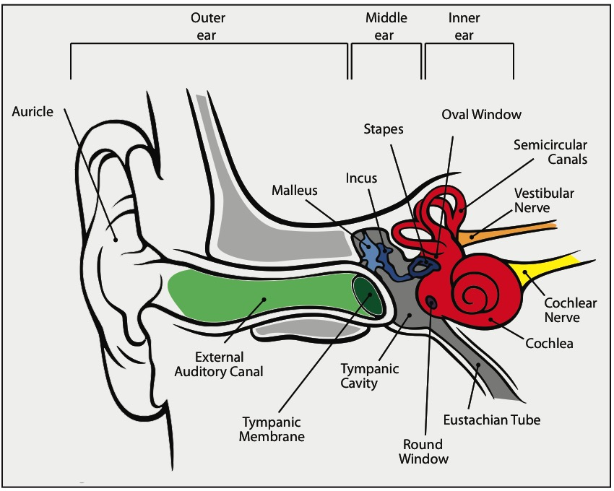
Difference conductive and sensorineural HL
HEARING & GENES
Conductive HL
  Ear canal
  Tympanic membrane
  Middle ear cavity
  Middle ear ossicles
Sensorineural HL
  Cochlea
  Auditory nerve
  Cortical problem

Slide 48
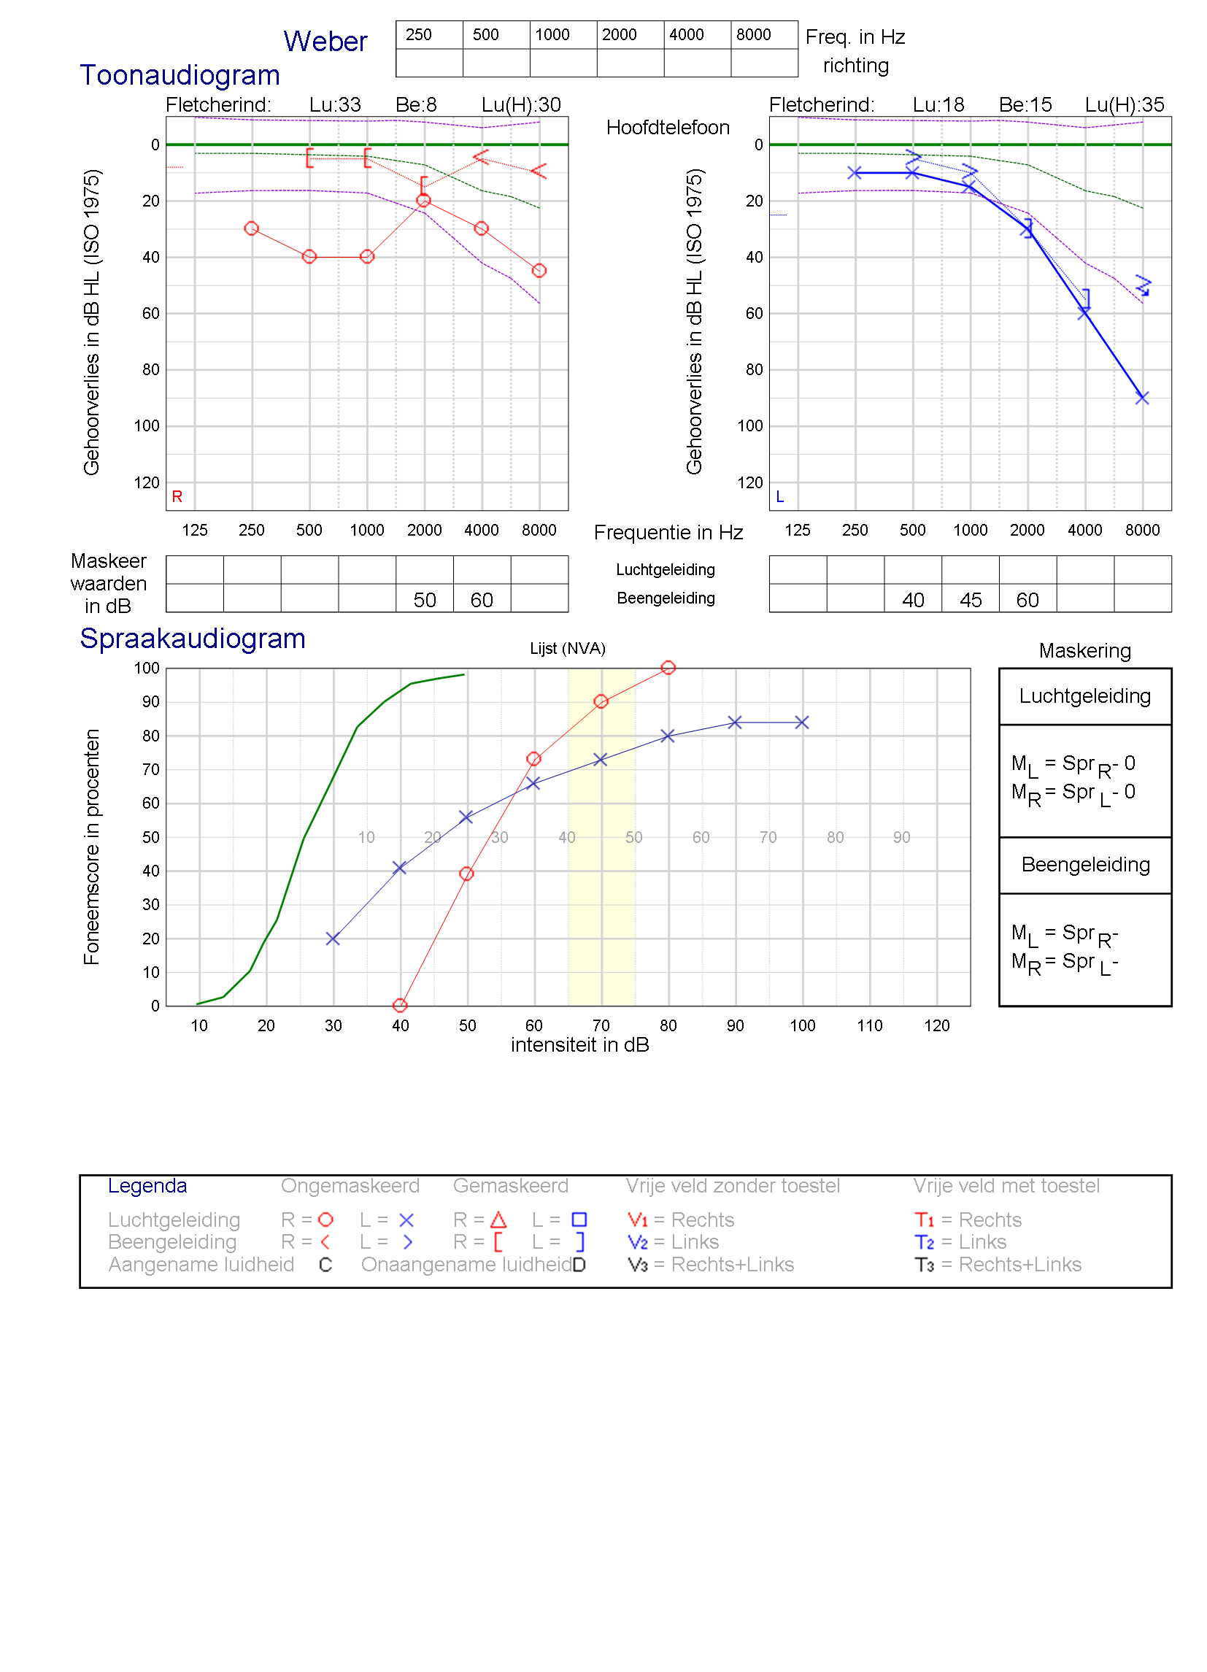
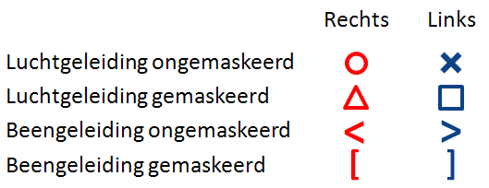
Pure tone audiogram
Fletcher index: average threshold @ 500, 1000 & 2000 Hz
FI air-conduction
FI bone conduction
Average airconduction threshold @ @1000, 2000 & 4000 Hz “Fletcher High”
Bone condution threshold of 10 dB HL @ 1000 Hz
Threshold worse than 50 dB @ 8 kHz
Air-conduction threshold of 90 dB @ 8 kHz
Ear (L/R)

Slide 49
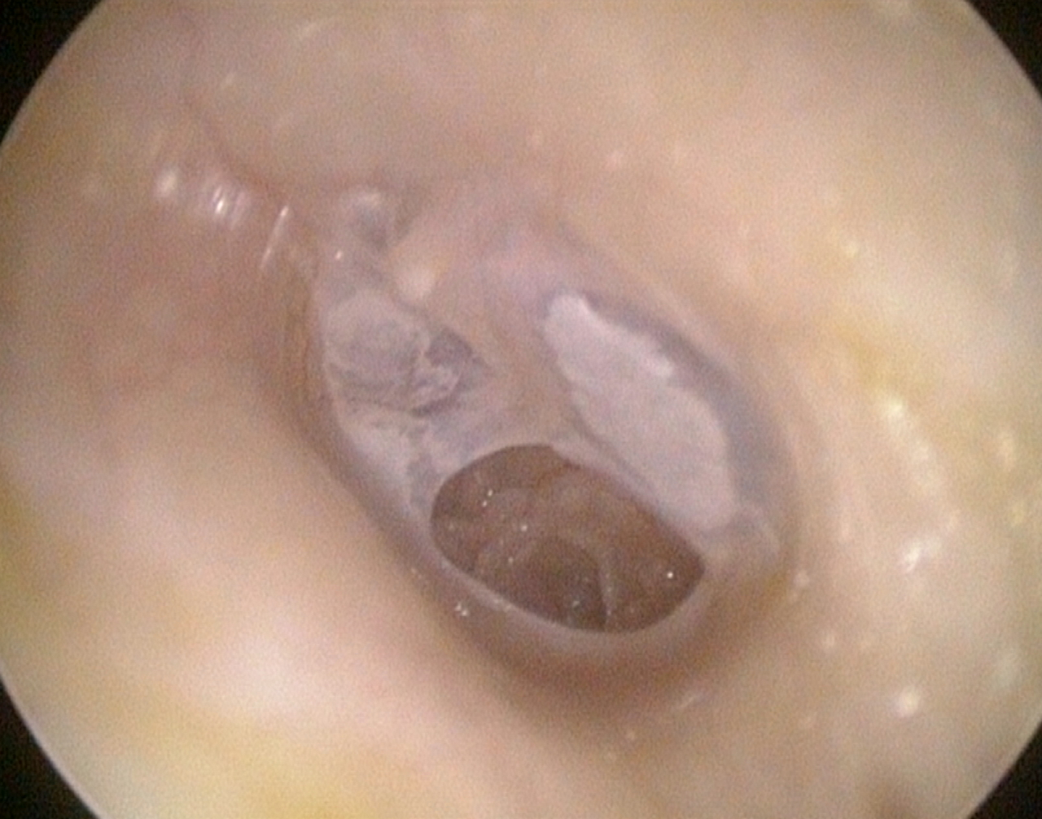
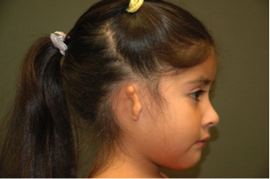
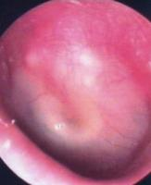
Conductive HL
Damage to tympanic membrane
Occlusion of the ear canal
Otitis Media (fluid in middle ear)
Otosclerosis (calcification of ossicles)

Slide 50
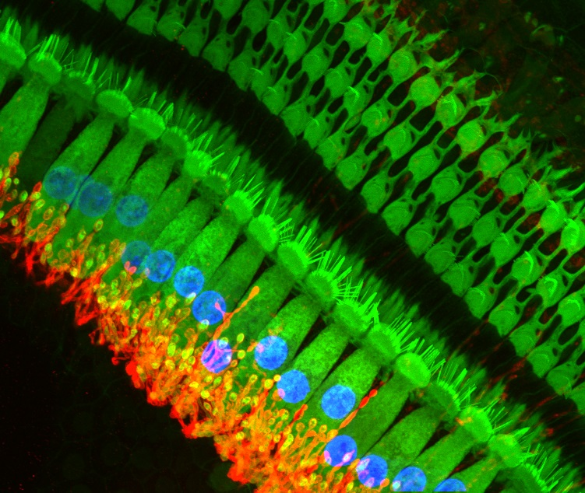
Hair cells and cell bodies confocal microscopy
Green:
Hair cells
Red: spiral ganglion cell bodies
Blue: cell bodies
Notes:
Source:
The vertebrate cochlea is responsible for transducing a mechanical stimulus, sound, into a synaptic signal that is relayed via the spiral ganglion cells to the brain. The auditory hair cells are the specialized sensory cells that mediate transduction. They do this by virtue of their specialized morphology, with actin-rich stereocilia that are sensitive to mechanical perturbation on their apical pole and robust innervation from the spiral ganglion cells on their basal pole. This micrograph uses confocal microscopy to visualize these essential components in the pathway of sound transduction in the rat cochlea. Hair cells (green) are labeled using a combination of fluorescently conjugated phalloidin (marking the actin-rich stereocilia) and an antibody against calretinin (a cytosolic calcium buffer enriched in the cytoplasm of sensory hair cells) to label the stereocilia and cell bodies. The afferent processes of the spiral ganglion cell bodies (red) are labeled using an antibody against a transporter, the Na,K-ATPase α3, enriched in the membrane of these processes. Each hair cell is approximately 10 µm wide.
Sonja Pyott; http://thepyottlab.com/

Slide 51




Sensorineural HL
Damage to hair cells due to
  innate vulnerability,
  noise,
  old age,
  ototoxic drugs (certain antibiotics + chemo),
  disease (meningitis),
  genetic.
Damage to auditory nerve, often due to acoustic neuroma.

Slide 52


Audiogram of a CHL

Slide 53
CHL vs SNHL
Conductive HL Sensorineural HL
Audiologieboek.nl: Hoofdstuk 7.2.2.3 – Uitleg audiogram otosclerose

Slide 54

Causes of SNHL

Slide 55


Niet-erfelijke vormen van gehoorverlies
Twee belangrijke vormen die veel impact kunnen hebben
  Meningitis
  Cytomegalovirus (CMV)

Slide 56

Cytomegalovirus (CMV)
Follow-up tot 6 jaar, meeste effect binnen 0-3 jaren

Slide 57

Bij congenticaal unilateraal verlies:gehoor permanent at risk

Slide 58

Age-related HL (Presbycusis) in western world vs non-western world
ROSEN, et al., (1962). The Annals of Otology, Rhinology, and Laryngology, 71, 727–43.

Slide 59

Typical Noise-induced HL

Slide 60

Hearing devices
Categorization
  Amplify acoustic energy
  Bypass middle ear
  Electrical stimulation

Slide 61




Hearing aid
Middle ear implant
Bone conduction device
Cochlear implant

Slide 62

Hearing aid

Slide 63


Bone conduction

Slide 64


Bone conduction: transcutaneous options

Slide 65

Middle ear implants

Slide 66

Cochlear inplant

Slide 67
Tonotopy
Notes:
http://www.cochlea.eu/en/cochlea/function

Slide 68
Greenwood formalization of von Bekesy’s findings

Slide 69


Tonotopy & place coding

Slide 70


Slide 71


Slide 72
Clinical case: single sided deafness & CI
https://www.medel.com/nl/hearing-solutions/cochlear-implants/closest-to-natural-hearing

Slide 73

Age-related typical audiogram (ARTA)

Slide 74

Gehoorschade & werk

