Slide 1

Cochlear Implantation outcomes in genotyped subjects with SNHL
Dr. Cris Lanting
Medical physicist-audiologist, ENT
Cris.Lanting@radboudumc.nl
This study was sponsored by Cochlear Ltd as an independent investigator-initiated research project.

Slide 2

Sensorineural hearing loss in infants
Some of them are CI candidate
Parents: ‘Gene therapy for OTOF? Why not wait with CI?’
Two questions:
  Underlying genetic cause?
  CI performance in genetic HL?

Slide 3
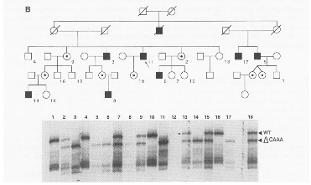
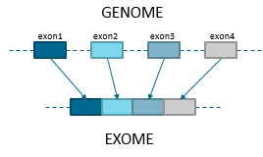
Otogenetic screening
1995, POU3F4 first deafness gene (de Kok et al.)
2005, Targeted gene sequencing
  Phenotype based
2015, Exome sequencing
  Genotype based
2024, Genome sequencing
  Current deafness panel 265 genes
  The Netherlands: ~600 exomes/year
WES-HEARING-IMPAIRMENT-(INCLUDING-GJB2)-DG-3-8-1.pdf (radboudumc.nl)

Slide 4
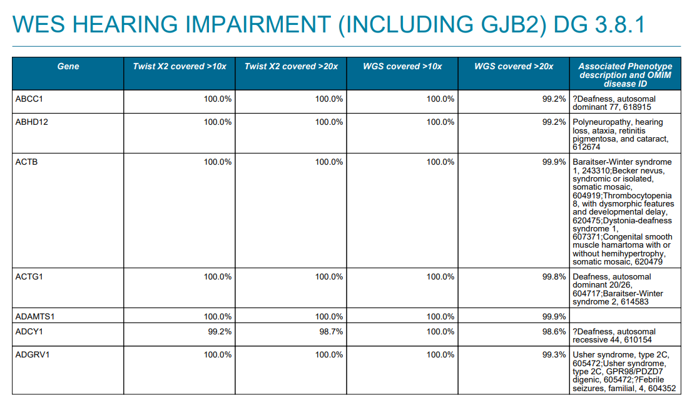
Exome Hearing Impairment Gene Panel
Several updates each year
Kids & adults can be tested
Fully reimbursed in the NL – ENT’s can order
Nonsyndromic & syndromic HI – counseling!
The Netherlands: ~600 exomes/year
265 hearing impairment genes
WES-HEARING-IMPAIRMENT-(INCLUDING-GJB2)-DG-3-8-1.pdf (radboudumc.nl)
Notes:
Wordt een paar maal per jaar bijgewerkt met de nieuwste genetische informatie
Bevat genen die niet-syndromaal gehoorverlies veroorzaken, maar ook syndromale vormen (bijv Usher syndroom, etc)
Kan worden aangevraagd door iedere specialist, met klinisch geneticus in cc
https://www.radboudumc.nl/Informatievoorverwijzers/Genoomdiagnostiek/en/Pages/Hearingimpairment.aspx

Slide 5
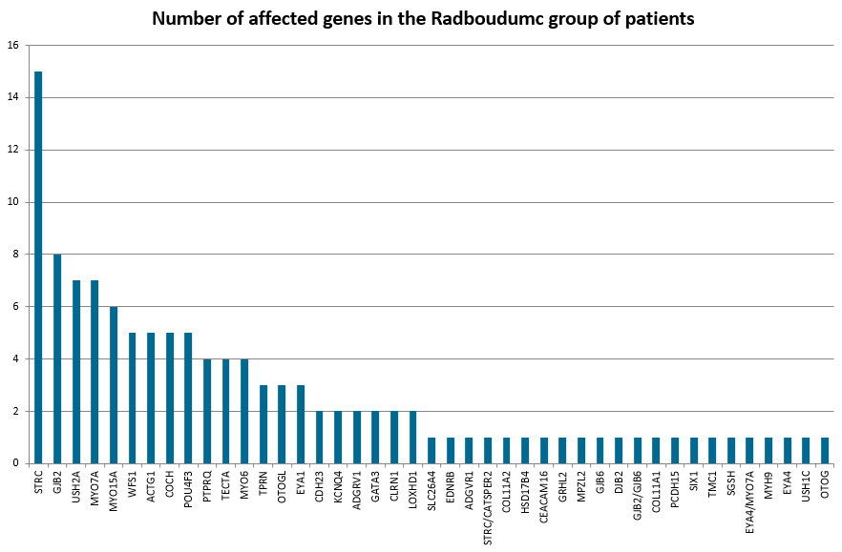
Results Exome Deafness Panel
Single gene sequencing: 16%
Exome sequencing: ±35%
Zazo Seco et al. Eur J Hum Genet 2017;25:308-314.
Notes:
Yield for congenital SNHL: 50-60%
After 50: limited yield;

Slide 6
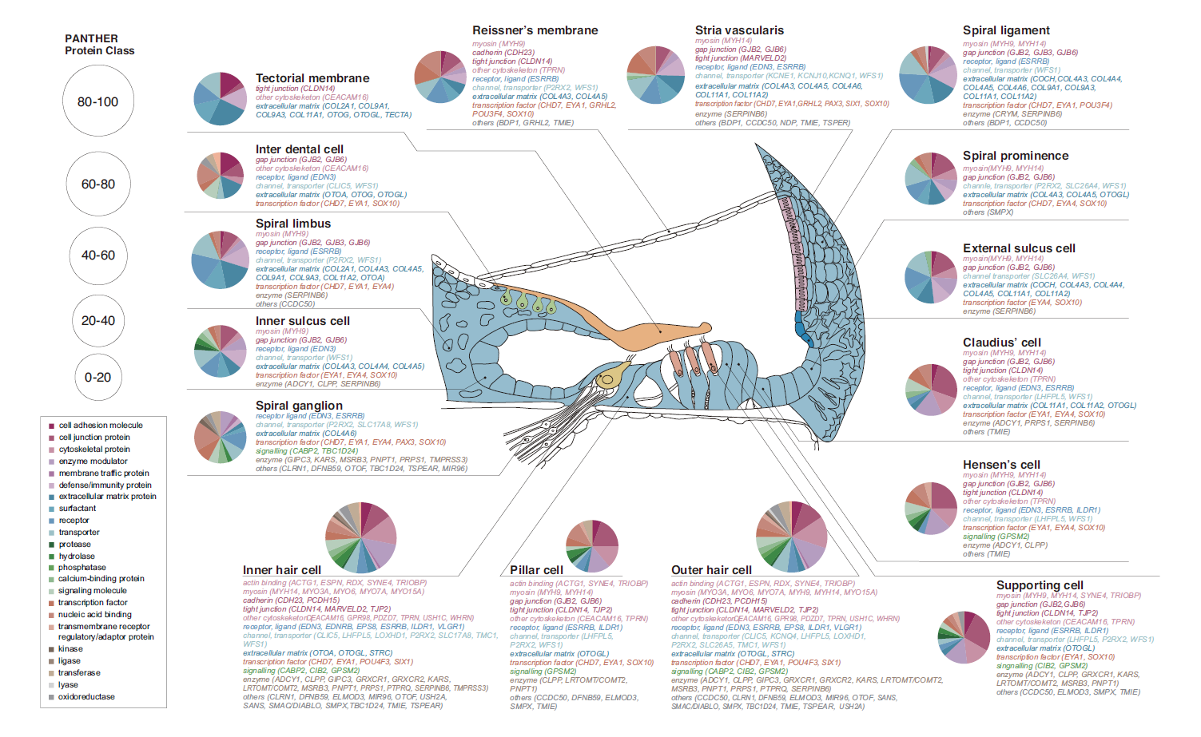
Site-of-lesion & CI performance
‘Etiological diagnosis of deafness including genetic testing is the single largest predictor of postoperative speech outcomes in adult cochlear implant recipients.’
Shearer et al. Hear Res 2017;348:138-142.
Nishio et al. Ann Otol Rhinol Laryngol 2015;124 Suppl 1:6S-48S
Notes:
Population: 155 adults with post-lingual deafness who received CIs at the University of Iowa.
Neural-Genetic Group → Pathogenic variants in SGN-related genes (e.g., OPA1, DFNB59, DIAPH3).
Sensory-Genetic Group → Mutations affecting the organ of Corti or synapse.
Genetics explained 18.3% of variance in CI outcomes (largest single predictor).
• CI users with SGN-related mutations performed significantly worse than those with sensory-related mutations.
• Post-implant performance was better in cases where the sensory partition was affected rather than SGNs.
• Results align with physiological studies showing that SGN health influences CI success (e.g., intraoperative electrocochleography studies).

Slide 7
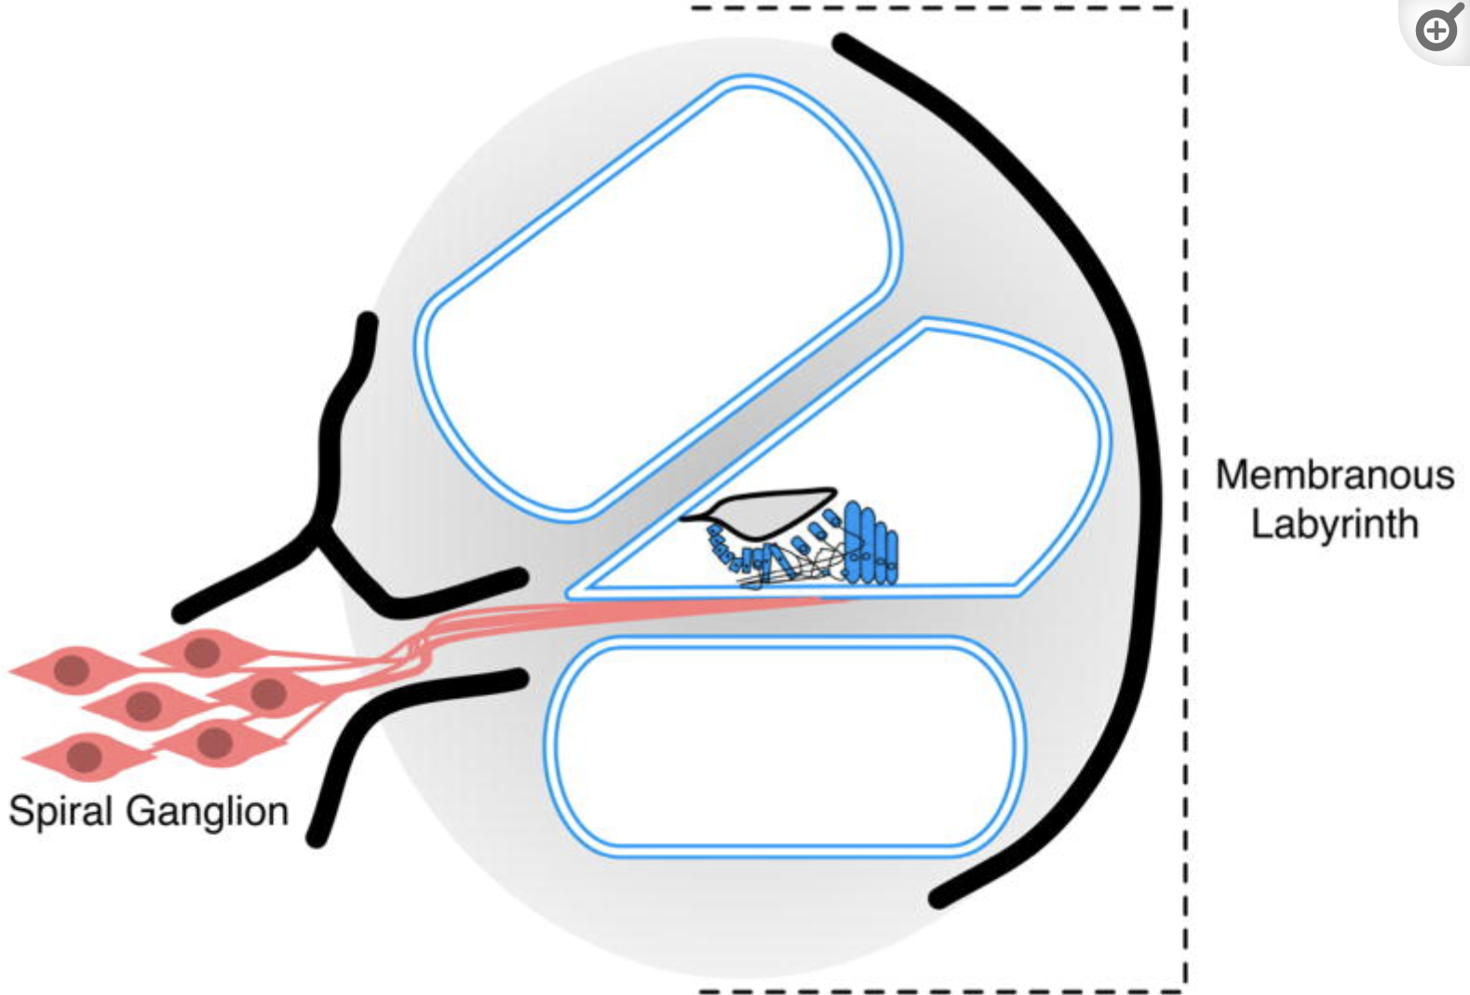
CI performance in genotyped patients
Literature: in general, good CI performance, though outcomes vary depending on the cochlear site of lesion:
  Eppsteiner et al. – spiral ganglion hypothesis (TMPRSS3)
  Tropitzsch et al. – confirmation of Eppsteiner
  Carlson et al. – contradictory results
Eppsteiner et al. Prediction of cochlear implant performance by genetic mutation: the spiral ganglion hypothesis. Hear Res 2012 Oct;292(1-2):51-8.
Tropitzsch et al. Variability in Cochlear Implantation Outcomes in a Large German Cohort With a Genetic Etiology of Hearing Loss. Ear Hear. 2023
Carlson et al. Association of Genetic Diagnoses for Childhood-Onset Hearing Loss With Cochlear Implant Outcomes. JAMA Otolaryngol Head Neck Surg. 2023;149(3):212-22
Notes:
Population: 155 adults with post-lingual deafness who received CIs at the University of Iowa.
Neural-Genetic Group → Pathogenic variants in SGN-related genes (e.g., OPA1, DFNB59, DIAPH3).
Sensory-Genetic Group → Mutations affecting the organ of Corti or synapse.
Genetics explained 18.3% of variance in CI outcomes (largest single predictor).
• CI users with SGN-related mutations performed significantly worse than those with sensory-related mutations.
• Post-implant performance was better in cases where the sensory partition was affected rather than SGNs.
• Results align with physiological studies showing that SGN health influences CI success (e.g., intraoperative electrocochleography studies).
Tropitzsch A, Schade-Mann T, Gamerdinger P, Dofek S, Schulte B, Schulze M, et al. Variability in Cochlear Implantation Outcomes in a Large German Cohort With a Genetic Etiology of Hearing Loss. Ear Hear. 2023: aud-44-1464.pdf (nih.gov)
Carlson RJ, Walsh T, Mandell JB, Aburayyan A, Lee MK, Gulsuner S, et al. Association of Genetic Diagnoses for Childhood-Onset Hearing Loss With Cochlear Implant Outcomes. JAMA Otolaryngol Head Neck Surg. 2023;149(3):212-22. Association of Genetic Diagnoses for Childhood-Onset Hearing Loss With Cochlear Implant Outcomes - PMC (nih.gov)

Slide 8
CI-GEN study
Retrospective observational cohort study
Cochlear implantees between 2002-2021 (n = 2,566 subjects)
DNA diagnostics: <2014 targeted (single gene) sequencing >2014 exome sequencing
CI Performance in cohort with a genetic diagnosis (n = 327 subjects 12.7%)
One year follow-up and no syndromic HL with cognitive dysfunction

Slide 9
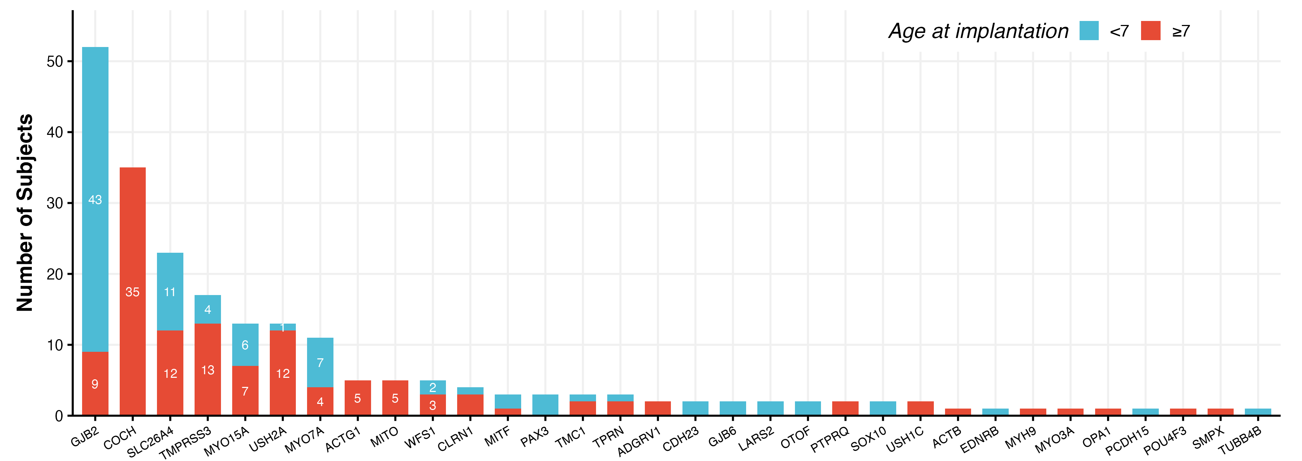
CI-GEN study cohort
N= 217 fully genotyped patients; 299 implanted ears

Slide 10
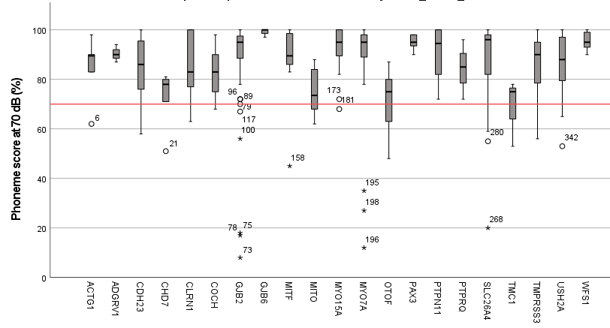
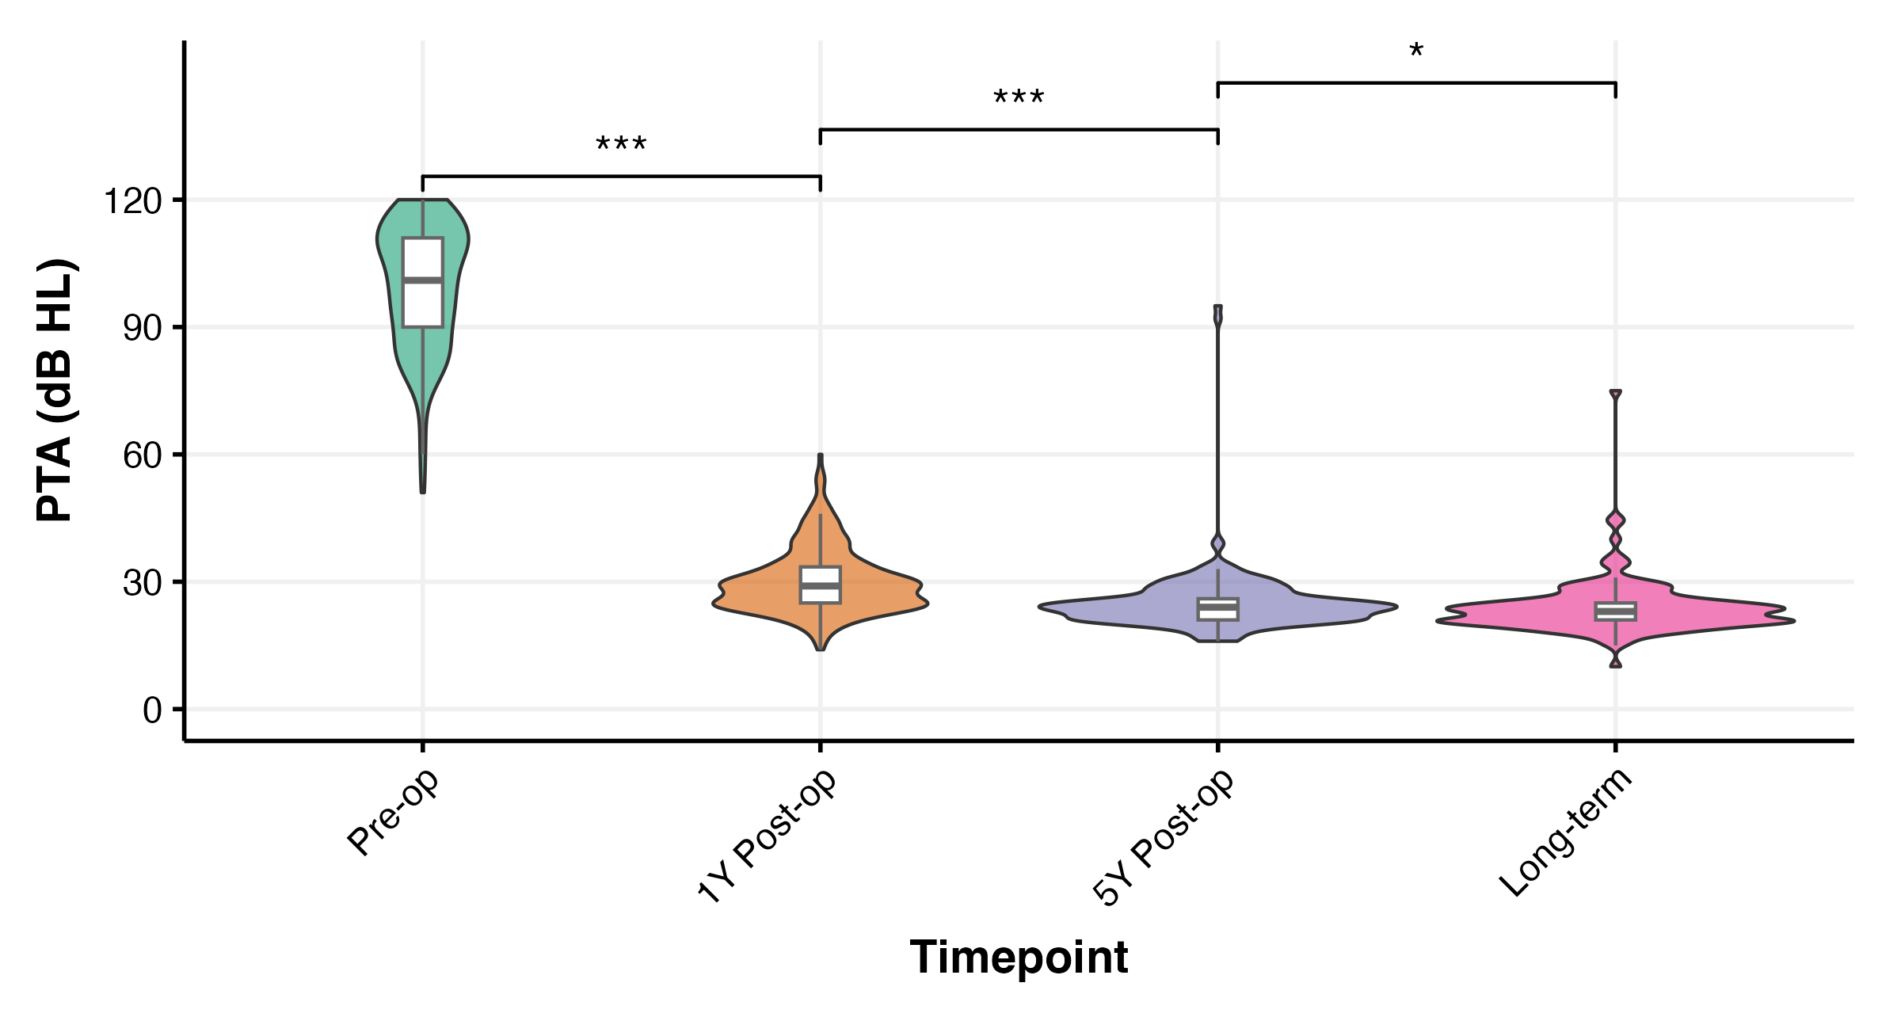
Long-term performance - PTA

Slide 11
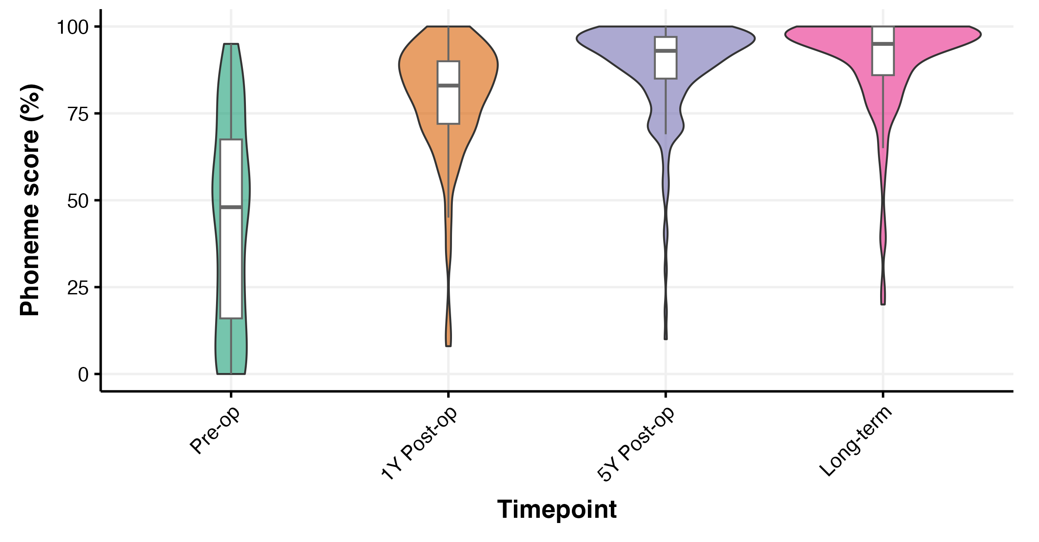
Long-term performance - Speech

Slide 12
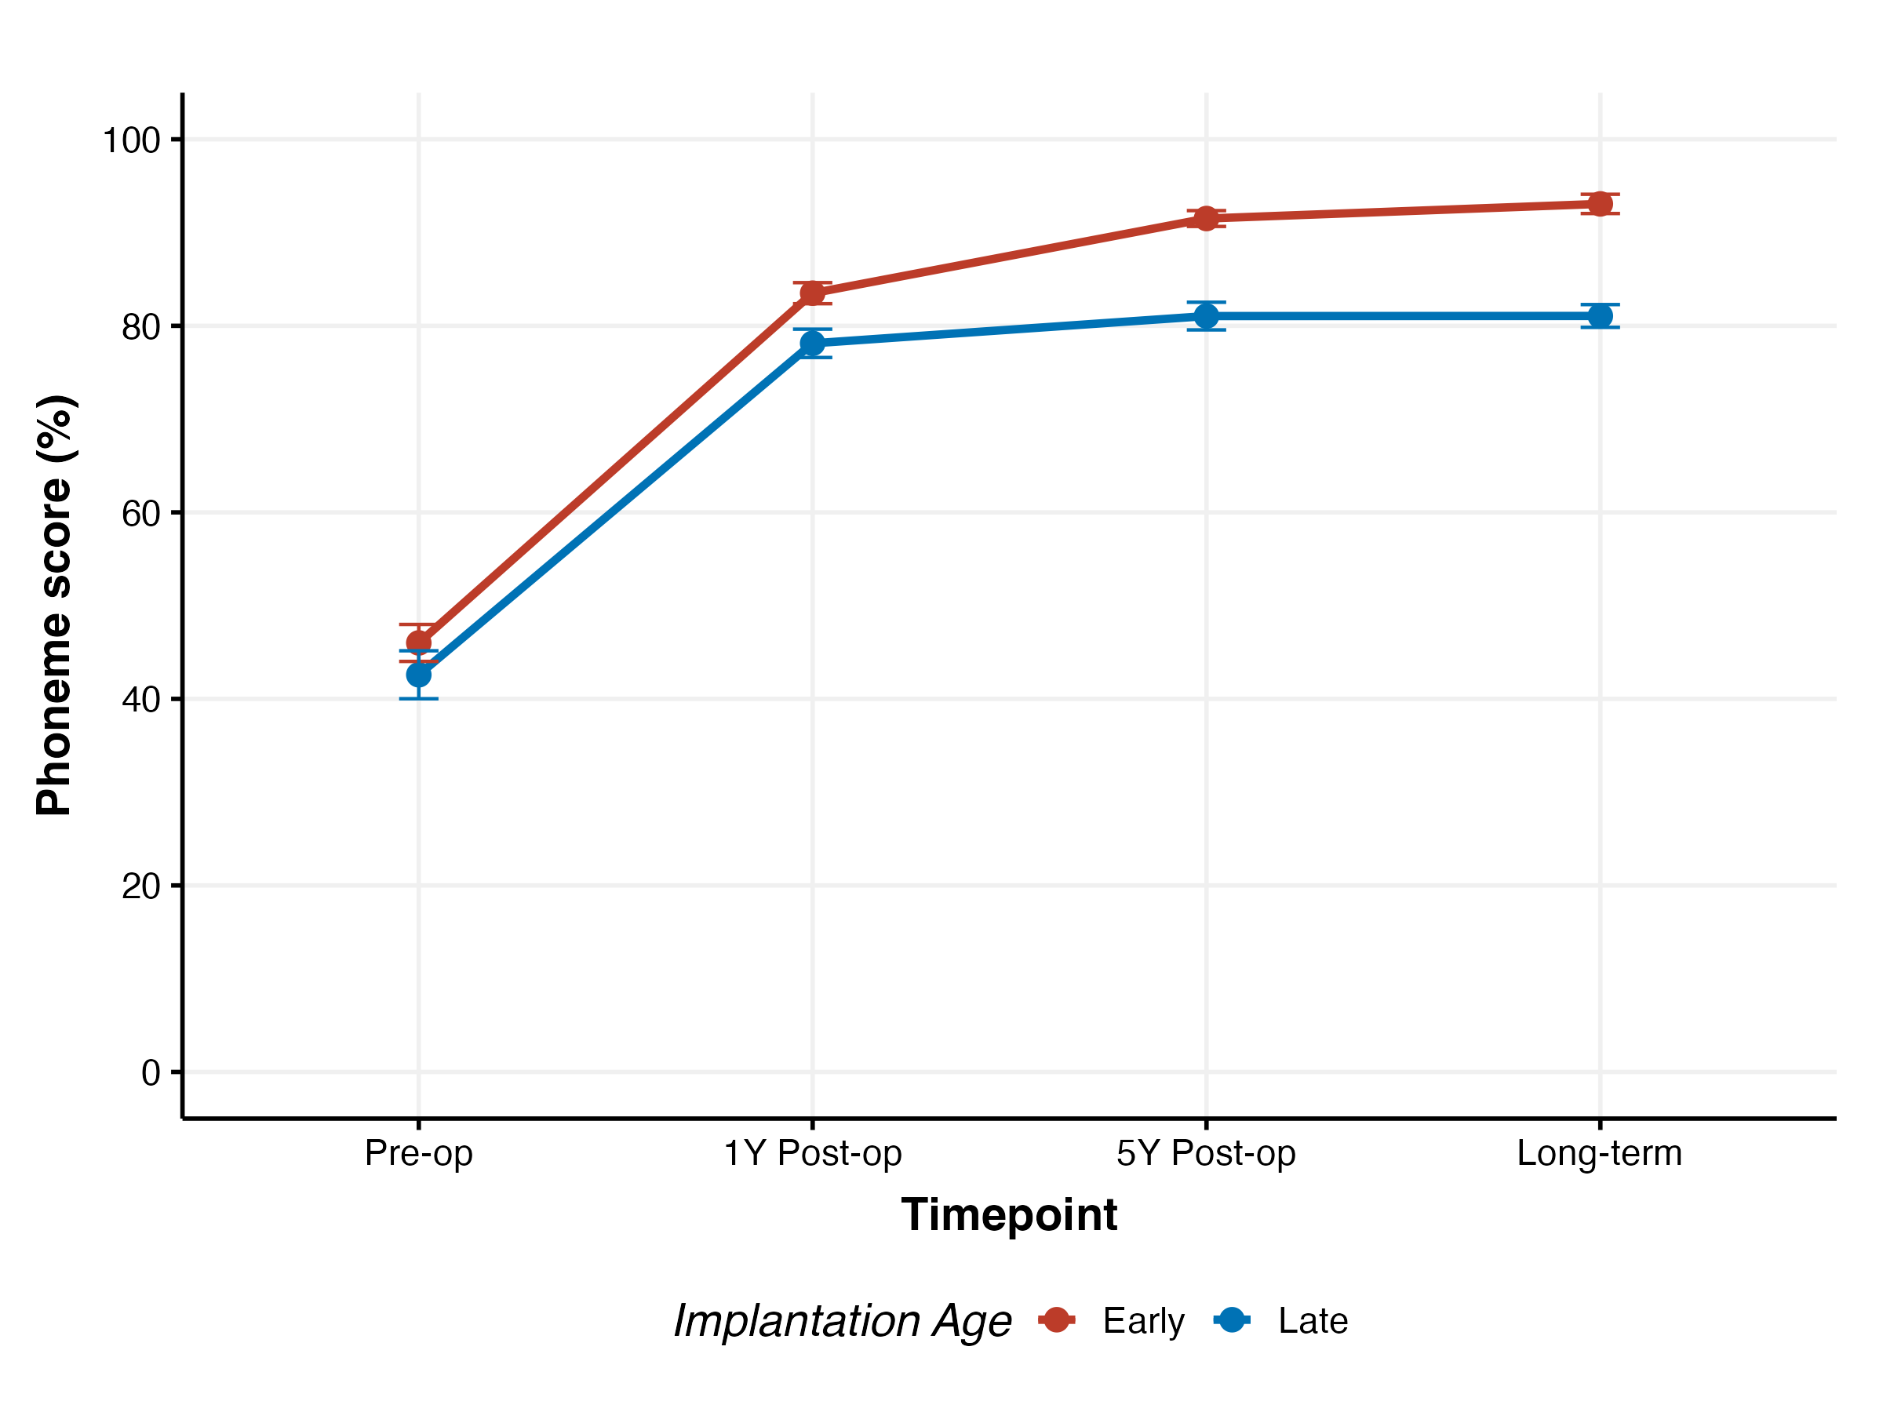
Speech early vs. late implanted
Early implanted: <=7 yrs of age
Late implanted: >7 yrs of age
FU long term:
9.8 yrs (IQR 7.9-12.0)
10.8 yrs (IQR 8.6-13.7)

Slide 13
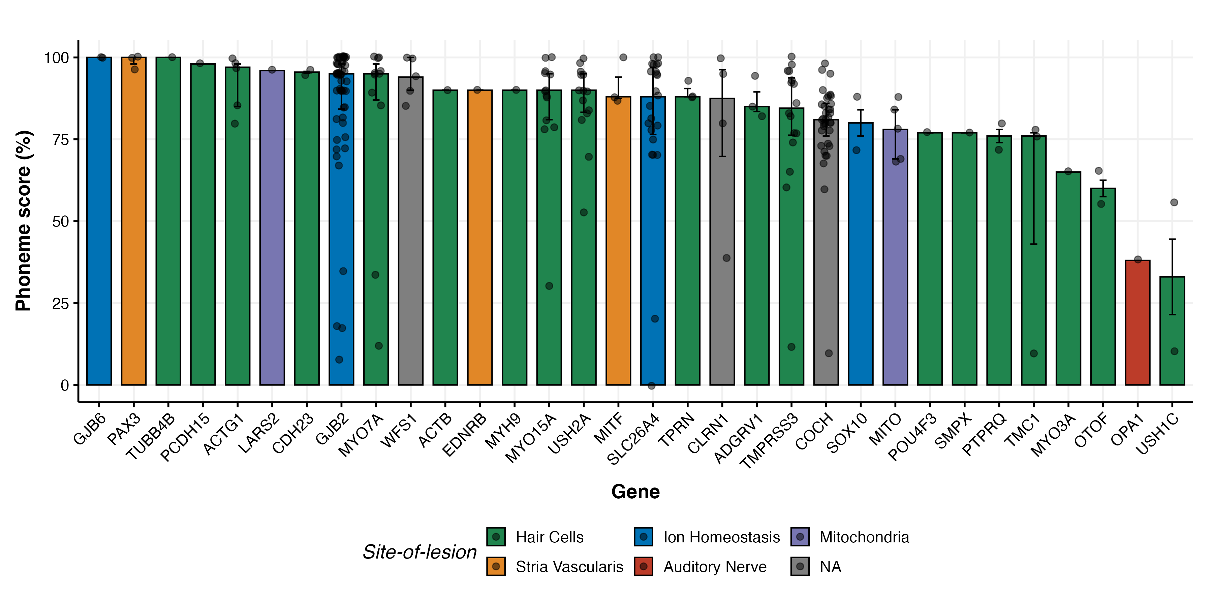
Speech ~ Cochlear site-of-lesion

Slide 14
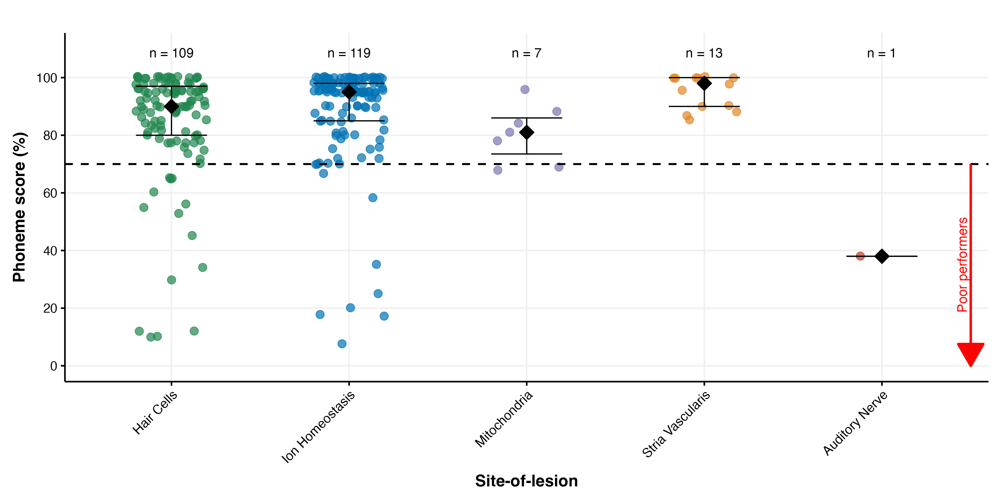
Speech ~ Cochlear site of lesion (grouped)
Last speech audiometry test

Slide 15
Poor Performers | N ears |  | Affected genes (N ears)
Prelingual deafness and implanted during adulthood | 8 | (26.7%) | GJB2 MYO7A TMC1 USH1C | (4) (2) (1) (1)
Struggling to adjust to sound of second sequentially implanted CI | 6 | (20.0%) | GJB2 MYO15A OTOF SLC26A4 USH1C USH2A | (1) (1) (1) (1) (1) (1)
Postlingual HL and CI at older age after prolonged period without sufficient auditory stimulation | 6 | (20.0%) | COCH MtDNA variants MYO3A TMPRSS3 | (2) (2) (1) (1)
Minimal encouragement from home or school for deaf to use the CI | 4 | (13.3%) | GJB2 OTOF SLC26A4 | (1) (2) (1)
Ski-slope HL with residual hearing in lower frequencies post implantation | 2 | (6.7%) | TMPRSS3 | (2)
Device failure | 2 | (6.7%) | COCH SLC26A4 | (1) (1)
AN hypoplasia or auditory neuropathy | 2 | (6.7%) | CLRN1 OPA1 | (1) (1)

Slide 16
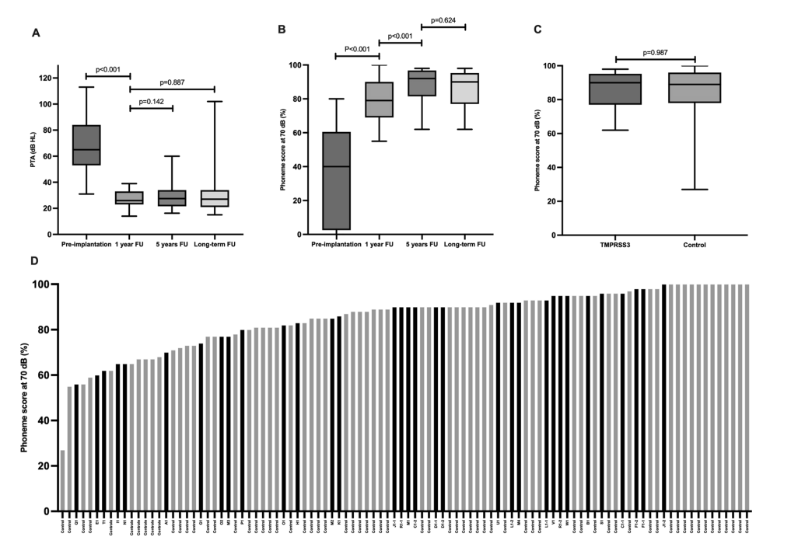
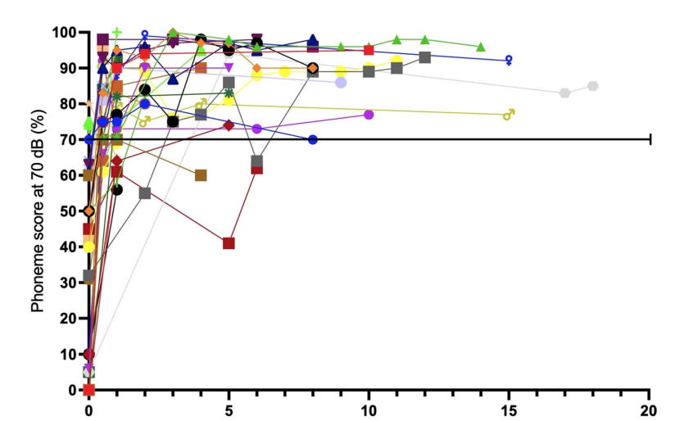
CI in TMPRSS3-associated HL
Hair cell expression and not spiral ganglion neuron expression!
Long-term FU in 27 subjects, 33 ears
Fehrmann MLA et al. Stable long-term outcomes after cochlear implantation in subjects with TMPRSS3 associated hearing loss: a retrospective multicentre study. J Otolaryngol Head Neck Surg. 2023 Dec 15;52(1):82.
Notes:
13: Tucker B, Chen Y-S, Shin T, Cabrera E, Booth K, Nelson R. Insights into the pathobiology of tmprss3-related hearing loss and implications for cochlear implant patients with TMPRSS3 Mutations. 2021.
14: Chen YS, Cabrera E, Tucker BJ, Shin TJ, Moawad JV, Totten DJ, et al. TMPRSS3 expression is limited in spiral ganglion neurons: implication for successful cochlear implantation. J Med Genet. 2022;59:1219–26.
26: Nishio SY, Takumi Y, Usami SI. Laser-capture micro dissection combined with next-generation sequencing analysis of cell type-specifc deafness gene expression in the mouse cochlea. Hear Res. 2017;348:87–97

Slide 17
Conclusions
CI in genetic hearing loss: excellent long-term results in most subjects, especially in early-implanted cases: important for counselling
Genetic defects in TMPRSS3 are not associated with inferior CI performance in short- and long-term (hair cell expression)
The spiral ganglion (or postsynaptic) hypothesis remains open for discussion and should be further studied in multicenter studies because it is rare or very rare (e.g., OPA1)
CI outcomes vary a lot and can be partly explained by subject-specific factors, such as duration of deafness and age at implantation
Notes:
Alternative:
Conclusion
• Gene expression classifications into pre-synaptic, post-synaptic, and mitochondrial groups are not absolute and have uncertainties.
• CI outcomes were not correlated with cochlear site-of-lesion, meaning genetic factors played a limited role in predicting performance.
• The spiral ganglion hypothesis was not confirmed, but some findings (e.g., worse outcomes in OPA1 cases) suggest a need for further research.
• Non-genetic factors (e.g., age at implantation, SNHL duration, CI experience, HA use) were the primary determinants of CI success, explaining 19% of the variance.
• While genetic testing did not significantly explain CI outcome variance, it remains useful for understanding SNHL etiology and prognosis.

Slide 18


Acknowledgements
Mirthe Fehrmann
Hearing & Genes
Ronald Pennings
Froukje Cals
Hannie Kremer
DOOFNL consortium
Marjolein Thijssen
Hearing & Implants
Emmanuel Mylanus
Wendy Huinck

Slide 19
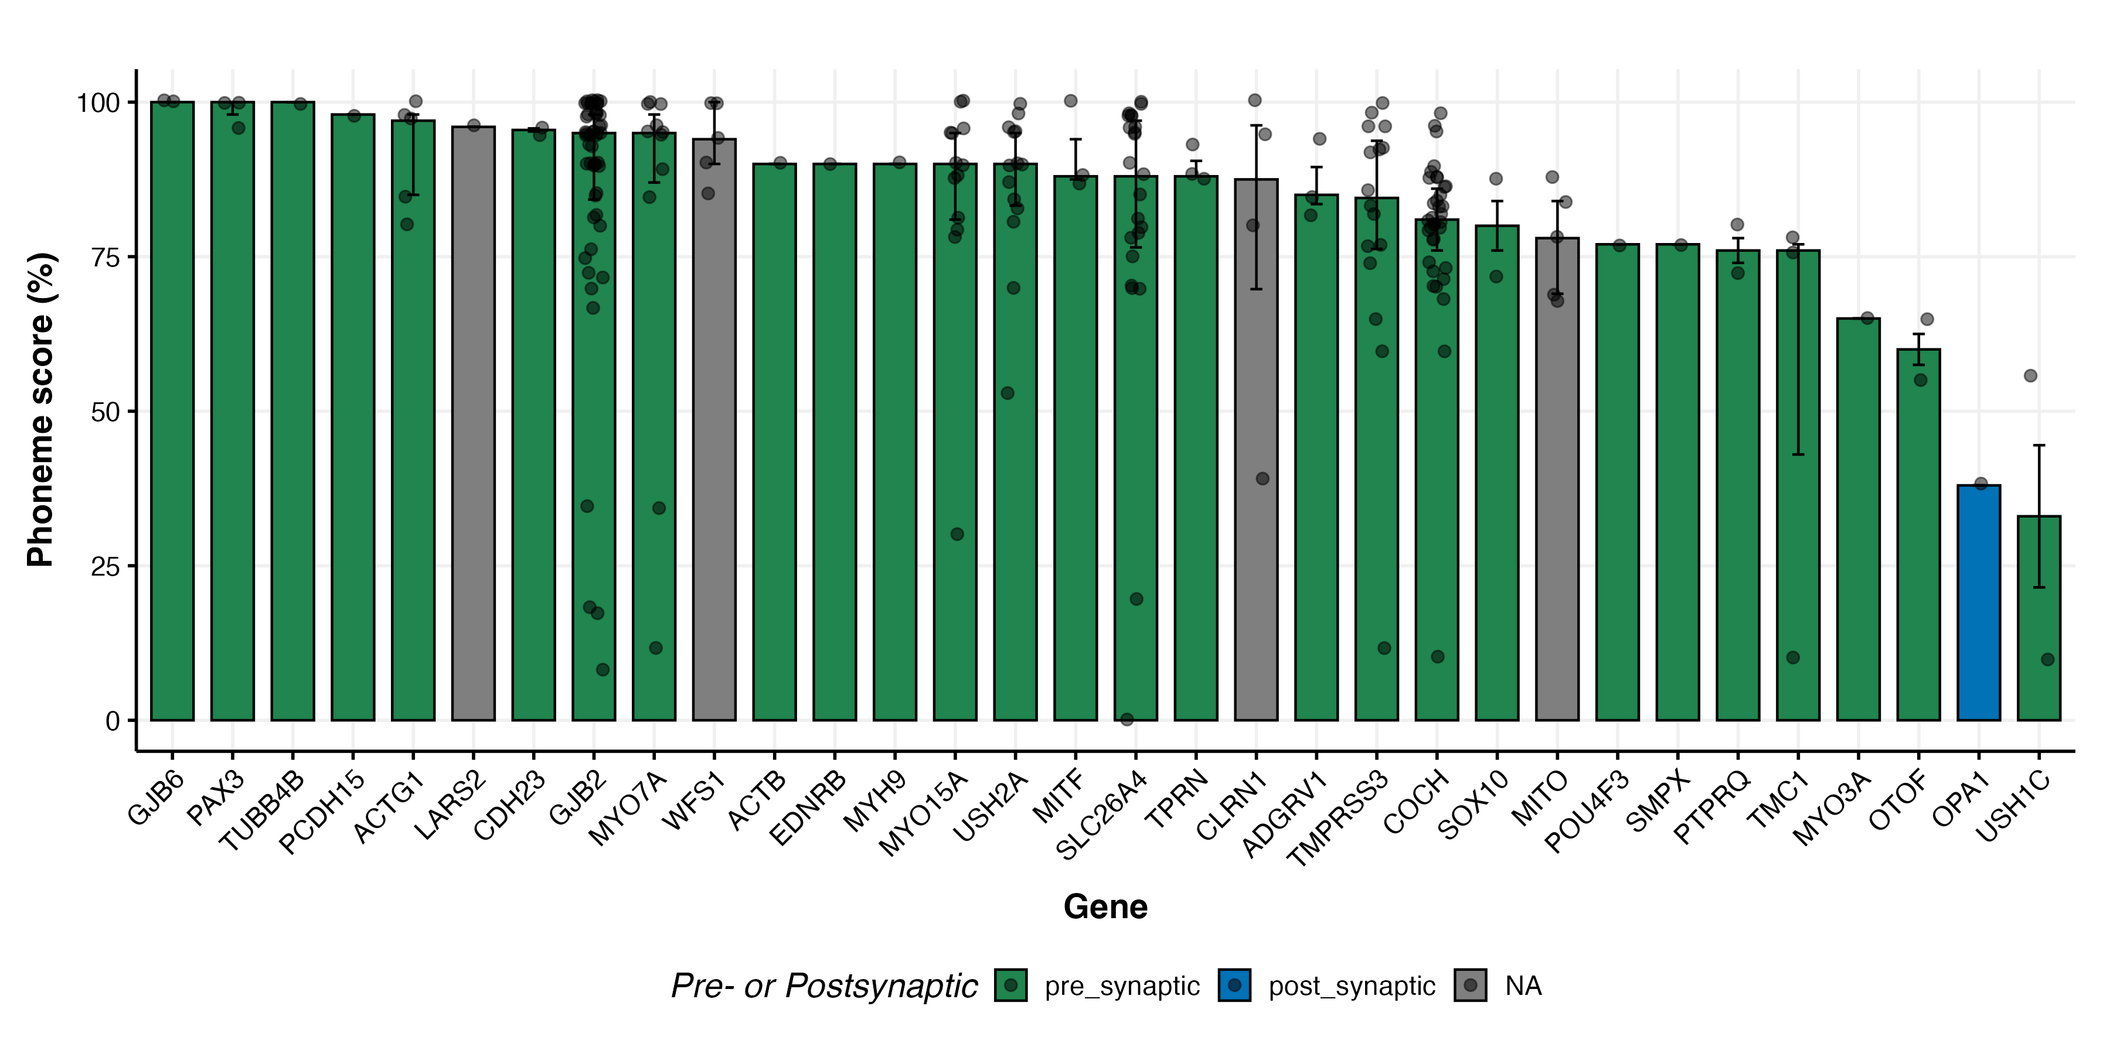
Speech ~ Pre- vs postsynaptic

Slide 20
Discussion
Gene expression classifications into pre-synaptic, post-synaptic, and mitochondrial groups are not absolute and have uncertainties.
CI outcomes were not correlated with cochlear site-of-lesion, meaning genetic factors played a limited role in predicting performance.
The spiral ganglion hypothesis was not confirmed, but some findings (e.g., worse outcomes in OPA1 cases) suggest a need for further research.
Non-genetic factors (e.g., age at implantation, SNHL duration, CI experience, HA use) were the primary determinants of CI success, explaining 19% of the variance.
While genetic testing did not significantly explain CI outcome variance, it remains useful for understanding SNHL etiology and prognosis.

